Slide 1

STAFFROOM BRIEFING
The use of VPNs to
bypass Age Verification

Slide 2
What is a ‘VPN’
A VPN, or Virtual Private Network, is a service that hides your online activity and your location.
VPNs stop your internet provider (e.g. BT, Sky, Virgin Media or TalkTalk) from seeing what you do online and make it look like you’re in a different city or country.
They can be a useful tool for security and privacy purposes, for example if you’re connecting to less secure networks like public Wi-Fi.

Slide 3




The Issue
The recent implementation of the Online Safety Act has led to a significant increase in the amount of VPN App downloads, with a spike of 1,800%. These Apps are now some of the most downloaded in the Apple App Store.
While VPNs are often used by adults to enhance online security, they can also be used by children and young people to bypass safety controls, set by parents or school internet restrictions.
Free or untrustworthy VPNs can pose major security threats, as they may contain malware or sell sensitive data.
This exposes children and young people to inappropriate or harmful content that would otherwise be blocked.

Slide 4








Popular VPN Services
Nord VPN
Proton VPN
Free VPN by Free VPN .org
Free VPN: Unlimited VPN Proxy
Opera: AI browser with VPN
VPN Lumos: Open Proxy, Connect
Thunder VPN
Pawxy – Fast VPN & Web Browser

Slide 5


Reality vs Fearmongering
It's important to remember that not all VPN use is malicious. A young person might use a VPN for a legitimate reason, such as protecting their privacy on a public Wi-Fi network.
However, the risks associated with VPNs, especially untrustworthy or free services, are very real. These risks include exposure to dangerous online content, security vulnerabilities, and a false sense of anonymity.
© Ineqe Group Ltd 2025
Notes:
The aim is not to instil fear but to provide staff with the knowledge to identify potential risks and address them through education and communication.

Slide 6


Responding Effectively
Foster a Culture of Openness and Trust
Encourage students to speak up
Remind students they can talk to a trusted adult - like a teacher, a school counsellor, or the safeguarding lead about any online concerns, including their use of a VPN.
Discuss online privacy in lessons
Integrate discussions about online privacy and the real limits of anonymity into specific online safety lessons. Use this as an opportunity to help students understand the difference between healthy digital habits and risky behaviours.

Slide 7


Responding Effectively
Review and Reinforce Online Safety Policies
Update Acceptable Use Policies
Ensure that your school's Acceptable Use Policy clearly outlines the rules regarding the use of VPNs on school networks and school-owned devices.
Promote safe device usage
Provide guidance to pupils on using school devices responsibly and reinforce the importance of not bypassing school network protections.

Slide 8


Responding Effectively
Provide Staff Training
Equip staff to identify risks
Train staff to recognise potential signs that a student may be using a VPN to bypass safety measures.
Know the right response
Ensure all staff members know the correct procedure for handling a disclosure about VPN use or other online safety concerns. This includes knowing when to escalate the issue to the safeguarding lead or other relevant school authorities.

Slide 9
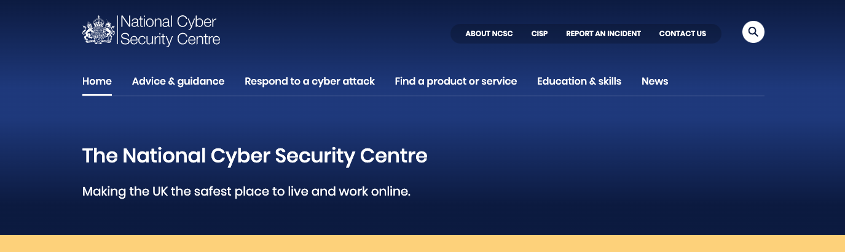
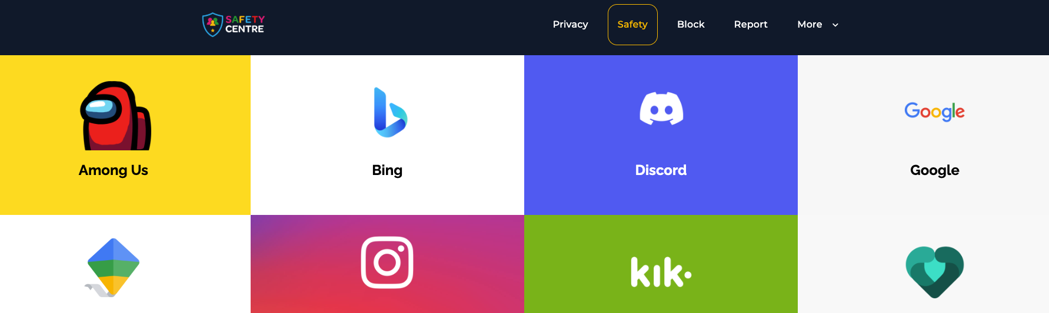
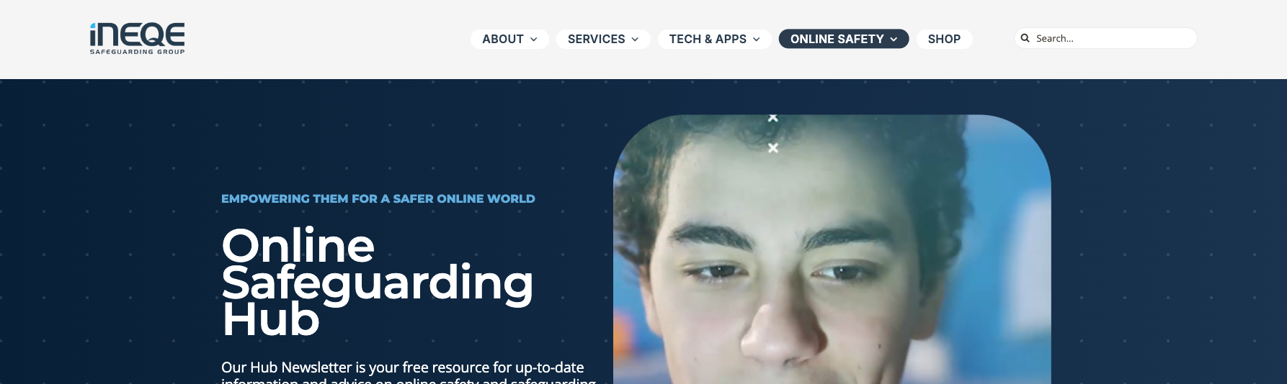



Helpful Resources
National Cyber Security Centre
Our Safety Centre
Online Safeguarding Hub
www.ncsc.gov.uk
oursafetycentre.co.uk
ineqe.com/safeguarding-hub
ACCESS YOUR APP
Any device, any time, everywhere

Slide 10
EDUCATE | EMPOWER | PROTECT

