Slide 1
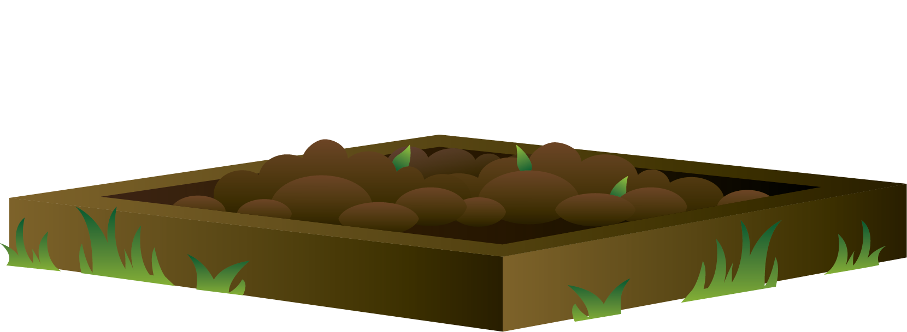
Question 1
Why didn’t Jack and his mum download the first four games they found?
They were too expensive
They were for older children

Slide 2
INCORRECT
Oh no! Jack didn’t download those games because he wasn’t old enough to play them.
Try Again

Slide 3
CORRECT
Well done! The first four games that Jack and his mum found all had 13+ age ratings so Jack’s mum said that he can play them when he is older.
Next Question

Slide 4
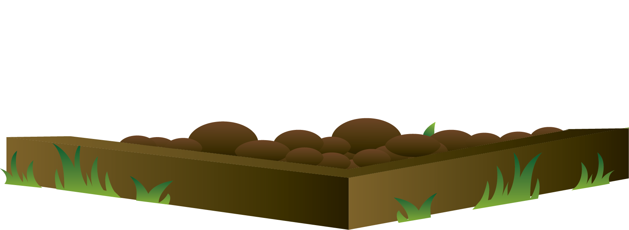
Question 2
What did Jack do in the garden with his mum?
Planted vegetable seeds
Played the Space Pirate game for an hour

Slide 5
INCORRECT
Oh no! Jack was only allowed to play the game for half an hour before taking a break in the garden.
Try Again

Slide 6
CORRECT
Well done! After playing the Space Pirate game for half an hour like he had agreed with his mum, Jack took a break to plant vegetable seeds in the garden.
Next Question

Slide 7
Question 3
What did Jack do when Maddie asked to board the Friend Ship?
He let her straight in without thinking
He made sure that she was someone he knew really well

Slide 8
INCORRECT
Oh no! Jack and Freddie paused to think before letting Maddie on board, rather than accepting straight away.
Try Again

Slide 9
CORRECT
Well done! Jack’s mum had told him that he can only accept requests to board from people he knows really well. This is why he paused to think before letting Maddie in.
Next Question

Slide 10
Question 4
Why did Jack call the Mothership?
A stranger wanted to come on board
He needed directions to planet YouTube Kids

Slide 11
INCORRECT
Oh no! Jack didn’t need directions, he called the Mothership to ask for some different advice.
Try Again

Slide 12
CORRECT
Well done! Jack didn’t know the stranger so did not accept her request to board the Friend Ship. Instead, he called the Mothership to ask his mum for her advice.
Next Question

Slide 13
Question 5
How did Jack know that it was safe to accept Leo’s request to board the Friend Ship?
Leo seemed friendly
He recognised Leo from class

Slide 14
INCORRECT
Oh no! Even if the person looks friendly, you must only accept their friend request if you know them really well.
Try Again

Slide 15
CORRECT
Well done! Well done! Jack knew Leo really well as they sat at the same table in class so he knew that it was safe to let him on board.
Next Question

Slide 16
Question 6
Who is Jack’s trusted adult?
First Officer Freddie
His mum

Slide 17
INCORRECT
Oh no! First Officer Freddie is very wise but isn’t Jack’s trusted adult.
Try Again

Slide 18
CORRECT
Jack’s trusted adult is his mum. He knows that he can rely on her advice when he calls for help.
Well done! Your understanding of online safety has grown alongside this sunflower!

Slide 19
CORRECT
Jack’s trusted adult is his mum. He knows that he can rely on her advice when he calls for help.
Well done! Your understanding of online safety has grown alongside this sunflower!

