Slide 1

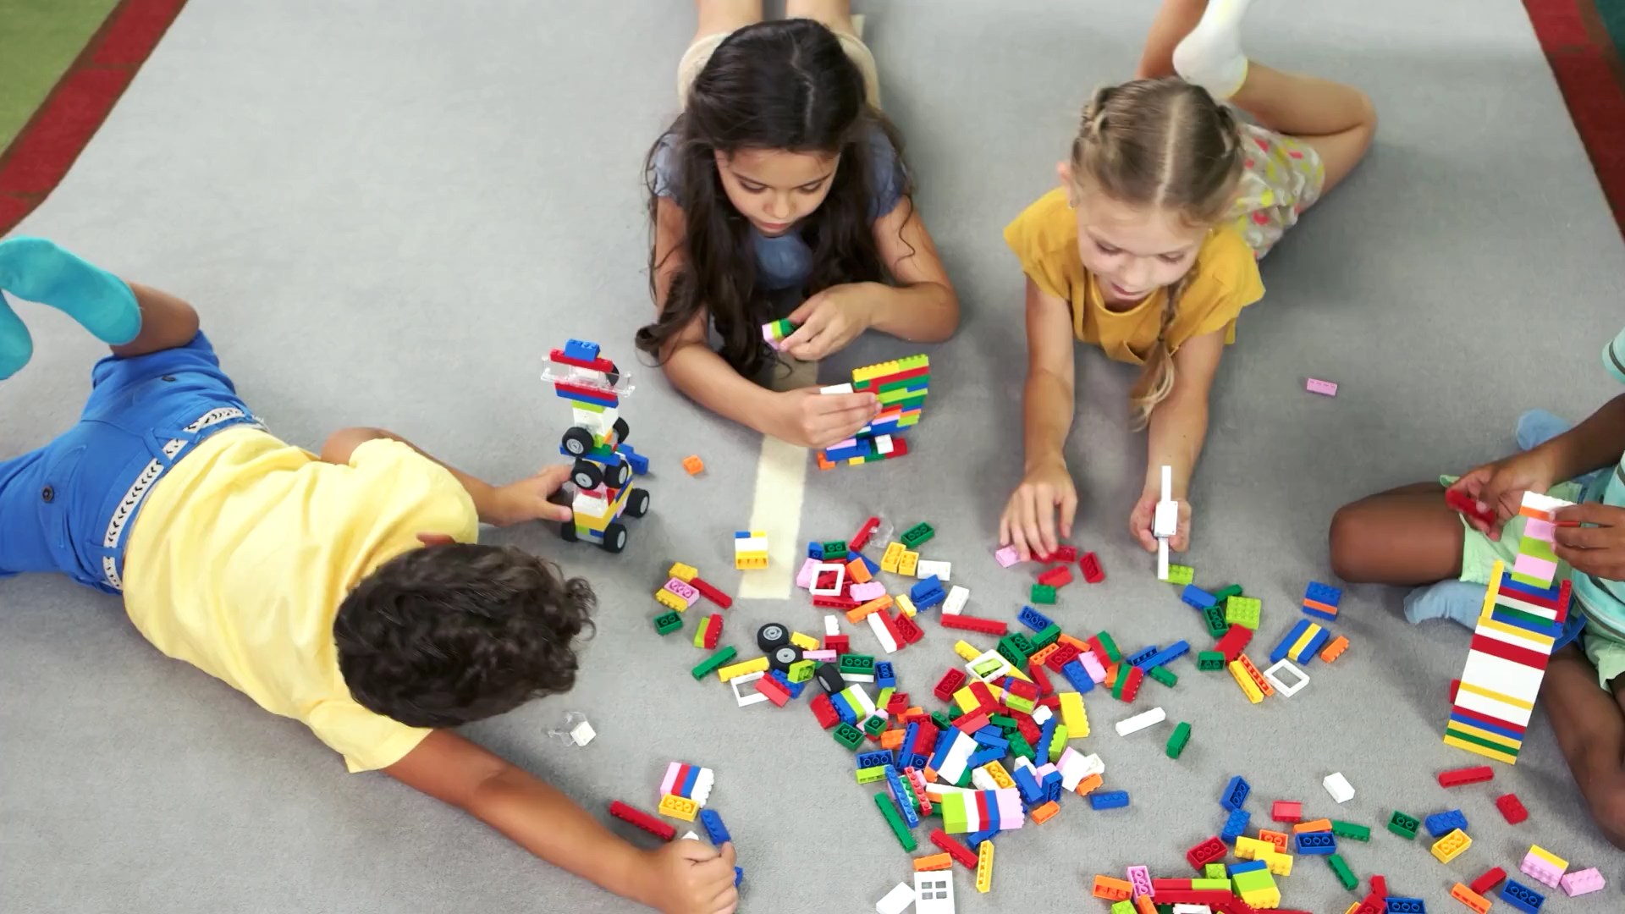



Random Acts of Kindness
Notes:
Use this script in the notes section on EVERY slide to help you get the most out of this PowerPoint – Thanks, The Safer Schools Teachers.

Slide 2


Notes:
Use this as an open question for the class to discuss – Take feedback from your pupils before moving on to the next slide.

Slide 3


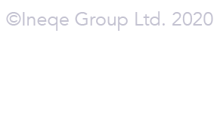
What is kindness?
Kindness is:
Being considerate, loving and helpful towards others
Looking out for others when they are upset or worried
Helping those in need
Doing nice things for others without expecting anything in return
Notes:
Provide examples of each bullet point for your class:
Bullet 1 – Using kind words towards others, complimenting your friends, saying please and thank you, etc.
Bullet 2 – Caring for a friend who has fallen/is upset, inviting someone to play who feels left out, helping someone else with their school work, etc.
Bullet 3 – Giving to charity, cake sales, donations, etc.
Bullet 4 – Helping an adult with a chore – to be kind, rather than for pocket money or to get more time on your PS4, for example.

Slide 4
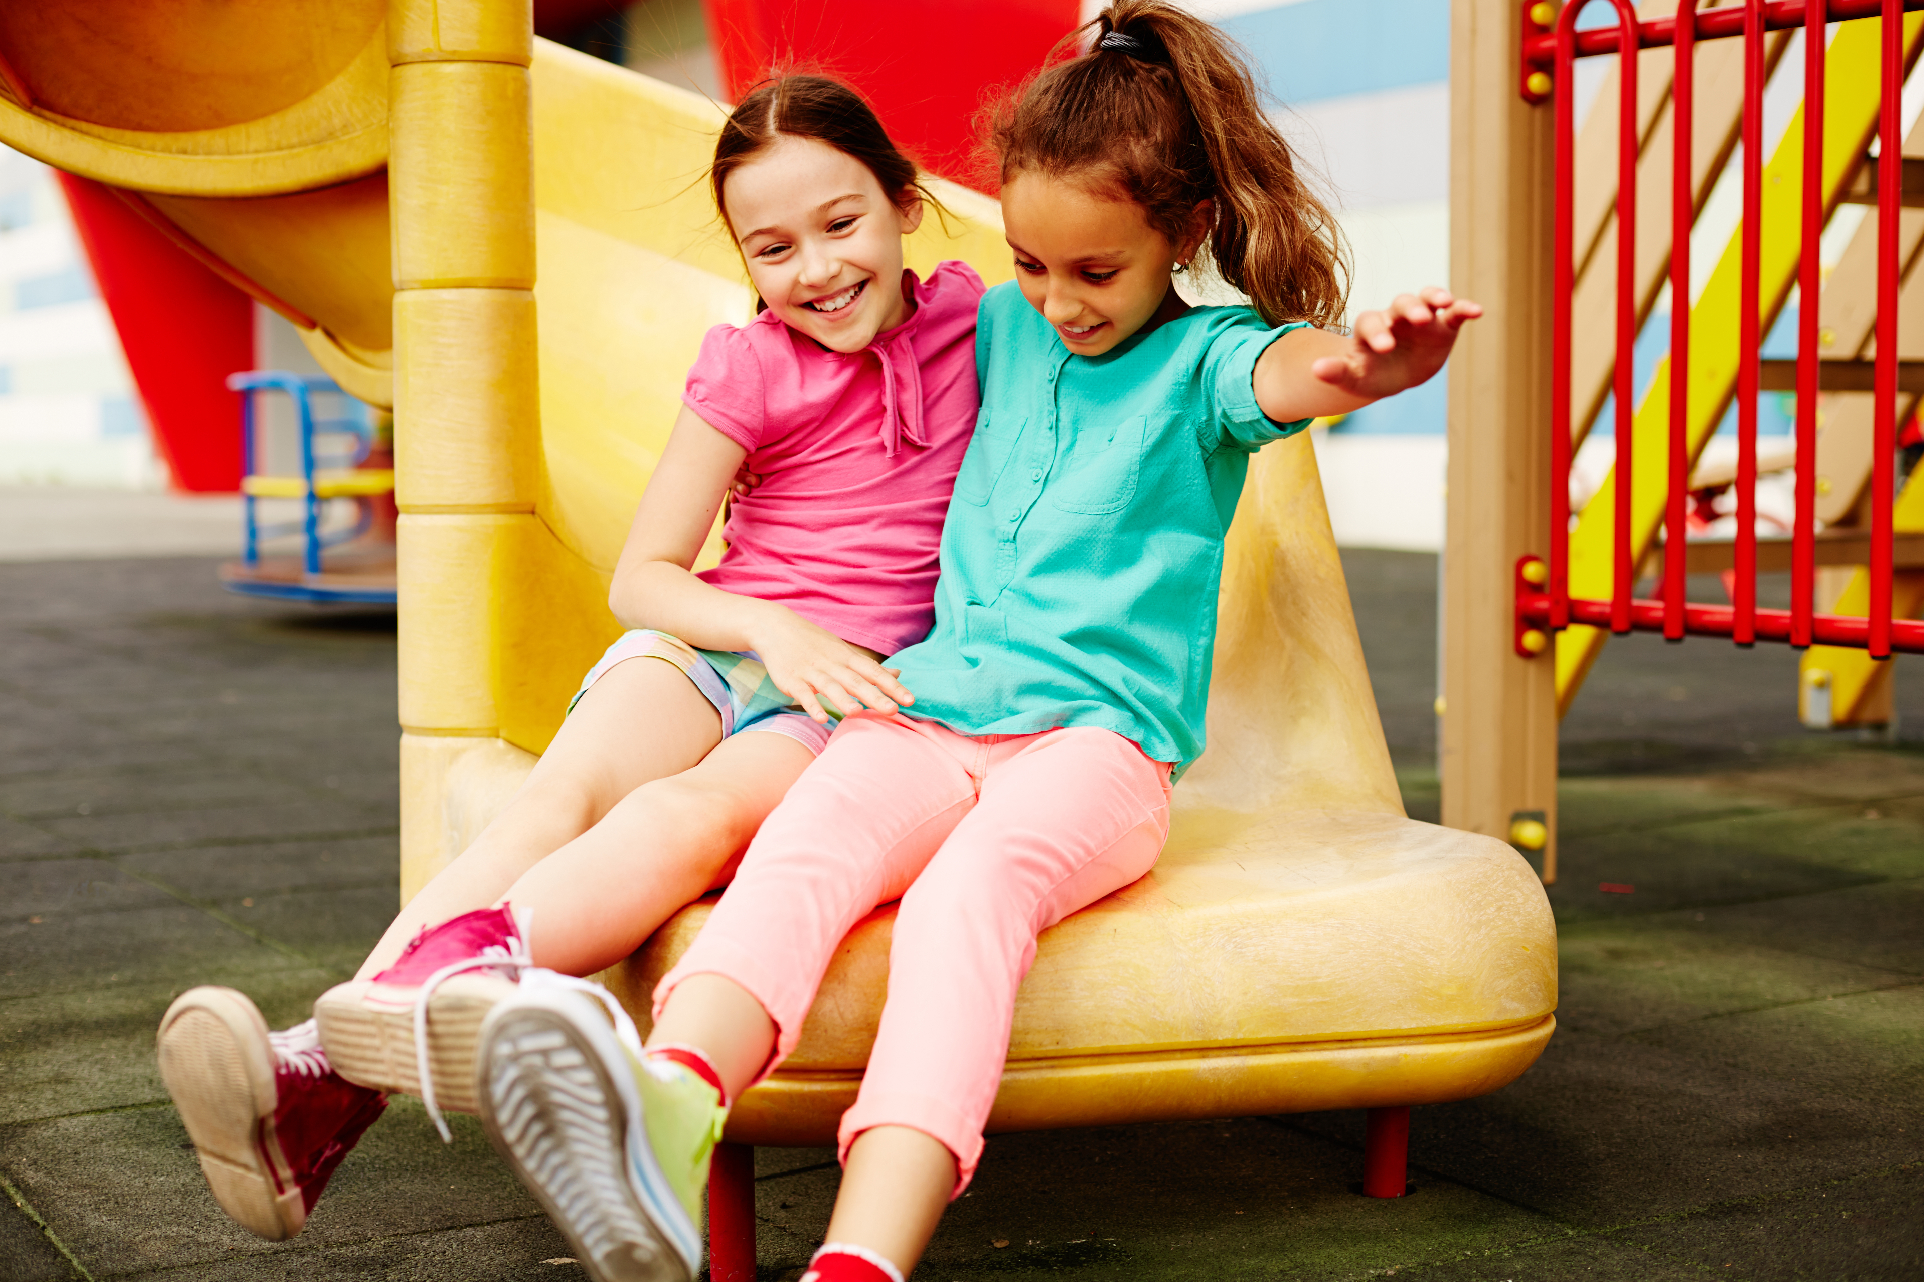



How can you show kindness to others?
Home
School
Community
Notes:
Pair pupils up and allow them to Think, Pair, Share ideas of how they personally can show kindness in each of these contexts.

Slide 5

How are you going to be even more kind this week?
We’ve got some ideas to help you out!
Simply choose a random act of kindness out of the hat!
Notes:
Use the PDF file from the lesson pack which contains 20 Random Acts of Kindness. Cut these up and share them with your class!

Slide 6


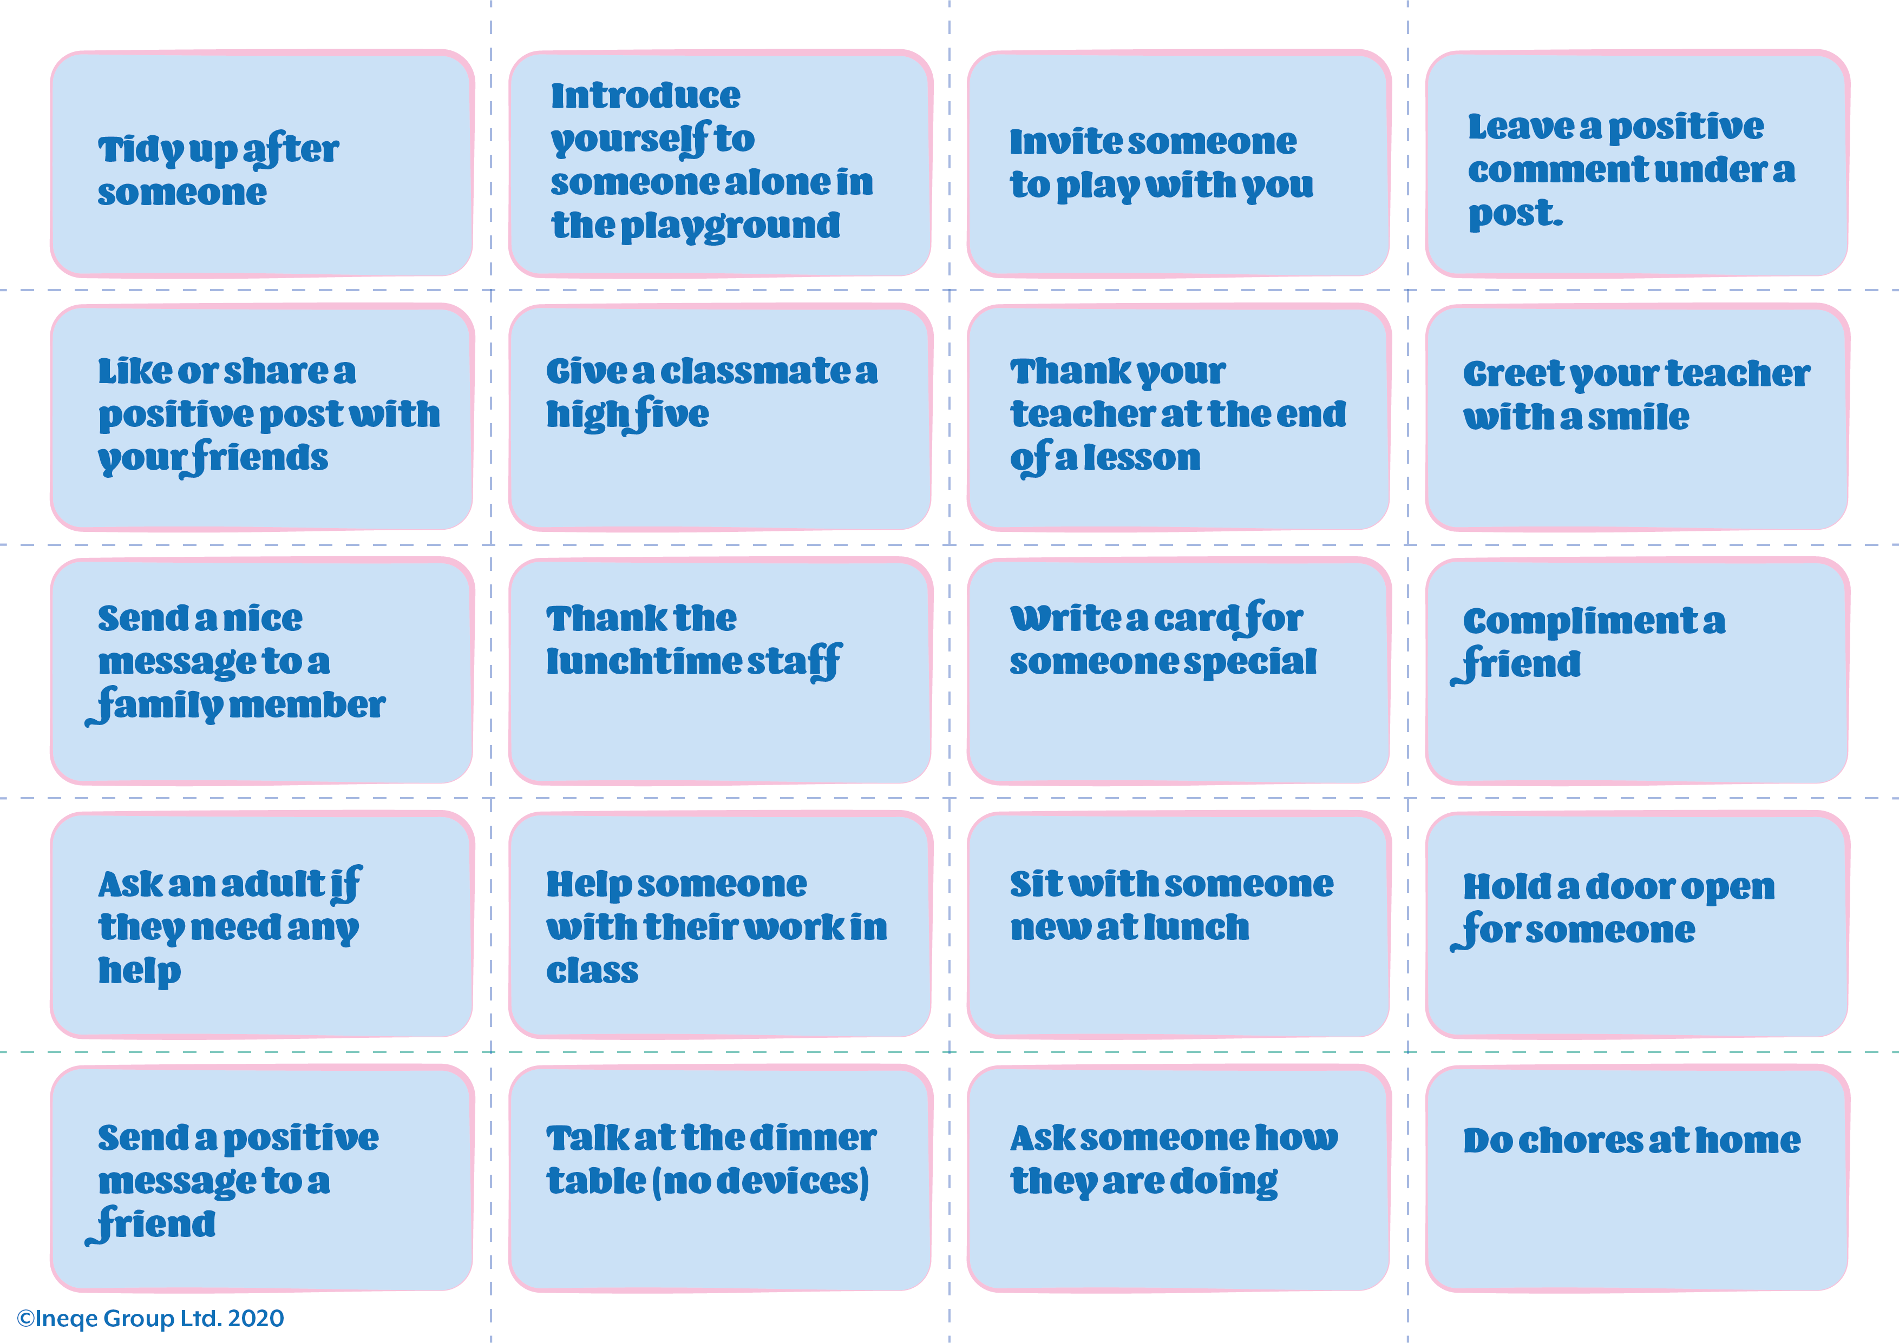
Notes:
Add each random act of kindness into a hat and allow the pupils to choose at random. It may be worthwhile reading over each act with the class and explaining what they mean e.g. “compliment” means saying something nice to someone, or “leave a positive comment under a post” means that you post something nice under someone’s social media post.

Slide 7

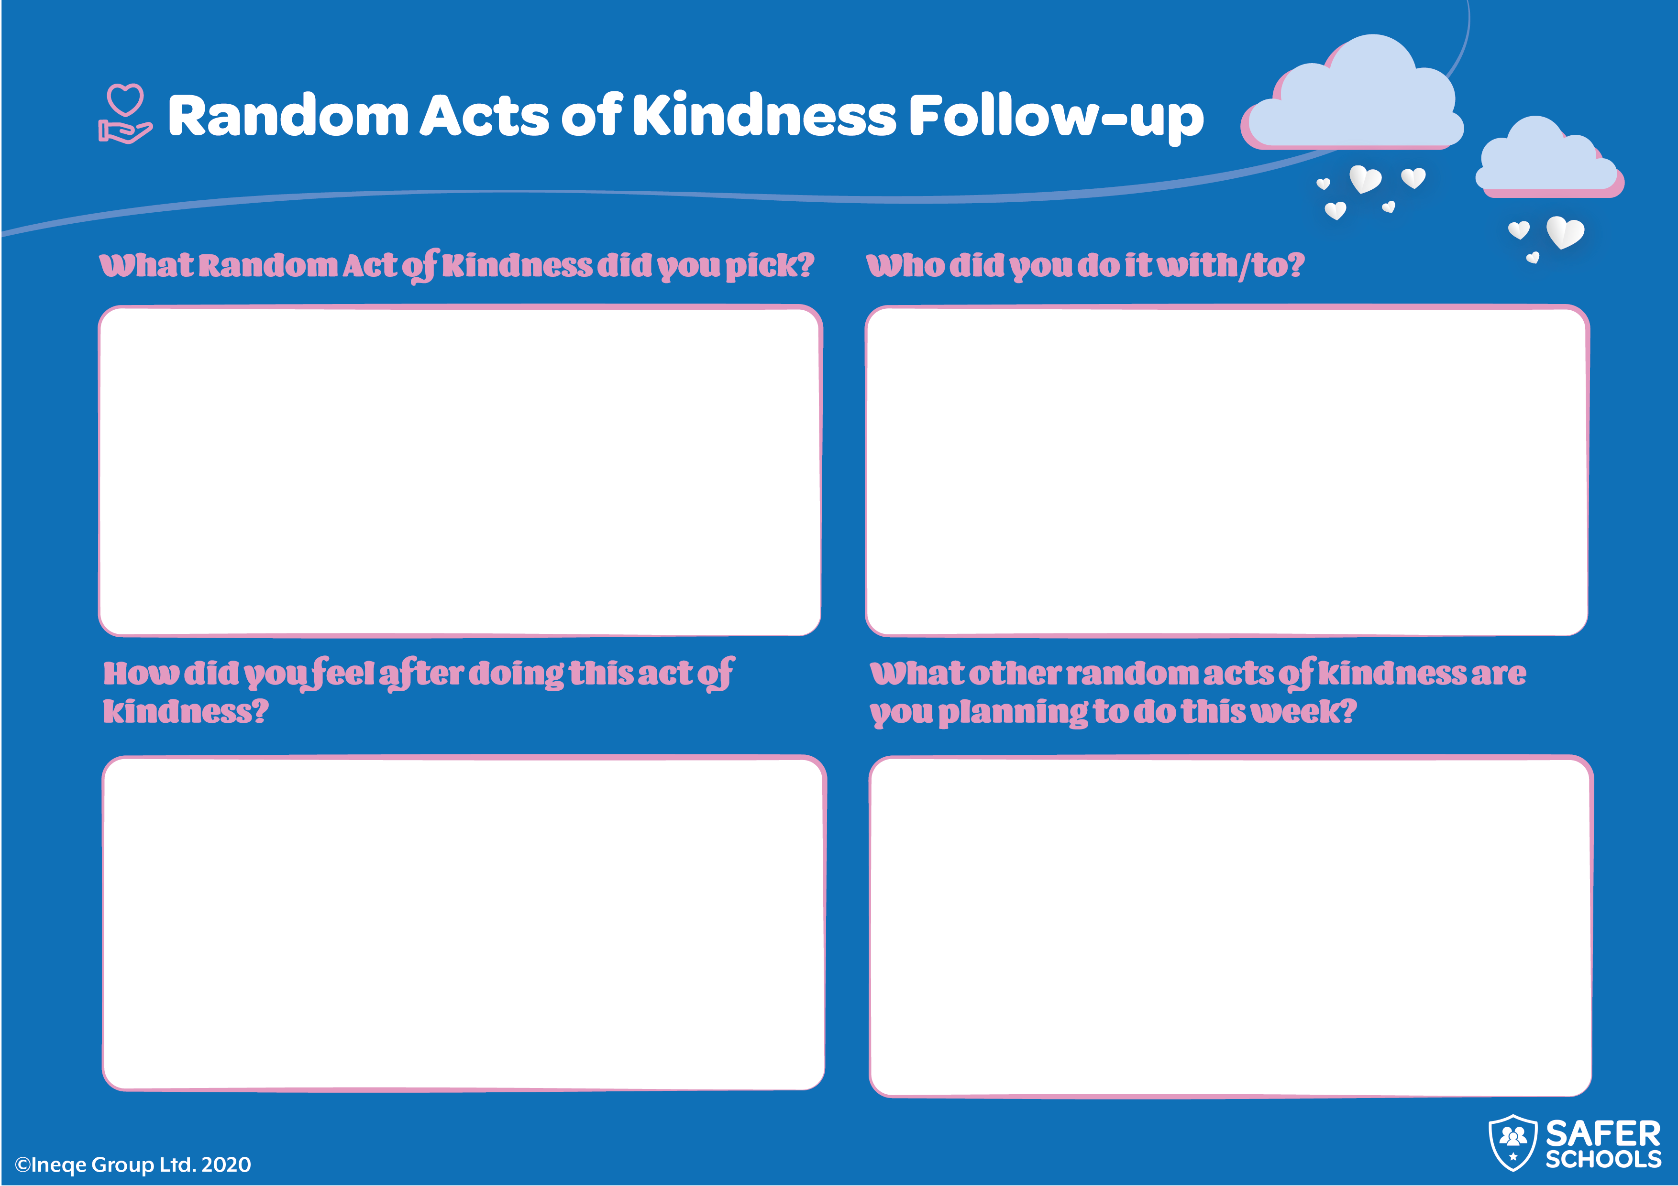
Notes:
This Follow Up task is available as a PDF within the lesson pack. This worksheet allows pupils the chance to reflect on their Random Acts of Kindness.

