Slide 1





Online Bullying
I saw her facebook… she is so fake its embarrassing!
Can’t wait to screenshot…
I posted ”you’re so ugly under her insta” hahaha!

Slide 2

Learning Objectives
To understand what is meant by ‘Online Bullying’
To be able to identify ways in which they can effectively deal with a range of scenarios
To know how to respond to online bullying

Slide 3
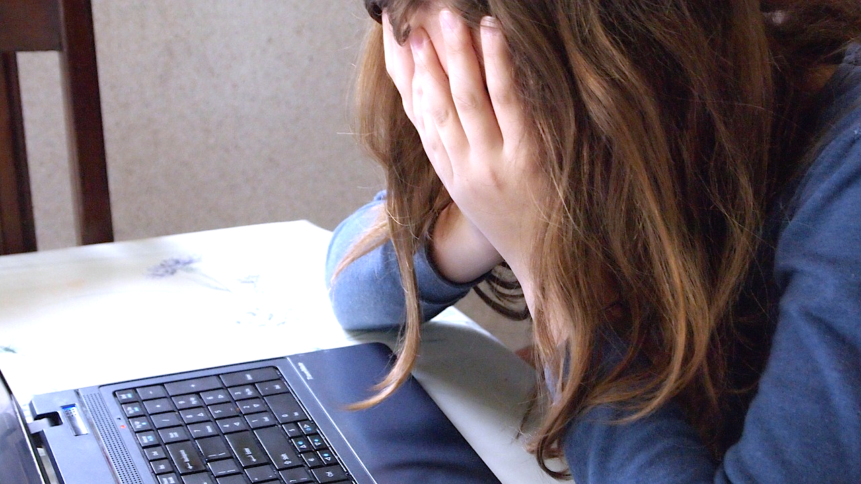

What is ‘Online Bullying’?
‘Online Bullying’ (aka Cyber-Bullying) is bullying that takes place online.
It is using the internet, email, online games or any digital technology to threaten, tease, upset or humiliate someone else.
Can you think of any examples?
Nasty comments via chat apps or under pictures.
People making fun of you online.
Getting nasty messages or calls from anonymous numbers.
Pictures being uploaded without your consent.

Slide 4

Online Bullying Scenarios
We are going to look at some scenarios together.
After each scenario, I want you to discuss what you would do if this was your friend.
Think about what you would say to them, who they could talk to and how they would report it.

Slide 5

Just a little note…
Who you can speak to in school:
Your teachers
Safeguarding Lead in school
Who you can speak to outside of school:
Parents/carers
An adult you trust
Childline 0800 1111
The following scenarios are based on issues young people may face.
Therefore you may find they bring up unwanted memories and emotions.
Please know that this is OK and you can speak to a trusted adult for support.
Notes:
More on ‘Trusted Adults’ in your Safer Schools App

Slide 6


Slide 7


Slide 8


Slide 9
Learning Objectives
To understand what is meant by ‘Online Bullying’
To be able to identify ways in which they can effectively deal with a range of scenarios
To know how to respond to online bullying

Slide 10

Quick Fire Quiz
What is online bullying?
Is online bullying less 'wrong’ than offline bullying?
Who can someone turn to if they are feeling bullied online?
What are some key things you can do if you are being bullied online?

Slide 11

Extended task:
Complete our school survey on the Safer Schools App on online bullying
Notes:
Add phone and example here.

Slide 12

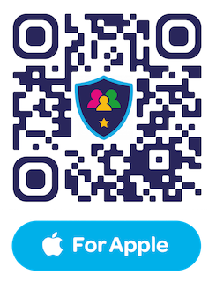
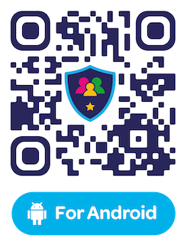
Have you downloaded the Safer Schools App? Scan below!

