Slide 1
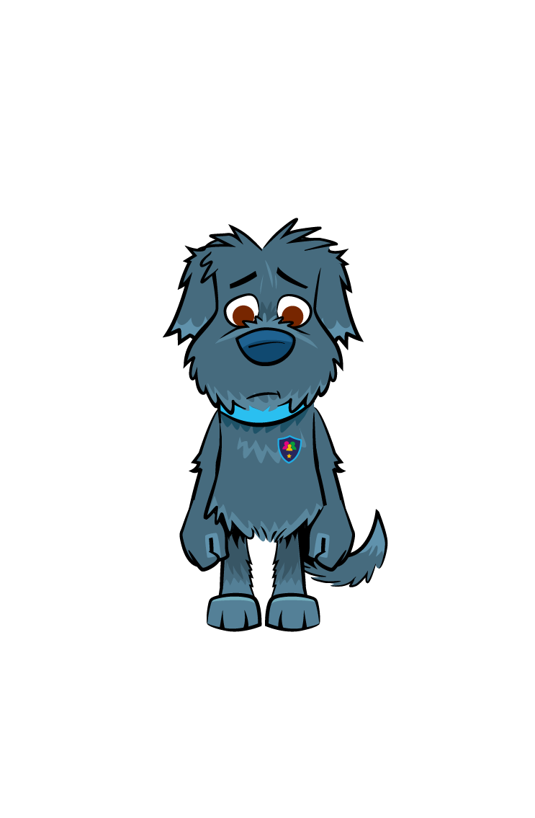




Online Bullying
Freddie is so uncool…
I would not want to be friends with him!

Slide 2
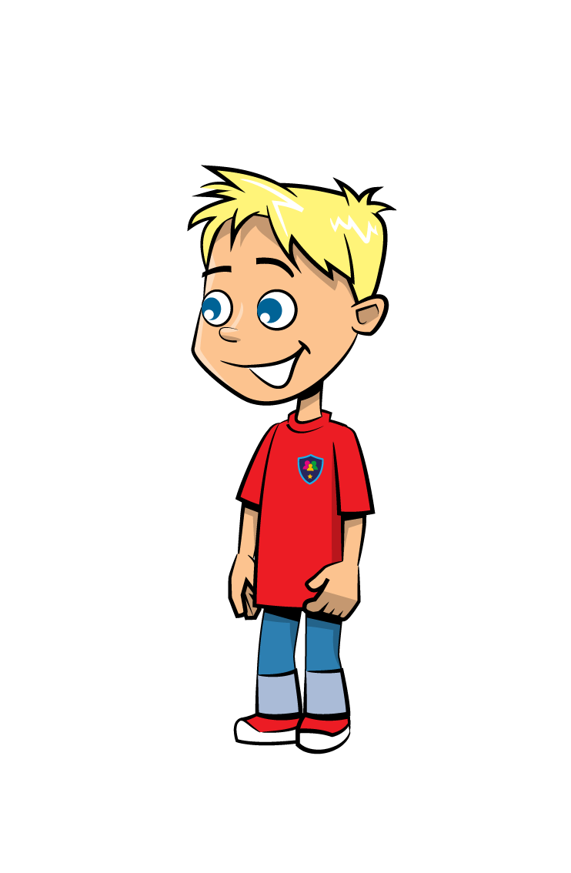



Learning Objectives
Understand what ‘Online Bullying’ is.
Discuss different bullying scenarios & how we might deal with them.
Develop our confidence in how we respond to ‘Online Bullying’.

Slide 3
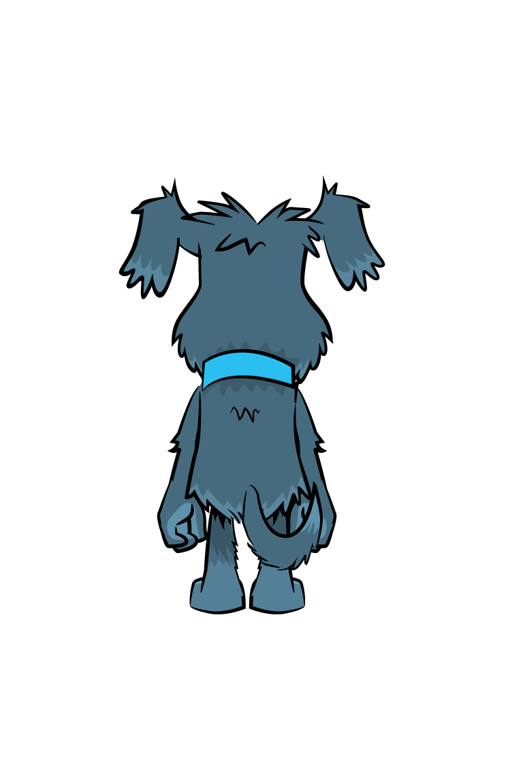
What is ‘Online Bullying’?
It is using the internet, email, online games or any digital technology to threaten, tease, upset or humiliate someone else.
‘Online Bullying’ (aka Cyber-Bullying) is bullying that takes place online.
Can you think of any examples?
Nasty comments via chat apps or under pictures.
People making fun of you online.
Getting nasty messages or calls from anonymous numbers.
Pictures being uploaded without your consent.

Slide 4


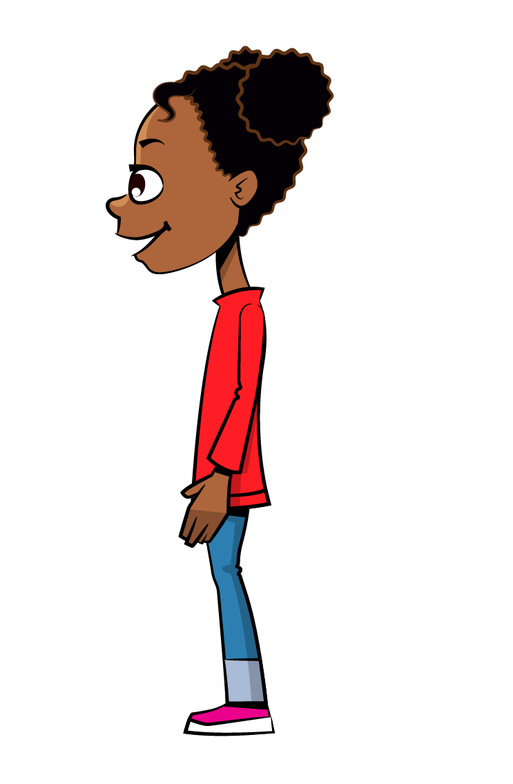

We are now going to look at some scenarios.
In your groups, discuss what you think you should do.

Slide 5

Scenario 1

Slide 6

Scenario 1
Abida is the new girl in her Year 5 class. One day, a group of Year 6 girls take her pencil case and cover it in slime. Abida tells the teacher. When she gets home, she receives constant messages calling her a liar and other nasty names. Abida is upset and thinks about sending a message back.
What would you do if this was your friend?

Slide 7

Scenario 2

Slide 8
Scenario 2
David uploads a tutorial video on how to play Minecraft.
“Hey there. It’s David here. Today I’m going to show you how to find and mine Redstone in Minecraft.”
People begin to leave mean comments below his video. As well as this, the video gets more and more dislikes. He messages his friend Amir asking him if he has seen the comments.
What would you do if this was your friend?

Slide 9
Scenario 3

Slide 10
Scenario 3
Caitlin and Bryn are best friends. They always play duos together on Fortnite. One day when they are playing, Bryn gets really frustrated and says he does not want to play with her anymore. Caitlin is shocked and upset. She never thought her friend would do that. Bryn decides to replace Caitlin with a new duo partner. Caitlin becomes jealous and angry. She creates a meme to make fun of Bryn online. Her post says that Bryn is trash at Fortnite. Her finger hovers over the ‘send’ button.
What would you do if this was your friend?

Slide 11
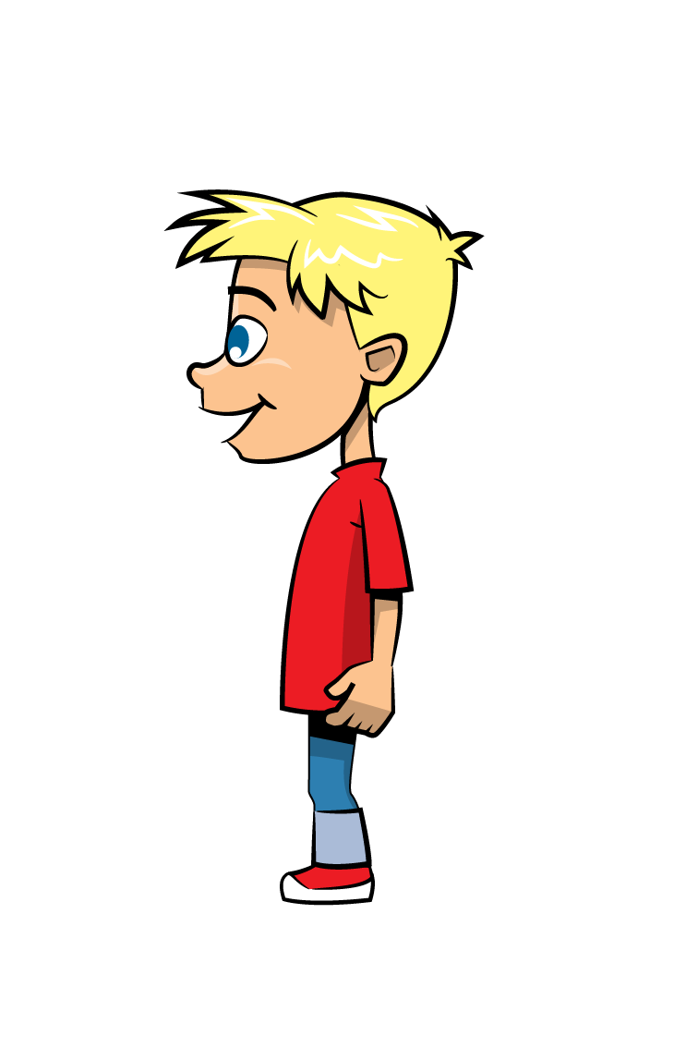
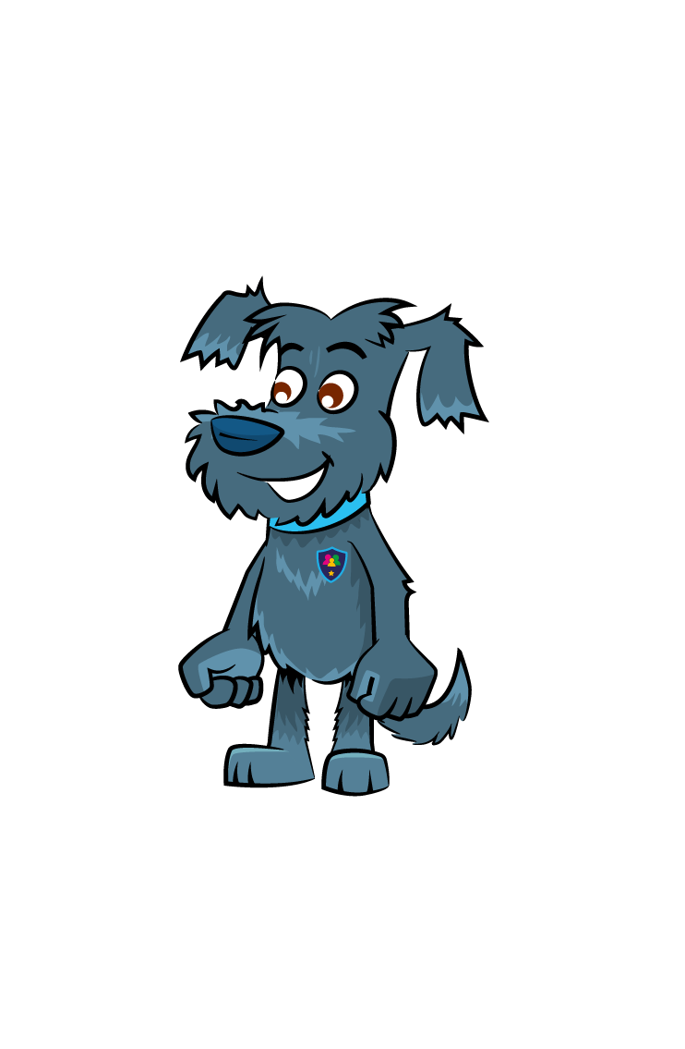
Think, Pair, Share
What is online bullying?
Can you think of any other examples of online bullying?
What advice would you give your friend if they were being bullied online?

Slide 12
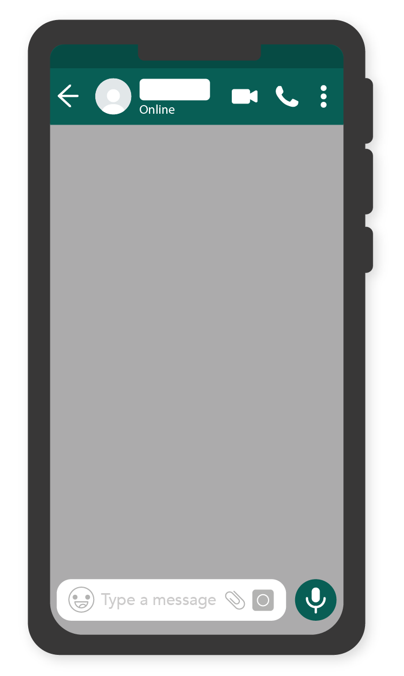
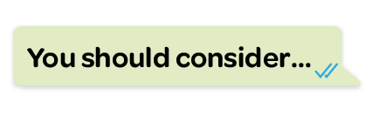
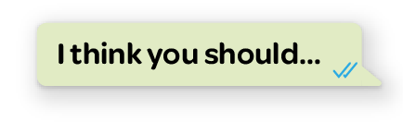
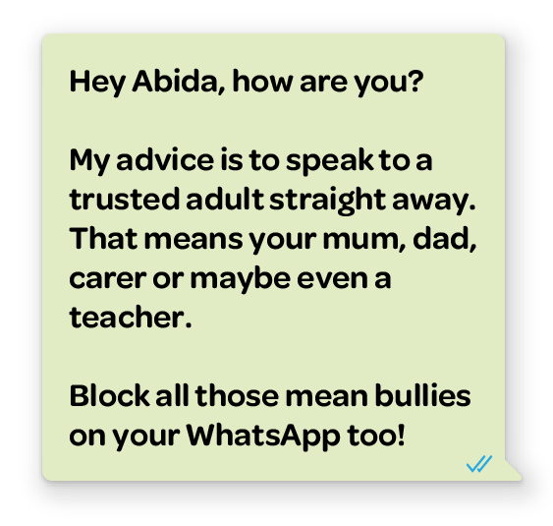
Extended task:
Write a text message to one of the characters telling them what they should do in their scenario.
Notes:
Add phone and example here.

Slide 13


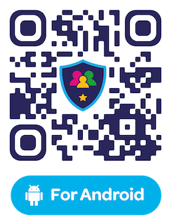
Have you downloaded the Safer Schools App? Scan below!

