Slide 1


Student Use of AI
to Create Sexual
Images of Peers
STAFFROOM BRIEFING
Notes:
This briefing includes speaker notes to support the key messages on each slide. These notes provide additional context and suggested points you may wish to highlight when sharing this information with staff. A printer-friendly version containing all notes is also available for those who would prefer to read the information separately.

Slide 2

The Issue
Students are using widely available AI apps and chatbots to take ordinary photos (from social media or school websites) and generate nude images by digitally removing the clothing.
Artificial intelligence has provided tools to generate such imagery within a few seconds – no technical skill required.
Some platforms have been banned in the UK, but this is being easily bypassed by the use a VPN - in some cases the homepages of the platforms encourage this.
What some young people view as a prank, banter or bullying, is a serious criminal offence. The law classifies this as Child Sexual Abuse Material (CSAM).
Girls are disproportionately targeted. Research shows that some are more concerned about featuring in a deepfake image due to its non-consensual nature, the anonymity of the creator, and fears that others will believe it is real*.
Children who create these images are committing offences, but they are also children who may need safeguarding support.
*Children’s Commissioner for England, Children, Nudification Tools and Sexually Explicit Deepfakes (2025); Internet Matters, The New Face of Digital Abuse: Children’s Experience of Deep Fakes (2024)
Notes:
The Issue
Staff should be aware that incidents involving AI-generated sexual images of peers are being reported in schools internationally and are becoming more common due to the rapid growth of publicly accessible AI tools.
Images that young people have easy access to, such as photos shared on social media, messaging apps, or sometimes publicly available images linked to school activities. This means any student with an online presence or visible on school websites could potentially be targeted.

Slide 3






Algorithm Exposure
“Just a Joke”
Curiosity
Why young people may create AI-generated sexualised imagery
Bullying
Retaliation
Wanting to Fit In
Notes:
Why young people may create AI-generated sexualised imagery
Algorithm Exposure
Online spaces that objectify women and girls can normalise rating, exposing or humiliating female bodies. Repeated exposure can reduce empathy and increase harmful behaviour.
Curiosity
Highly accessible and easy to use AI tools can lead to experimentation without fully understanding the consequences.
Retaliation
A young person may try to ‘get back’ at someone, including an ex-partner, or respond to an image created of them.
Wanting to Fit In
If peers appear to be receiving or sharing nude images, young people may feel pressure to partake to gain status or approval.
Bullying
Images may be created to shame, humiliate or damage someone’s reputation - including within same sex friendship groups.
“Just a Joke”
Some may describe it as a joke or prank without understanding the legal or emotional harm it can cause.

Slide 4








The Legal Reality
It is a criminal offence to make, distribute or possess an indecent image of a child.
This includes ‘pseudo-photographs’ – images that appear real but have been created with AI or other means.
Protection of Children Act 1978, Section 1 and Criminal Justice Act 1988 (Section 160)
Civic Government (Scotland) Act 1982, Section 52
Protection of Children Act 1978 (IoM)
Notes:
The Legal Reality.
Some pupils may not understand that creating AI-generated sexual images of peers can be a criminal offence.
The law treats these images the same as other sexually explicit images of a child, even if they are artificially created.
It is important that adults address this early and clearly with pupils before this behaviour occurs.

Slide 5
Making an image
If someone creates an indecent / sexual image of a child, they are breaking the law.
What the law means by…
Distributing an image
If someone shares or shows an indecent image of a child to someone else, this becomes a separate crime. Every time that image is shared, a new offence can occur.
Possessing an image
This means having an indecent image of a child on your device. Even if you did not create it or share it, knowingly keeping it can be an offence.
Never save an image, even to report it. Always seek advice from your safeguarding lead or the police on how to report safely.
© Ineqe Group Ltd 2026
Notes:
What the law means by…
Making an indecent image can include:
Taking a nude or semi-nude /sexual photo of a child
Using an app to remove clothing from an image
Editing or altering a photo to make it sexual
Creating an AI generated nude image of a child
Screenshotting an indecent image of a child
Distributing and image can include:
Sending it via social media or gaming platforms
Posting it online
Forwarding an image that has been sent to you
Possessing an image can include:
Saving it to your camera roll
Keeping it in a messaging app (like WhatsApp or Snapchat) where you can still access it
Storing it in cloud storage

Slide 6



Serious Crime Act 2007, Sections 44 to 46
Further Offences
Criminal Justice and Licensing (Scotland) Act 2010 and common law ‘art and part’ liability
Criminal Law Act 1981 - aiding, abetting, counselling or procuring an offence
In some cases, where instructions are provided by the child to another child/adult, this may constitute as intentionally encouraging or assisting the commission of an offence.
Image processed using ‘Uncensor’ tool
14:32
Upload it and it will remove her clothes for you and you pick what type of body to give her. its great
This is an AI generated image used for example purposes only
© Ineqe Group Ltd 2026
Notes:
Further Offences
Pupils should be aware that not only creating or sharing these images can be illegal, but advising, encouraging, or showing someone else how to create them may also be considered assisting an offence.
This could include sharing links to tools, giving instructions, or helping someone edit an image.
Some young people may believe they are not responsible if they didn’t create the image themselves, but encouraging the behaviour can still have serious legal consequences.

Slide 7
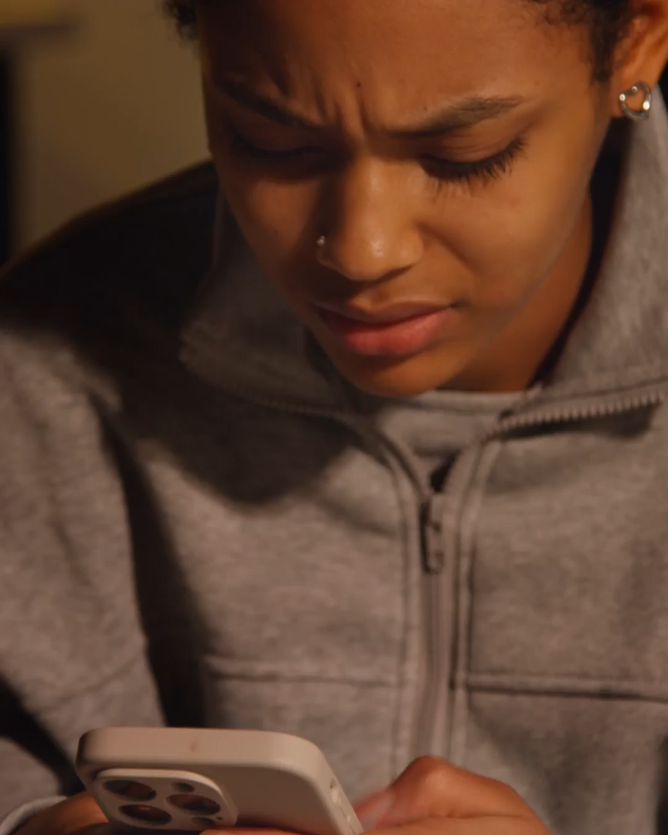

Advice for Young People
Tell a trusted adult immediately
Never screenshot, save or forward the image
Make them aware of ReportRemove
Delete the image
© Ineqe Group Ltd 2026
Notes:
Advice for Young People
Tell a trusted adult immediately
Encourage young people to report it straight away to a parent/carer, Safeguarding Lead or another trusted adult. Acting quickly helps limit the spread and shows they are not participating in the harm.
Never screenshot, save or forward the image
Young people should never recreate or share the image (even to show an adult). Creating or sharing sexual images of someone under 18 may be viewed as making or distributing indecent images. The safest action is always to tell a trusted adult first.
Make them aware of ReportRemove
While you should encourage speaking to a trusted adult first, some may not feel able to. Make young people aware of Childline’s Report Remove service, which helps under 18s confidentially report sexual images of themselves. It is free and designed specifically to support young people.
Delete the image
Young people should not handle the situation alone. Once reported, a Safeguarding Lead, parent/carer or police will advise on next steps. In most cases, removing the image from their device protects them from being seen as in possession of an indecent image and reduces the risk of it being accidentally shared or causing any further harm.

Slide 8


Explain what a bystander is and what choices someone has when they witness harmful behaviour.
Clarify the legal position.
Promote Childline’s Report Remove.
Educate to prevent incidents from taking place.
Address the myth that AI-generated imagery is less serious.
© Ineqe Group Ltd 2026
Notes:
The Umbrella of Protection.
The best way to safeguard our children and young people is to educate and empower them and the entire school community.
Explain what a bystander is and what choices someone has when they witness harmful behaviour
Reinforce that children are not responsible for stopping harm to themselves, but that speaking up to a trusted
adult can help keep everyone safer.
Educate to prevent incidents from taking place
Integrate the topic into your curriculum before incidents occur, rather than only as a way of responding to harm.
Address the myth that AI-generated imagery is less serious
Make it clear that AI generated sexual images can cause the same distress as a ‘real’ image.
Clarify the legal position
Ensure pupils understand that creating, sharing, or encouraging the creation of AI-generated sexual images of someone under 18 is a criminal offence.
Promote Childline’s Report Remove service
Ensure that Childline’s Report Remove tool is visible and understood within your school community.

Slide 9




How can you prepare?
Prepare policies.
Don’t avoid the topic.
Create safe reporting spaces.
Ensure both parents and staff understand your school’s stance.
Notes:
How can you prepare?
Prepare policies
Ensure your safeguarding, behaviour, anti-bullying and online safety policies explicitly reference AI-generated sexual images, nudification platforms and deepfake technology.
Don’t avoid the topic
Address AI image misuse proactively. Avoiding the conversation for fear of introducing something new can leave students uninformed and unprotected.
Create safe reporting spaces
Children may be reluctant to report incidents if they fear sanctions such as having their phone confiscated. Make it clear that reporting leads to support, not automatic punishment.
Ensure both parents and staff understand your school’s stance
Staff and parents should understand your school’s position, the potential legal implications, and how incidents will be managed. Do not minimise the harm because images are digitally created - the impact on the child can be just as significant.

Slide 10


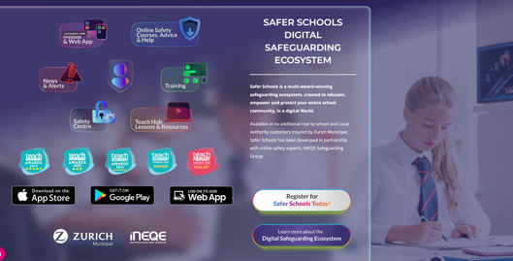

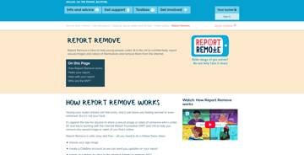







Helpful Resources
Report Remove Childline
Our Safety Centre
Safer Schools Website
Digital
Proficiency Course
https://www.childline.org.uk/
oursafetycentre.co.uk
www.saferschools.co.uk
oursaferschools.co.uk/digitalproficiency
ACCESS YOUR APP
Any device, any time, everywhere
Notes:
Helpful Resources
Our Safety Centre (oursafetycentre.co.uk): This is a digital library of ‘safety cards’ that provide step-by-step instructions on how to use the safety, privacy, and reporting features of popular social media apps, games, and streaming platforms. It is designed to empower users to take control of their digital footprint and provide them with information on how to quickly block or report harmful content.
Report Remove (Childline): This is a confidential service for young people under 18 in the UK to report and request the removal of sexual images or videos of themselves that have been shared online.
Safer Schools (Web and Mobile App): This platform provides a one-stop-shop for digital safeguarding information tailored specifically to your school community, including staff, parents, and pupils.
Safer Schools Digital Proficiency Course: This is a series of interactive, video-led educational modules designed to build digital resilience and literacy across the entire school community. The courses cover essential topics like AI, grooming, and online bullying, culminating in a proficiency test and a certificate to evidence that the user has understood how to navigate the online world safely.

Slide 11

EDUCATE | EMPOWER | PROTECT
STAFFROOM BRIEFING

