Slide 1
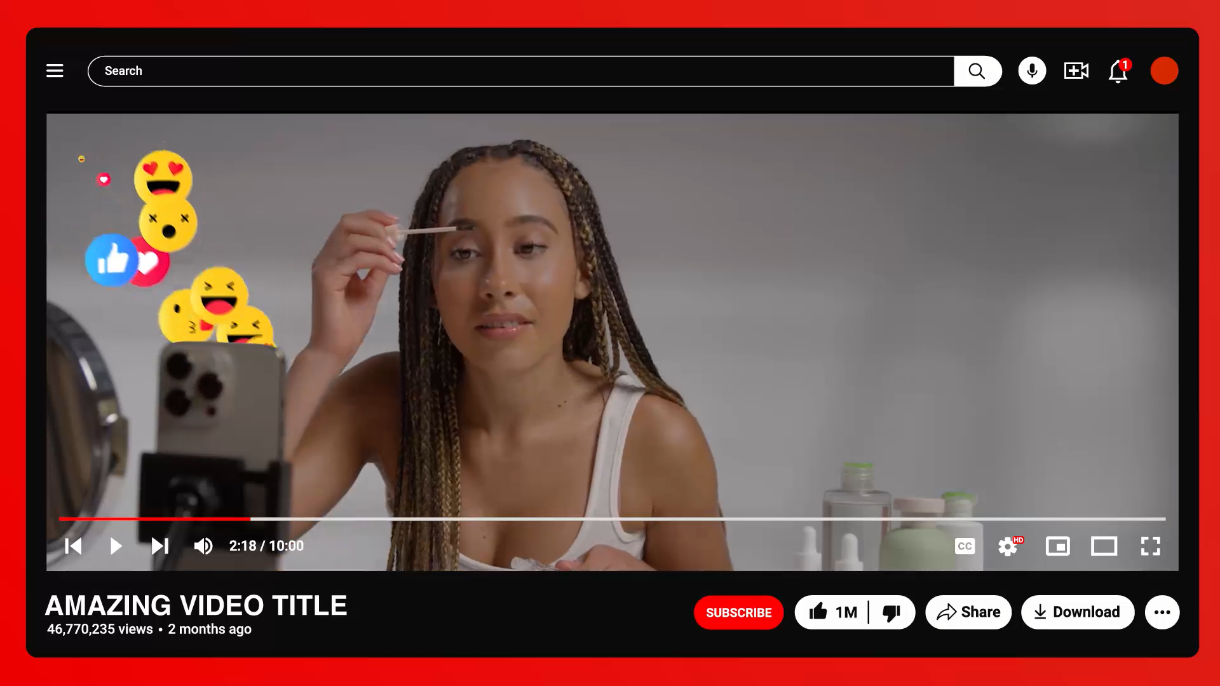

Influencers

Slide 2


Learning Objectives
To explain how what we see online makes us think about how we look, what to buy and other behaviour.
To explain how and why influencers might try to influence us to make bad choices.
To explain that some influencers may be virtual (AI-generated personalities) and not real people.
©Ineqe Group LTD 2025
©Ineqe Group LTD 2025

Slide 3
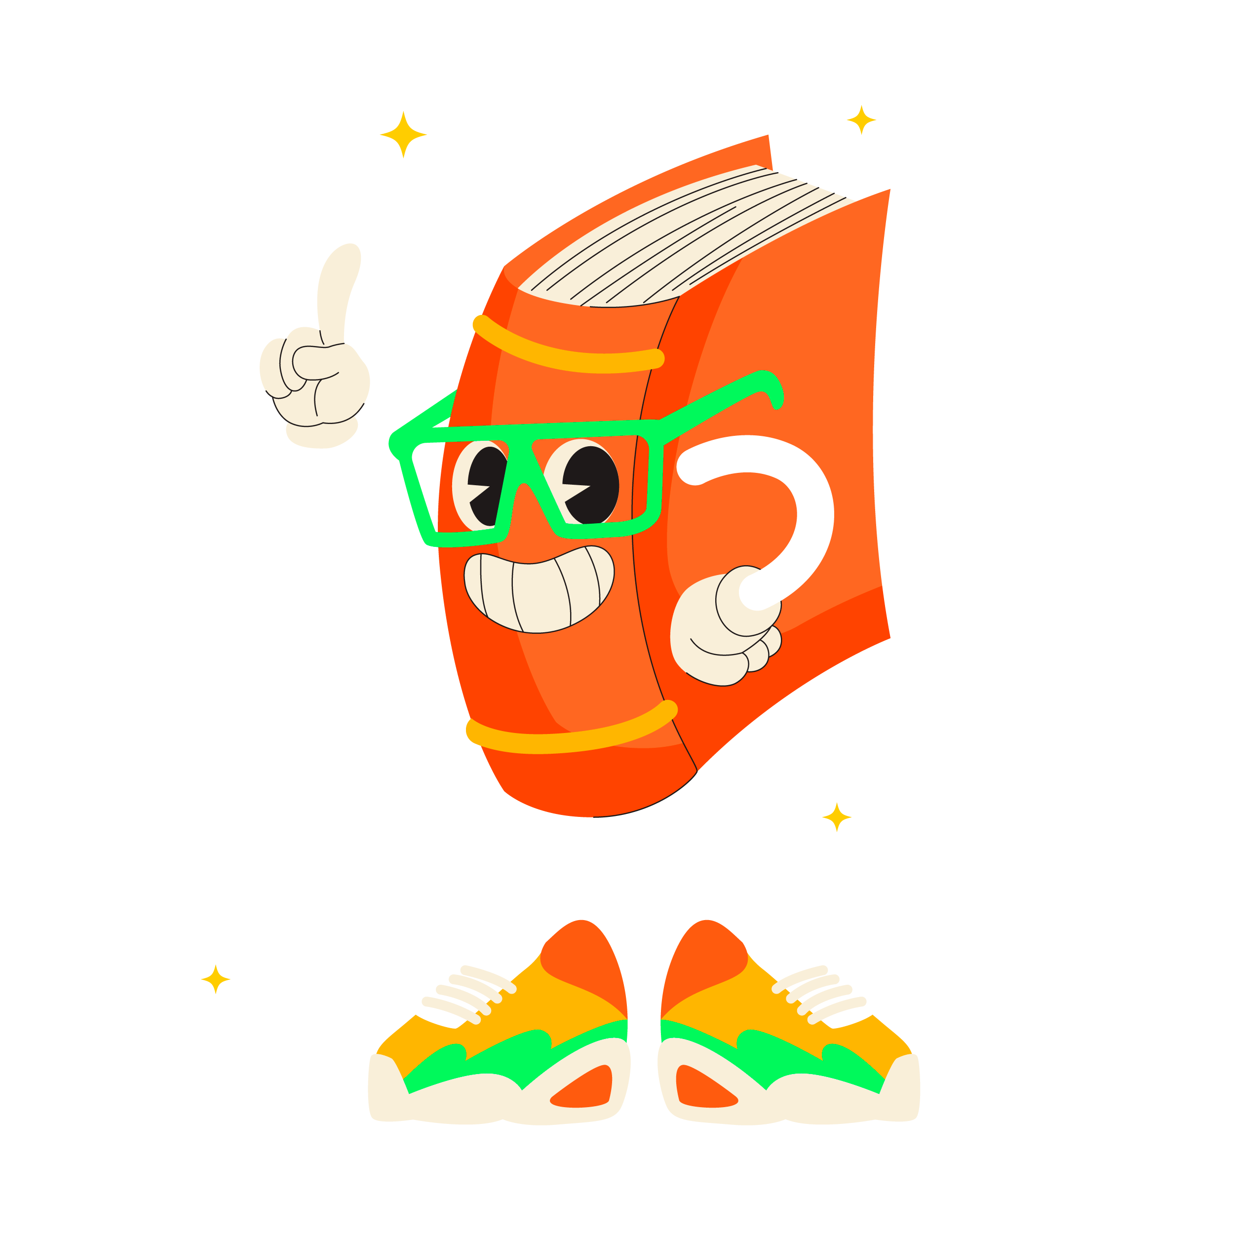
Dictionary
Challenge!
Look up the definition for ‘influence’.
First to find the definition wins!
Notes:
Pupils must look up the definition of influence. The Oxford dictionary definition of ‘influence’ is: “the capacity to have an effect on the character, development, or behaviour of someone or something, or the effect itself”.

Slide 4
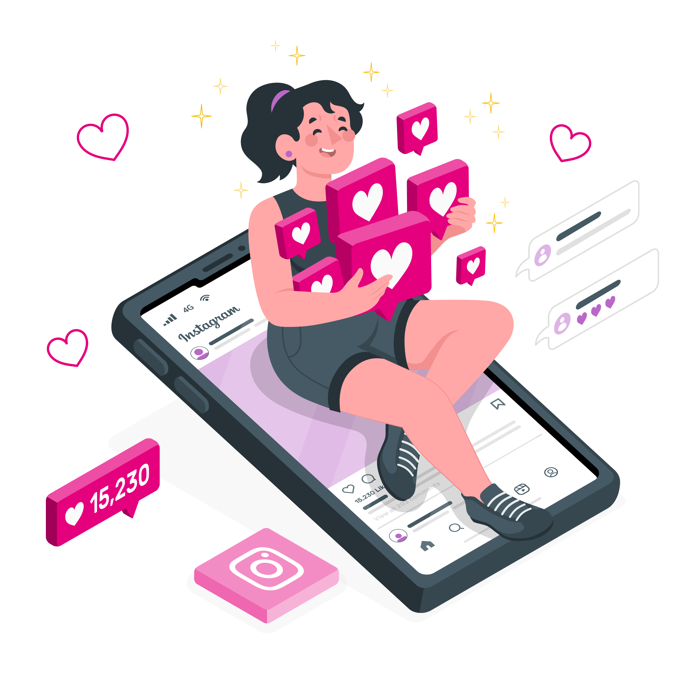
What is an
Influencer?
An influencer is someone with a large social media following who can ‘influence’ their audience.
Can you think of any examples?
Toy unboxers
Reality TV stars
YouTube vloggers
Instagram celebrities
Beauty bloggers
Pranksters
Notes:
An influencer is someone with a large social media following who can ‘influence’ their audience. Influencers exist on many platforms, but the main platforms are Instagram, TikTok and YouTube.
Can you think of any more examples? E.g., Toy unboxers, reality TV actors, YouTube vloggers, Instagram celebrities and beauty bloggers, pranksters. Pupils may suggest influencers that they follow or watch themselves e.g., Zoella, Ninja, Kai Cenat etc.

Slide 5
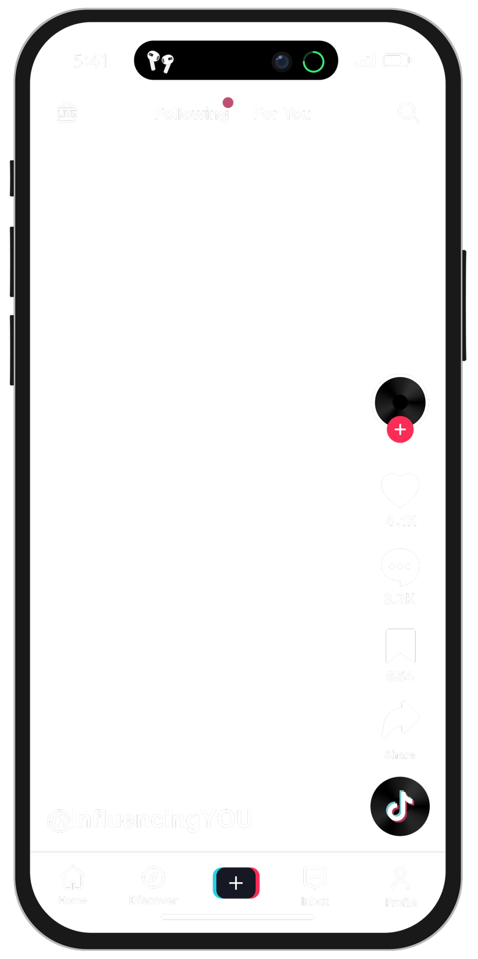
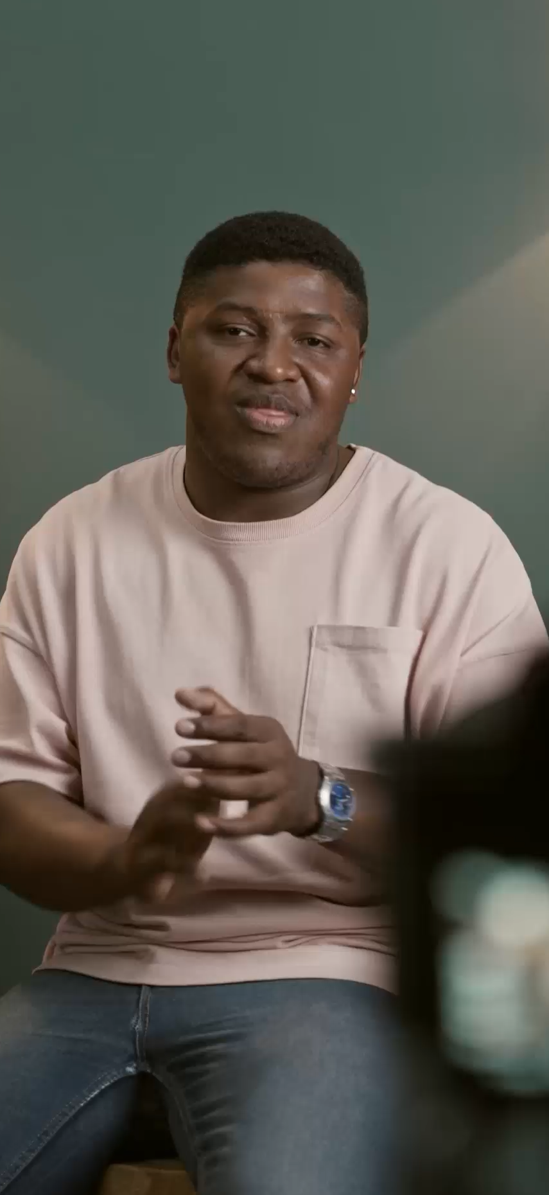
What do
they do?
An influencer is someone who can ‘influence’ their audience’s behaviour.
They can also be sponsored to promote certain products.
Influencers can be entertaining, but they can also provide us with information, advice and guidance.

Slide 6
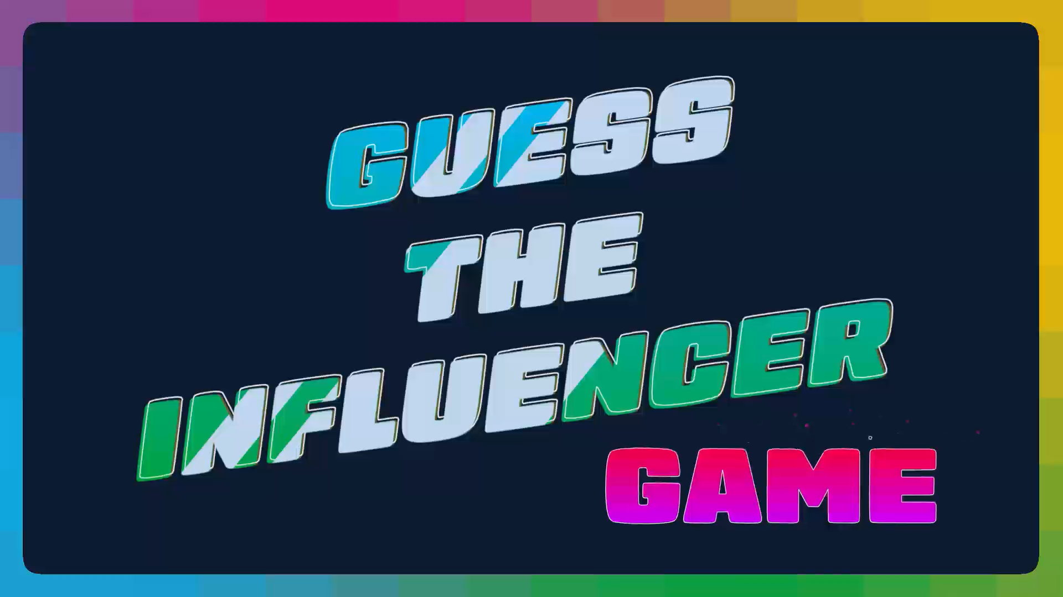
©Ineqe Group LTD 2025
Notes:
Guess the influencer game
Make sure to tap/click on the top right corner of the slide to move on.
Invite a pupil up to the board to click on the correct name for each influencer.
If they get it wrong, a buzzer will sound (The slides in-between each influencer contains the ‘correct’ animation).

Slide 7
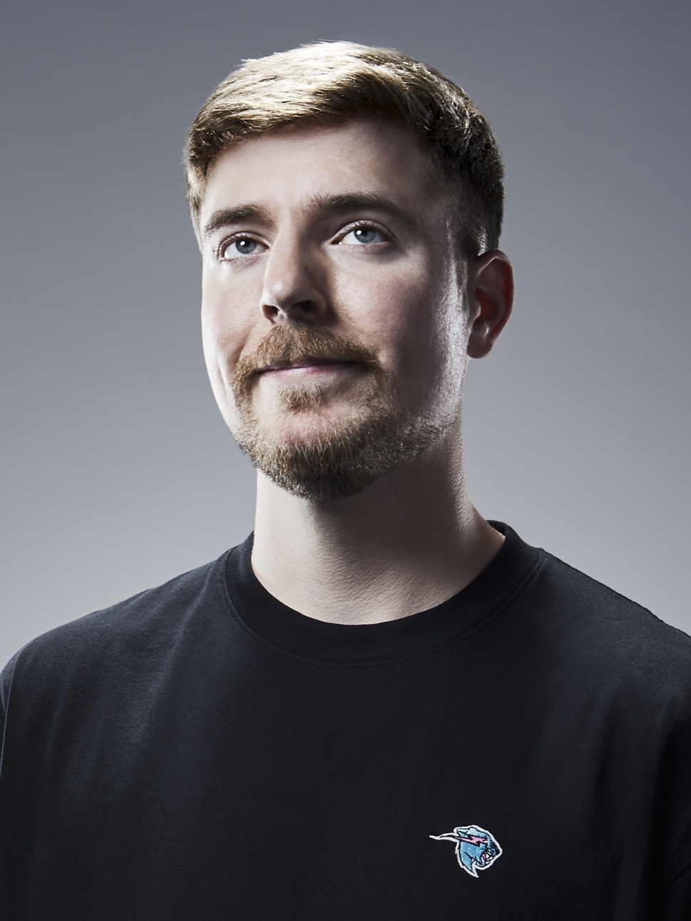
Logan Paul
KSI
PewDiePie
Mr Beast

Slide 8
Logan Paul
KSI
PewDiePie
Mr Beast

Slide 9
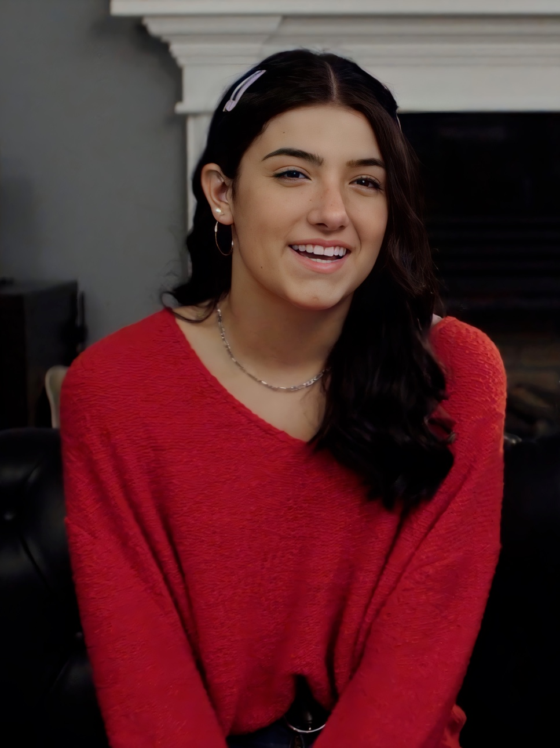
Hayley LeBlanc
Zoella
Charli D’Amelio
Kylie Jenner

Slide 10
Hayley LeBlanc
Zoella
Charli D’Amelio
Kylie Jenner

Slide 11
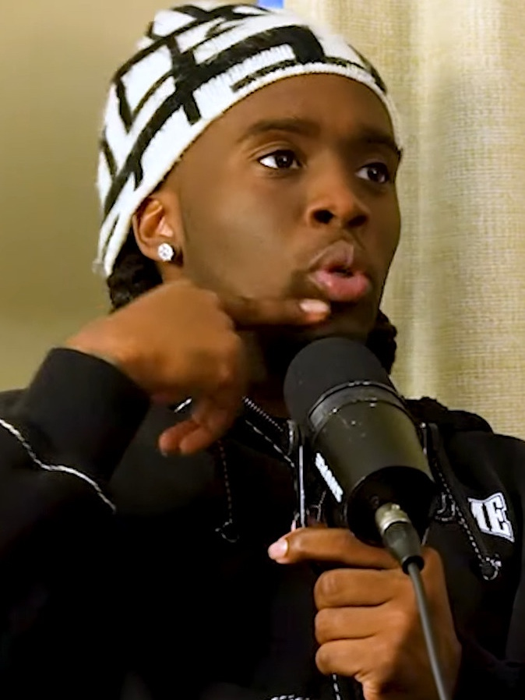
KSI
Kai Cenat
David Dobrik
Ninja

Slide 12
KSI
Kai Cenat
David Dobrik
Ninja

Slide 13
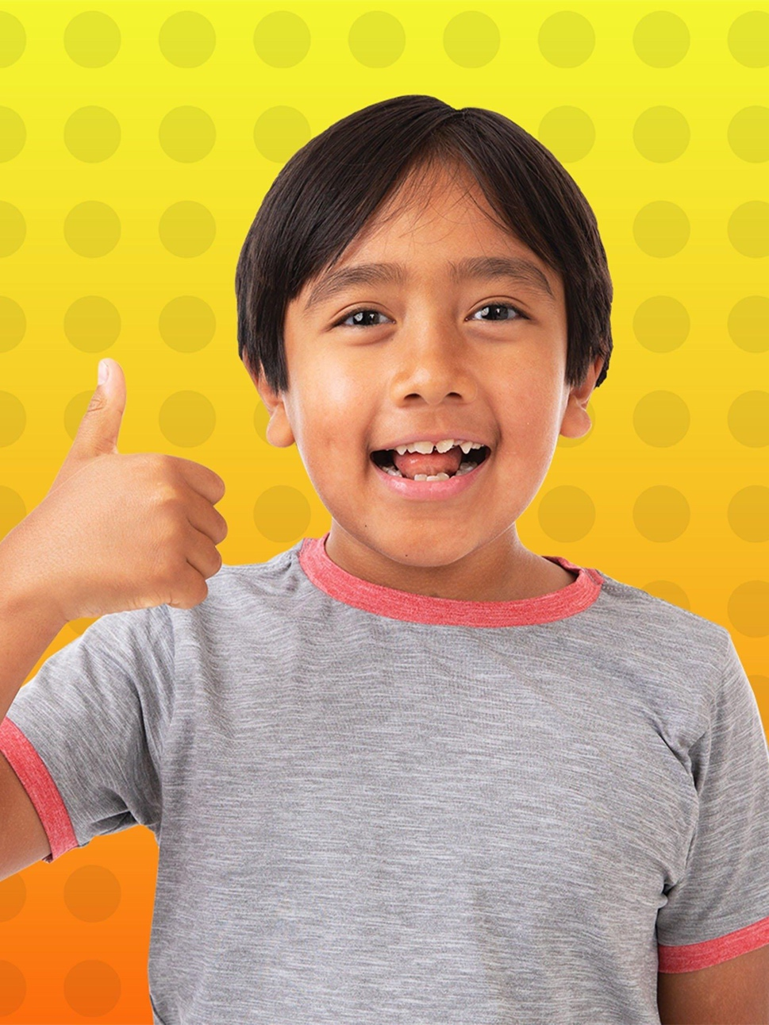
Ryan’s World
Ninja Kidz
CKN
Toys
Ethan Gamer

Slide 14
Ryan’s World
Ninja Kidz
CKN
Toys
Ethan Gamer

Slide 15
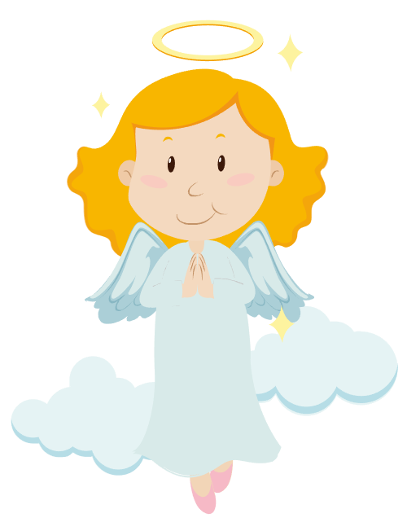
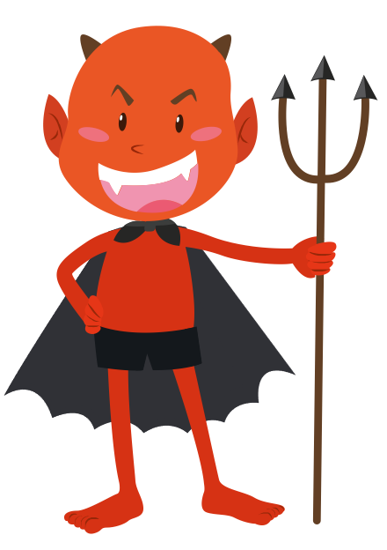
Positives
They may inspire us in an area of interest e.g., fitness, fashion and gaming.
They may encourage positive behaviour in school and with friendship groups.
Negatives
They may influence us to take part in harmful behaviour such as smoking, drinking or using bad language.
They may make us believe in unrealistic body standards.
Notes:
**Unrealistic body standards refer to young people comparing their bodies to what is seen in the media, which is often digitally modified and unrealistic. This increases their chance of having a poor body image.

Slide 16
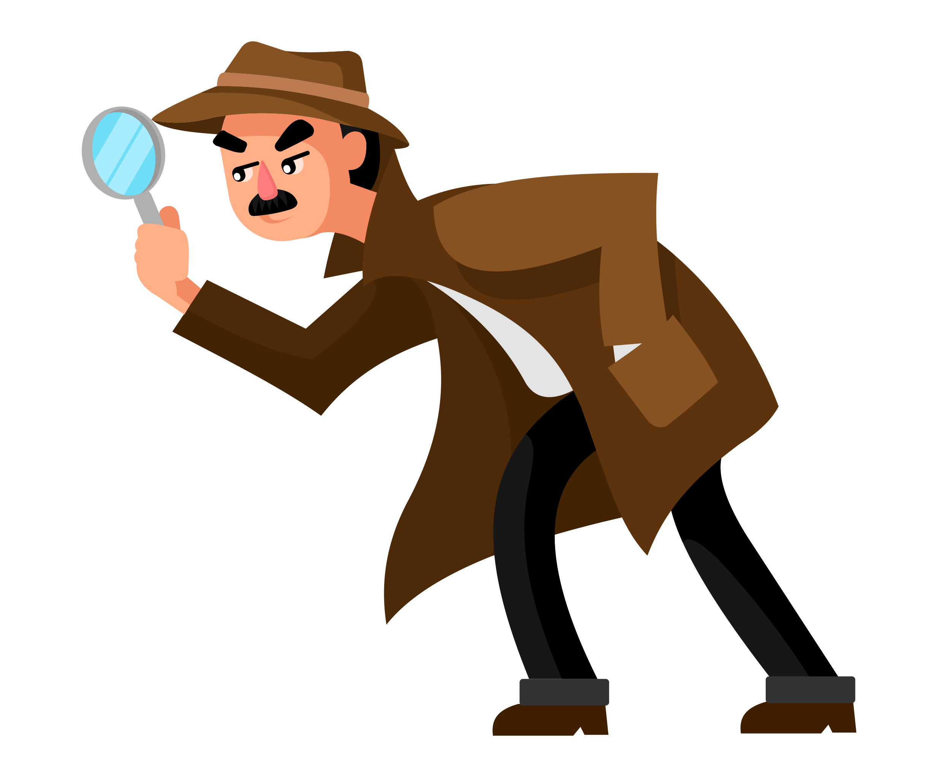
Are there product placements on these thumbnails?

Slide 17
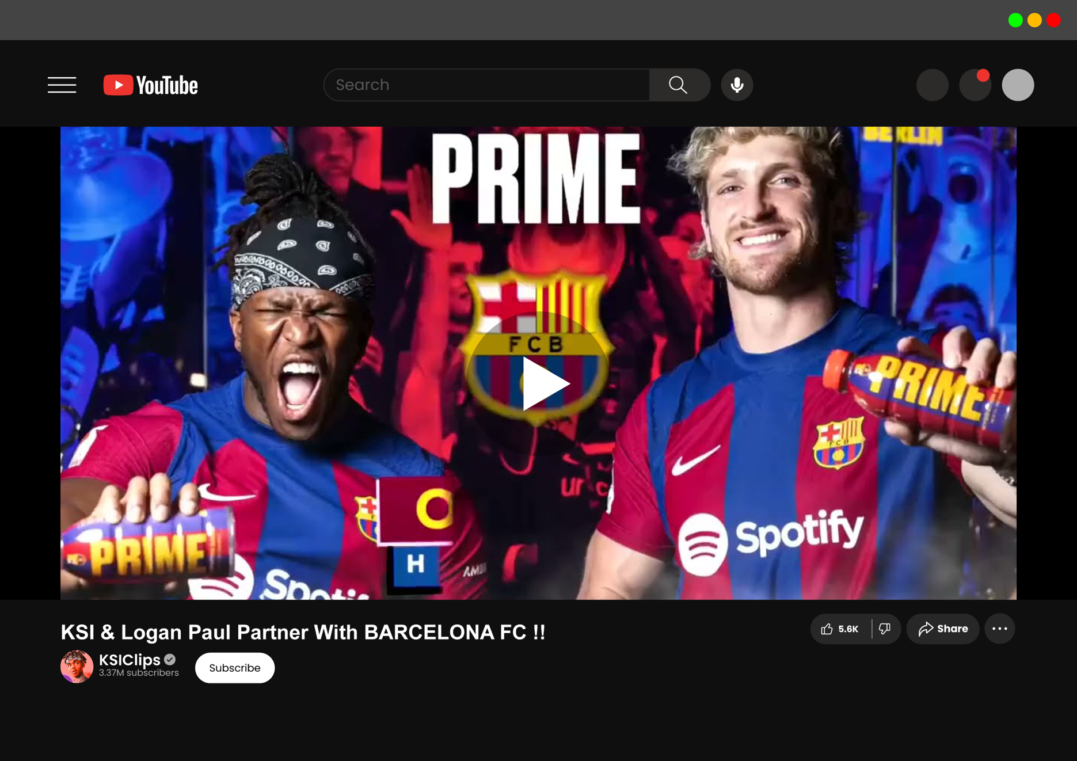
Notes:
Do you think they advertise these products for free?
Hands up if you would buy these products because they are holding them. Hands down if you would not. Question pupils why they would and why they would not, reassuring pupils that there is no right or wrong answer and encouraging active listening from other pupils.

Slide 18
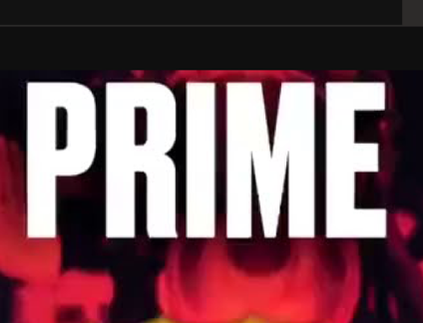
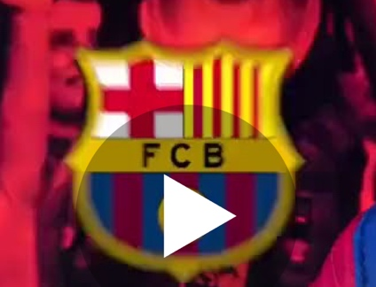
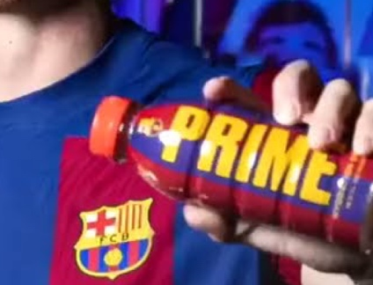
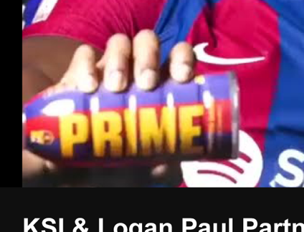
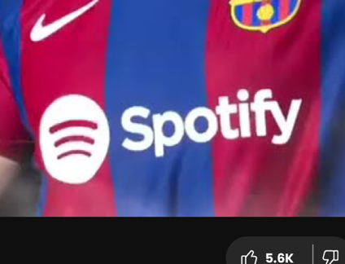
Notes:
Do you think they advertise these products for free?
Hands up if you would buy these products because they are holding them. Hands down if you would not. Question pupils why they would and why they would not, reassuring pupils that there is no right or wrong answer and encouraging active listening from other pupils.

Slide 19
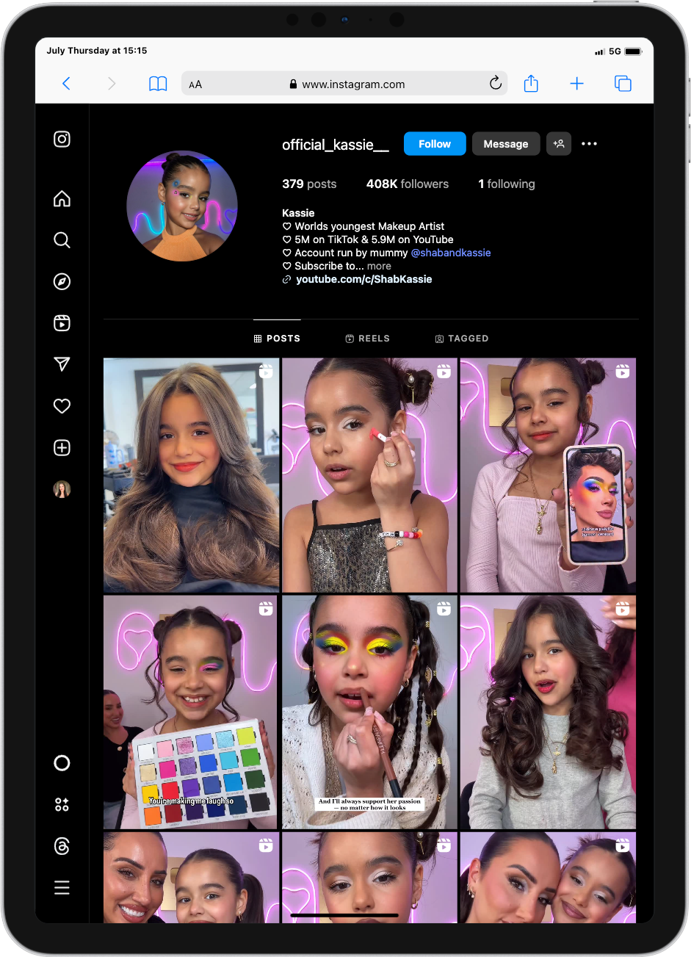
Notes:
Do you think they advertise these products for free?
Hands up if you would buy these products because they are holding them. Hands down if you would not. Question pupils why they would and why they would not, reassuring pupils that there is no right or wrong answer and encouraging active listening from other pupils.

Slide 20

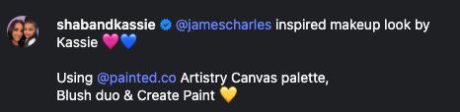
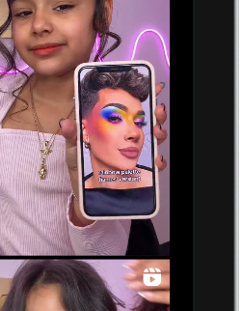
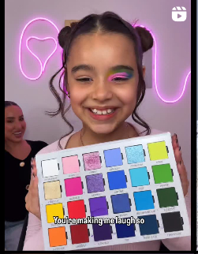
Notes:
Do you think they advertise these products for free?
Hands up if you would buy these products because they are holding them. Hands down if you would not. Question pupils why they would and why they would not, reassuring pupils that there is no right or wrong answer and encouraging active listening from other pupils.

Slide 21
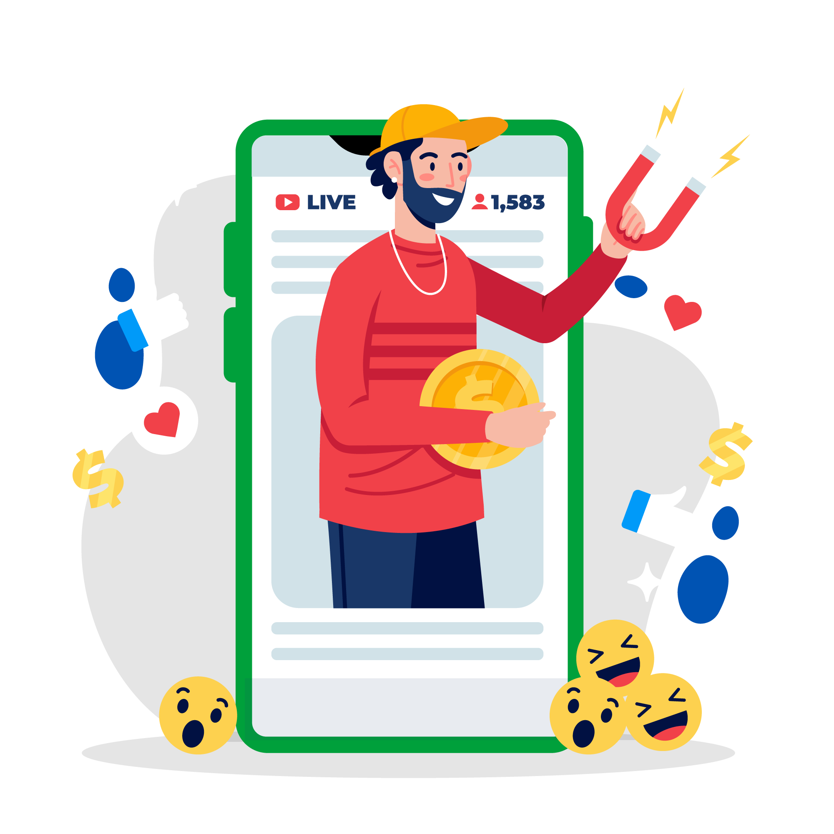


How influencers
make a living
Brands will work with influencers and will pay them or give them free products, services or experience in return for promotion or product placement.
YouTubers with a big following will also get money from the adverts attached to their videos.

Slide 22
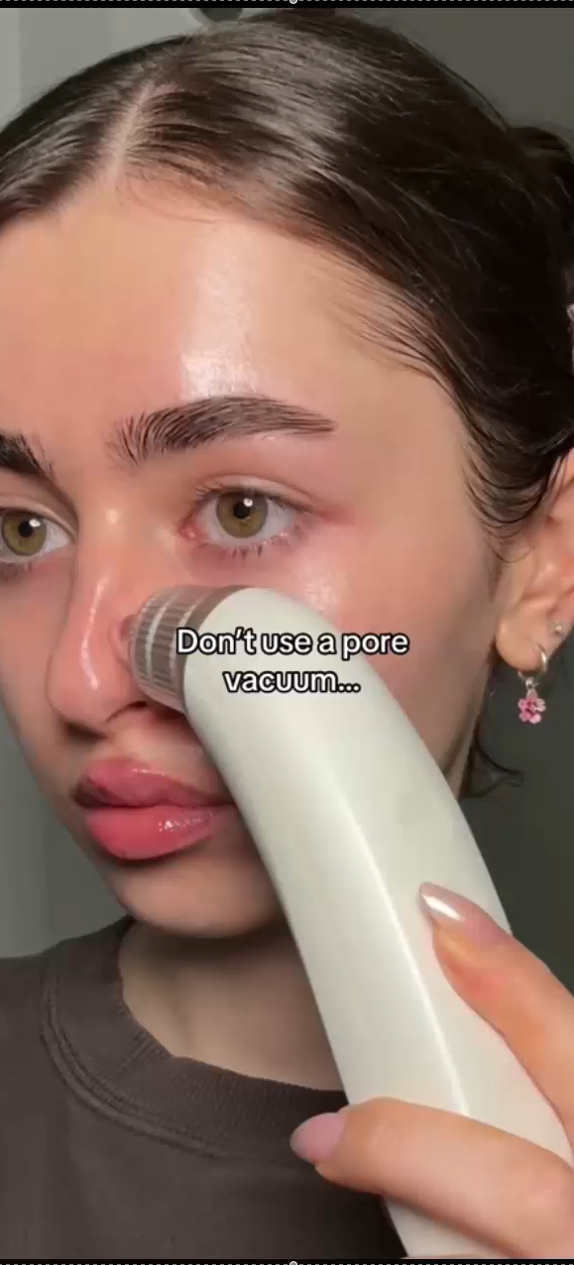

Negative
The list of products this TikTok account promotes using for skincare includes:
Influencing
Pore strips
Clay masks
Carrot juice
Salmon
LED mask
Tretinoin
Avocado
Clean makeup brushes
Eat clean
Face masks
Gua-shaing
Ice-bowling
Putting garlic on your skin
Eating aloe vera
Panoxyl cream
Pimple patches
Eating:
Steak
Cottage cheese
Zucchini
Dark chocolate
Strawberries
Red peppers
Broccoli
Sweet potato
Beef tallow
Using Korean skincare
Spearmint tea
Okra Water
Hypochlorous acid spray
Some products advertised can be negative influences and encourage you to buy products that aren’t right for you, or you don’t need.
Notes:
Tiktok profile: https://www.tiktok.com/@danicolexx

Slide 23
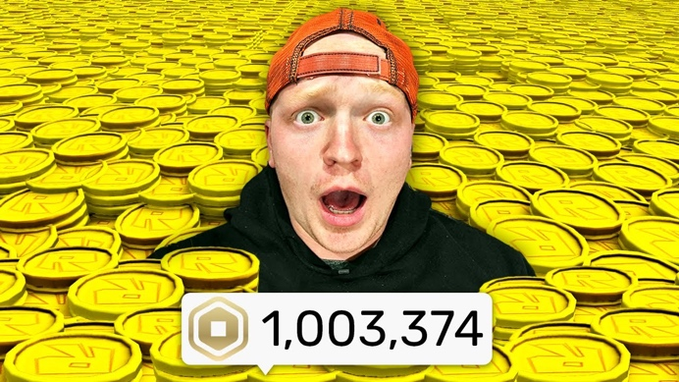
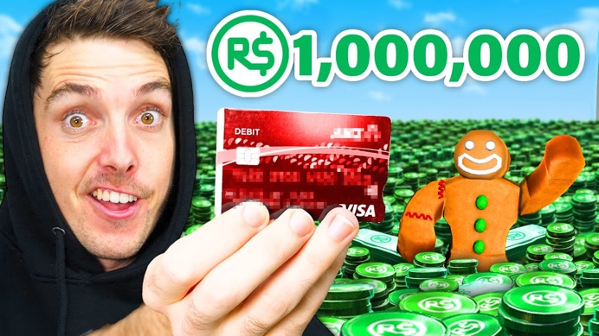
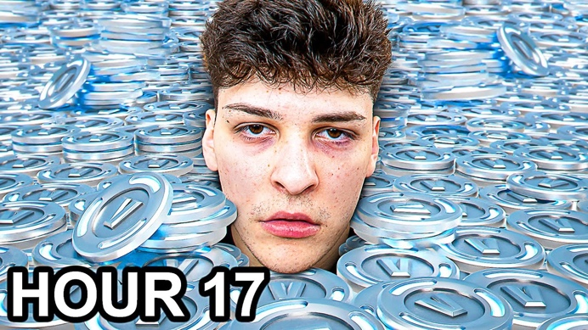
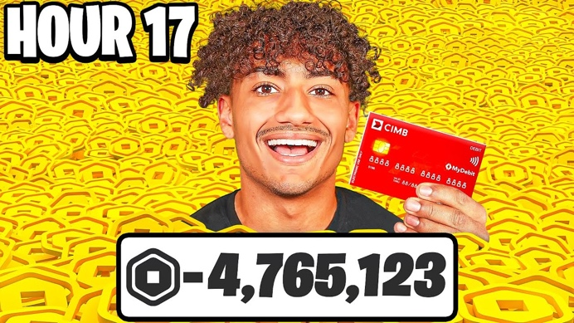
Negative
Influencing
Spending 1,000,000 Robux in 1 Hour!
14M views
I Spent $10,000 to Beat Every Roblox Game
59M views
Some products advertised can be negative influences and encourage you spend money on games, or play them for long periods of time.
Spending 1,000,000 Vbucks in 24 Hours
4.1M views
Spending 10,000,000 Robux in 1 Hour!
8M views
©Ineqe Group LTD 2025
Notes:
Videos: https://youtu.be/ZeHLcy1cZN0?feature=shared https://youtu.be/wG1HKc-eY-Y?feature=shared https://youtu.be/nX8Q-_HdFE4?feature=shared https://youtu.be/gE1ZF201zI4?feature=shared

Slide 24
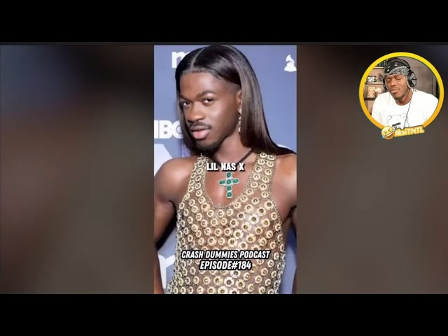

Negative
Influencing
Some products advertised can be negative influences and normalise harmful behaviour.
That’s A Lil Gay
15K views
Homophobic comments in the video title.
©Ineqe Group LTD 2025
Notes:
What influence does this image have? Pupils to discuss in pairs before sharing with class. Pupils to point out the negative video title, the clear bullying of another individual, the homophobia.

Slide 25
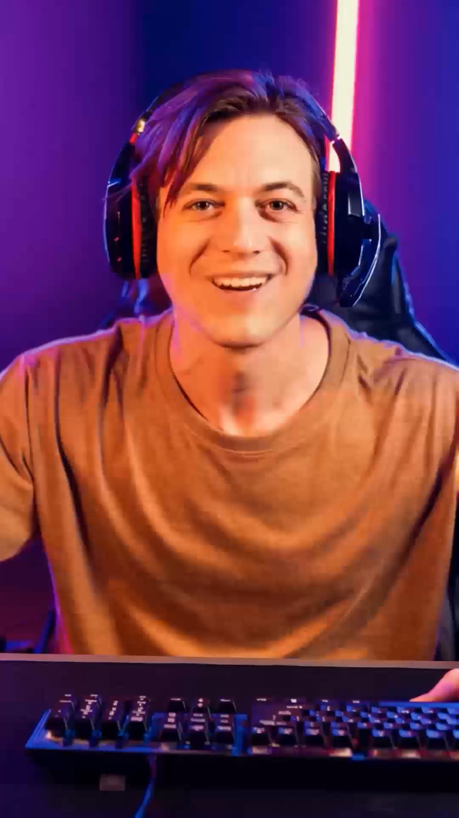

Name the
Influencer
This is an AI Generated video!
Notes:
Ai tools used: Freepik AI Suite (present AI influencer) Ask pupils if anyone know the name of this influencer? Would they be interested in watching their videos? What age do they think they are? – gather information from pupils.
Reveal the video is an AI-generated influencer. One of the latest dangers with influencer culture is that brands can create an AI-generated influencer to influence people to buy products/services or take part in harmful behaviours. There are some signs to look out for to question if a video is real or AI-generated.

Slide 26
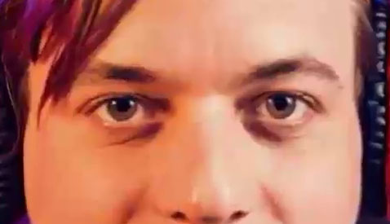
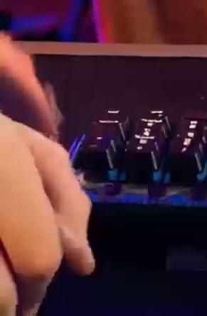
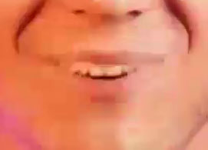
Name the
No blinking.
Influencer
No natural pauses in the audio.
Misalignments between lip movements and the audio.
Glitches
Notes:
There are some signs that you can look out for when watching videos to decide if the video is AI-generated or real. Look for signs such as no natural pauses in the audio, there are misalignments between lip movements and the audio, and the person is not blinking. There are also usually distortions in the background of the video, such as glitches or strange pattern noise.

Slide 27
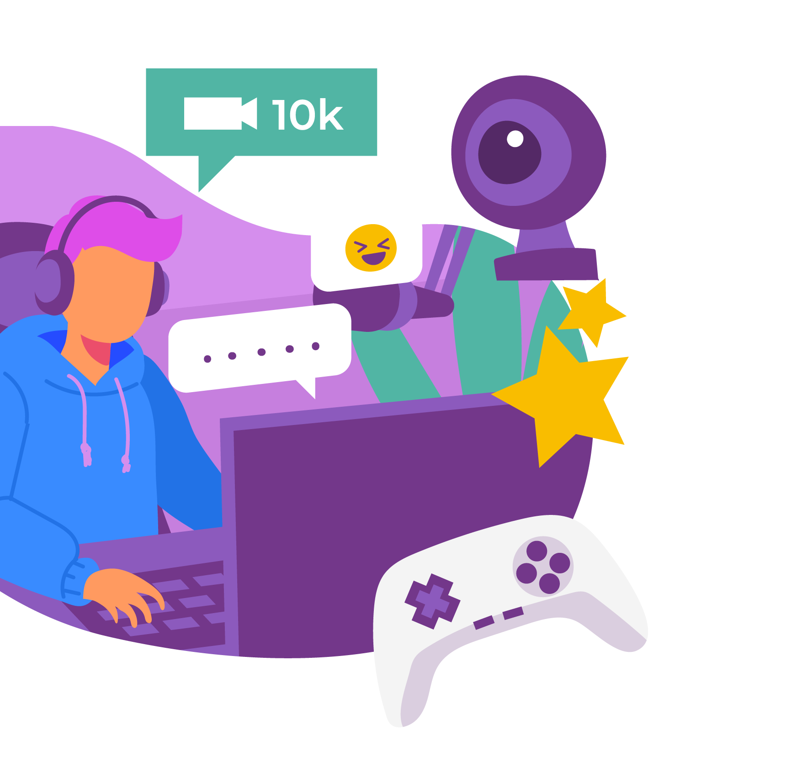
Key Learning
An influencer is someone with a big enough social media presence or following to market or ‘influence’ their audience with products or behaviour.
Influencers can be entertaining or provide us with information or guidance.
Influencers can be sponsored to promote harmful products, and they can also promote harmful behaviour.
Influencers can be created through AI and not be a real person.

Slide 28


Self-assessment
I can explain how online content can be shaped and targeted to influence body image, purchasing choices and behaviour.​
I can explain how and why people who communicate with others through online platforms may try to influence others negatively and I can offer examples.
I can explain why some social media influencers promoting products and lifestyle can be virtual (AI-generated personalities) and not real people.
Notes:
This provides the opportunity to assess pupil understanding.

