Slide 1
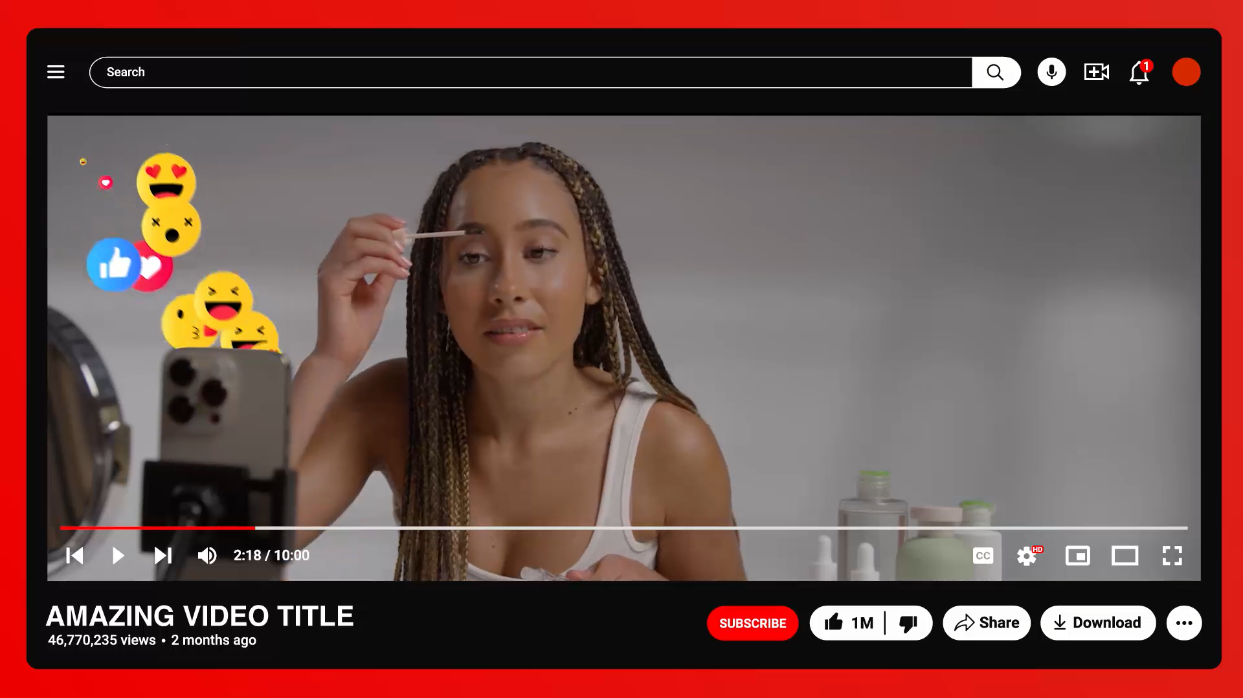

Influencers

Slide 2






Learning Objectives
To describe how to tell when online content has been paid for or promoted by companies or influencers.
To explain how online content is designed to influence how people feel, what they buy and how they behave.
To explain how and why some people use online platforms to influence others in negative ways, with examples.
To explain that some influencers online are not real people but computer-generated characters created to promote products or lifestyles.
©Ineqe Group LTD 2025
©Ineqe Group LTD 2025

Slide 3
Influencers
©Ineqe Group LTD 2025
Notes:
Discussion Starter: Start the lesson by asking pupils what they think of when they hear the word "influencer." Who do they follow? What kind of content do they engage with? Write their responses on the board

Slide 4
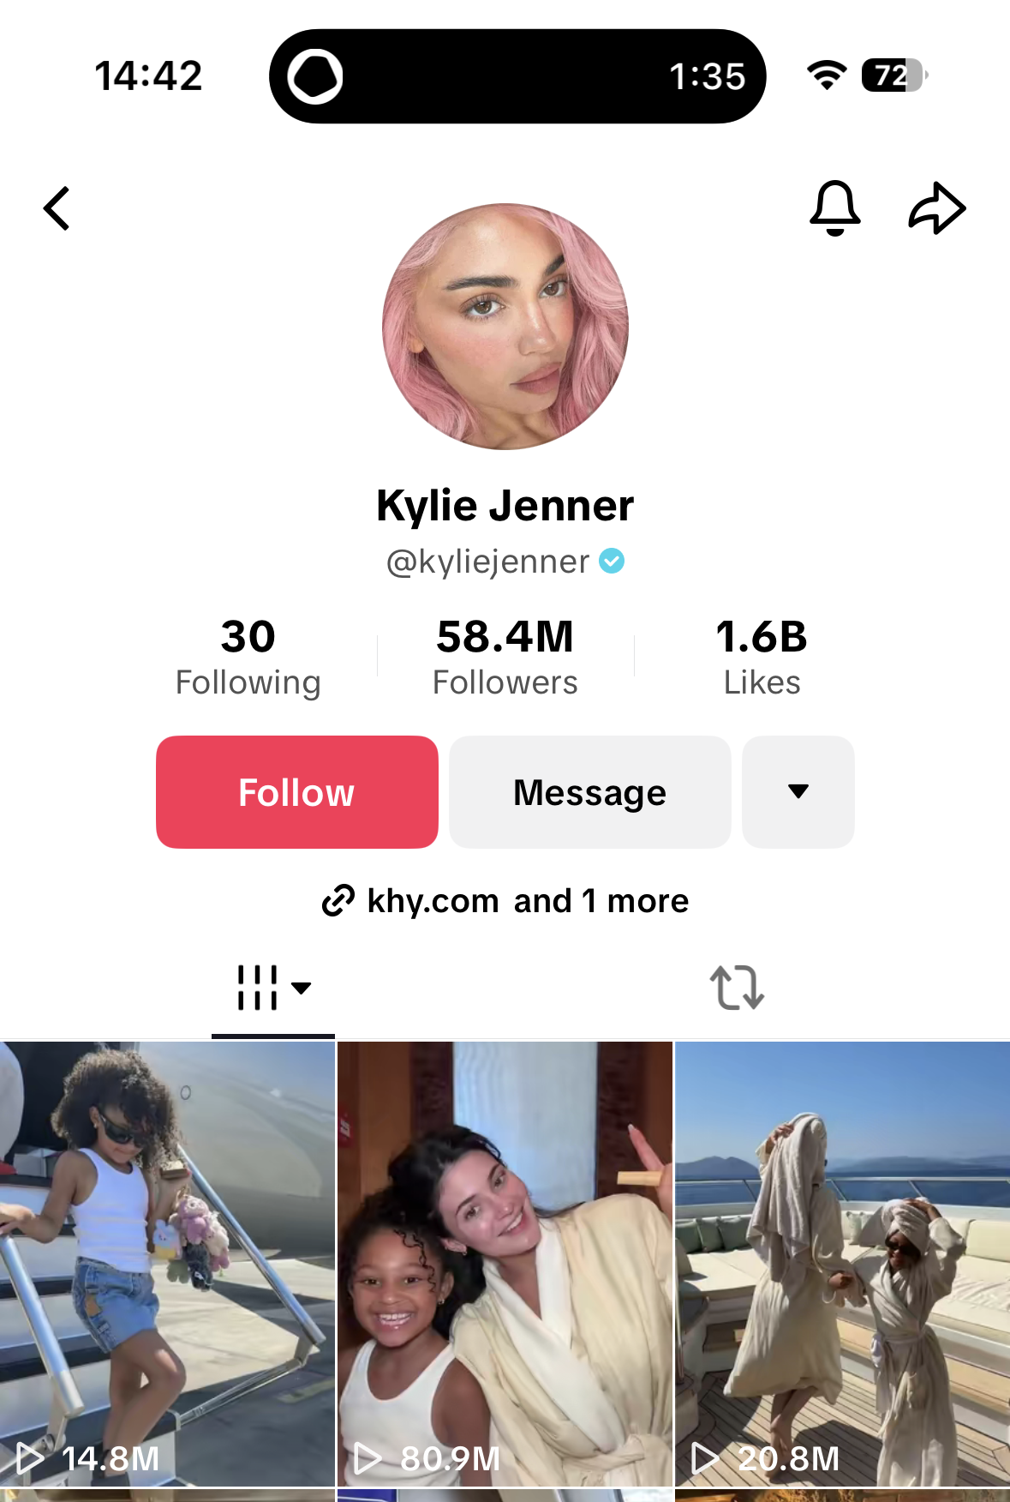
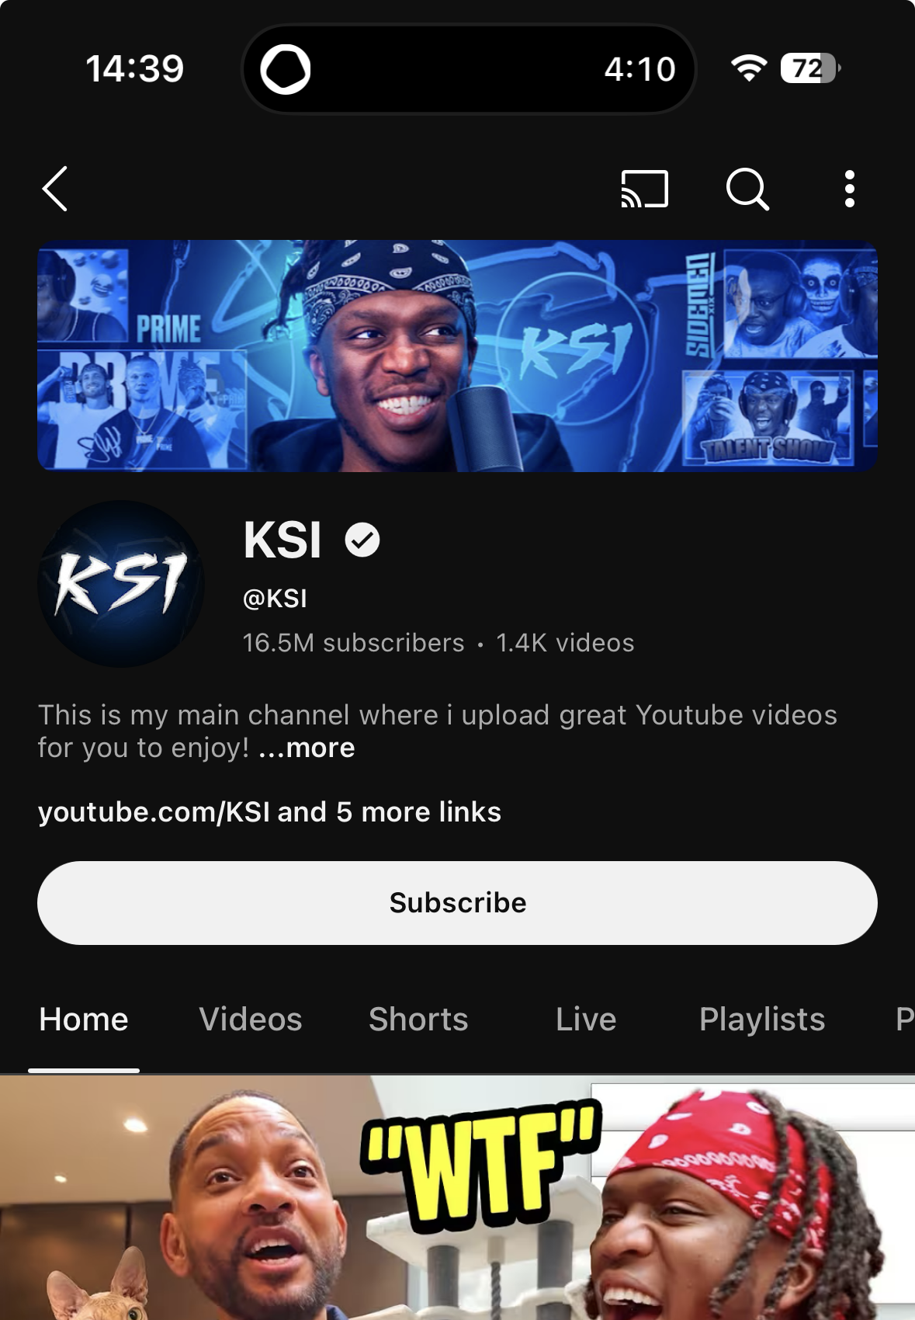
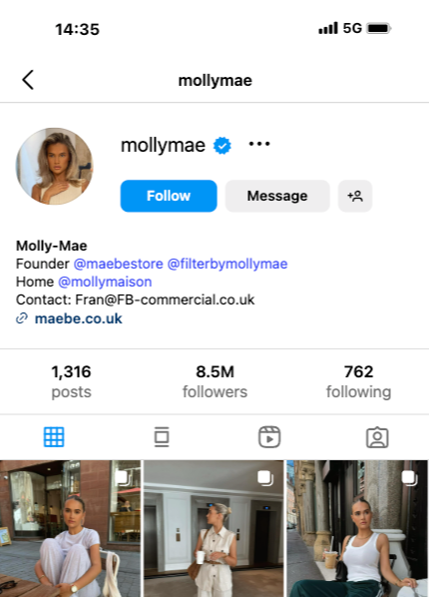
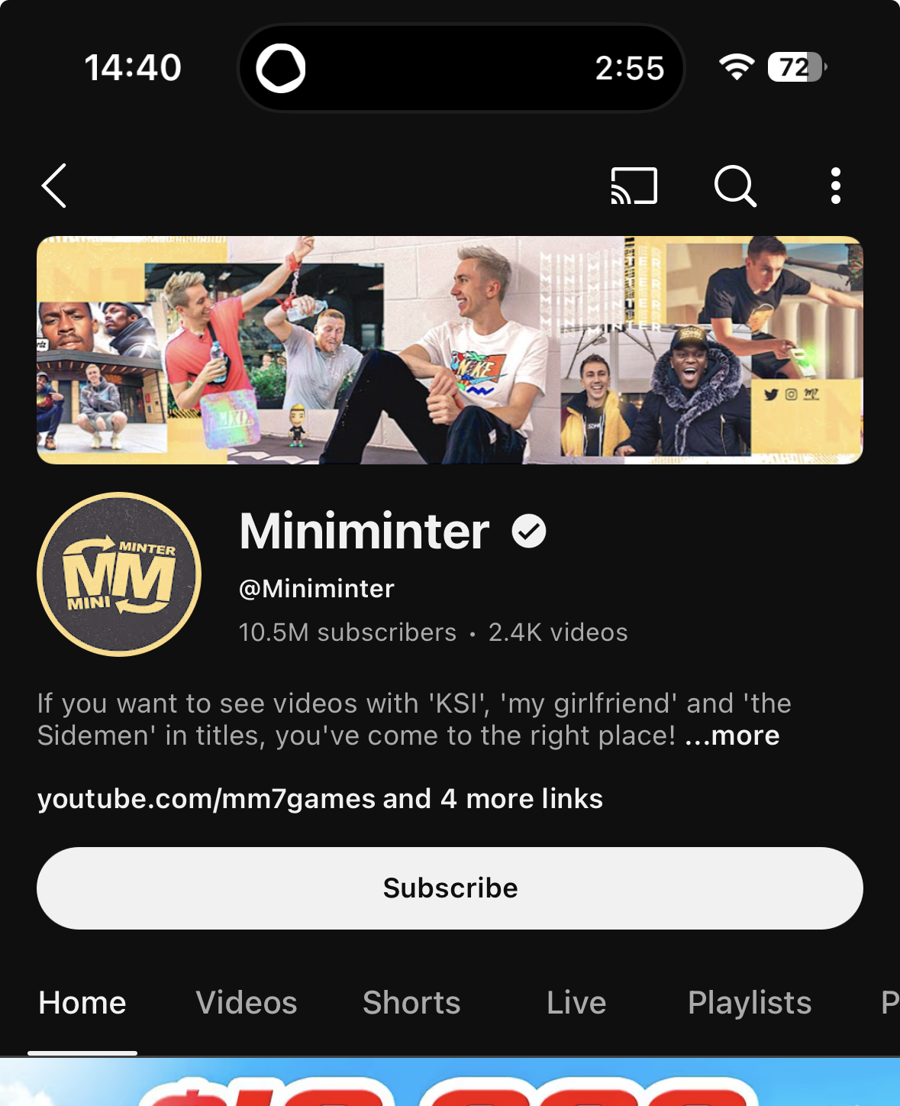
Influencers
Notes:
Definition of Influencers: Explain that influencers are people who have gained a large following on social media platforms such as Instagram, YouTube, TikTok, etc. They influence their followers' opinions, behaviours, and purchasing decisions through their content. Show examples of influencers and their follower count from Instagram, listed are Simon Minter (from the Sidemen), KSI (also from the Sidemen and a musician), Molly Mae Hague (former Love Island star and fashion brand owner) and Kylie Jenner (Reality star and beauty brand owner).

Slide 5
Sponsored
Content
#sponsored
#ad
#partner
Notes:
Definition of Sponsored Content: Introduce the concept of sponsored content, explaining that many influencers are paid or rewarded for promoting products, services, or brands. These promotions can look like regular posts, but they are usually paid for.
How to Identify Sponsored Content: Teach the students how to identify sponsored content. Key indicators include:
Hashtags like #ad, #sponsored, #partner

Slide 6
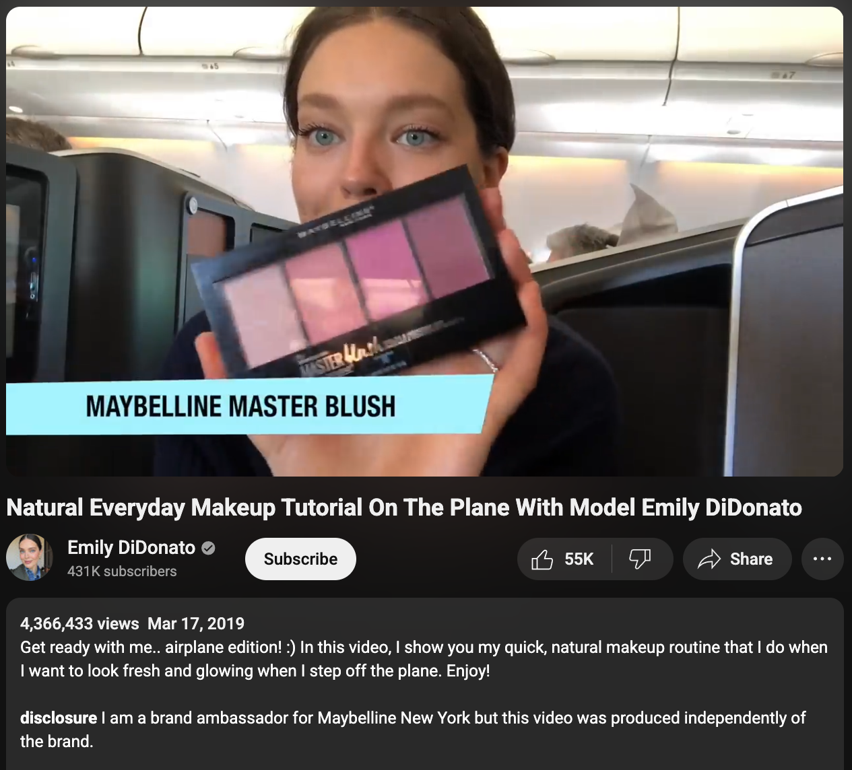
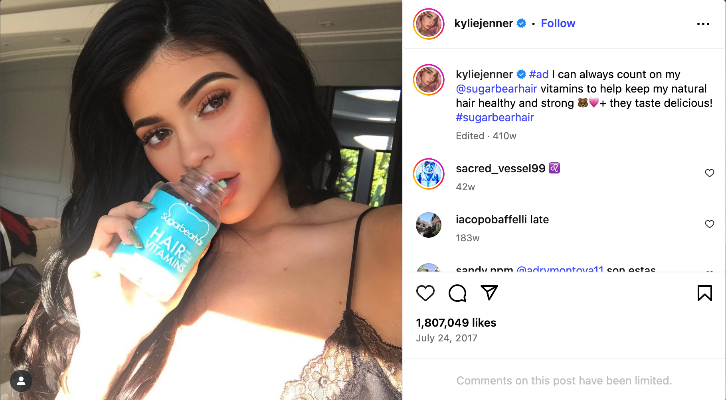
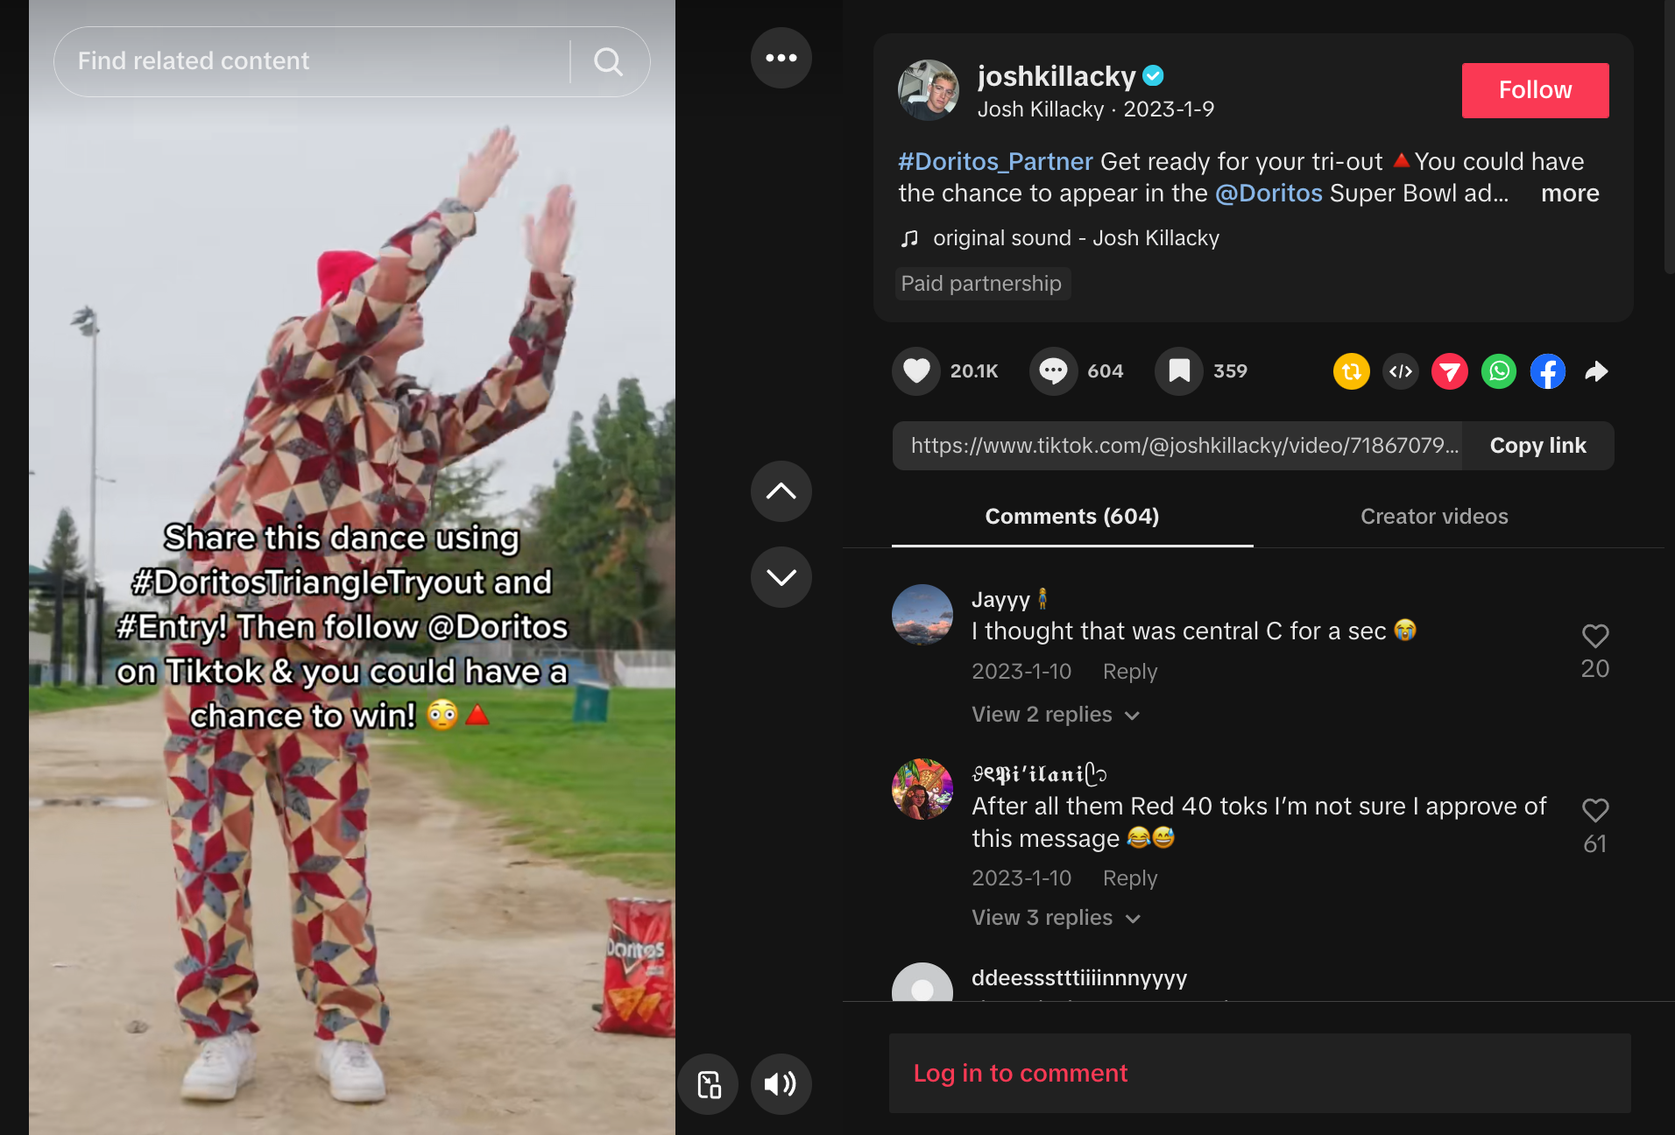

Sponsored
Content
Notes:
Definition of Sponsored Content: Introduce the concept of sponsored content, explaining that many influencers are paid or rewarded for promoting products, services, or brands. These promotions can look like regular posts, but they are usually paid for.
Prominent product placement (e.g., holding a branded product)

Slide 7
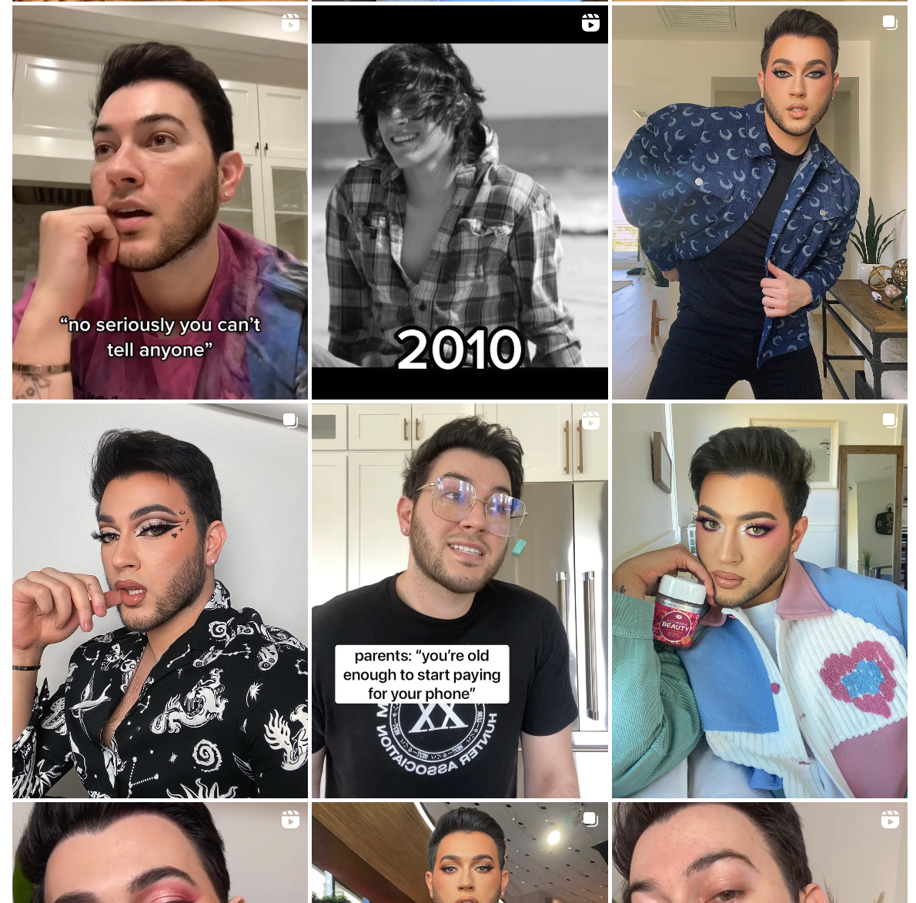
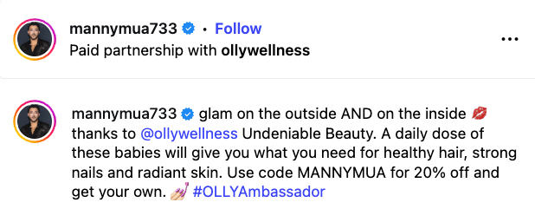
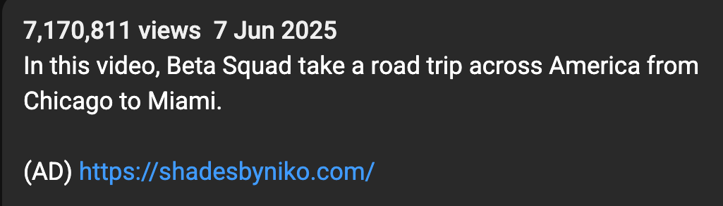
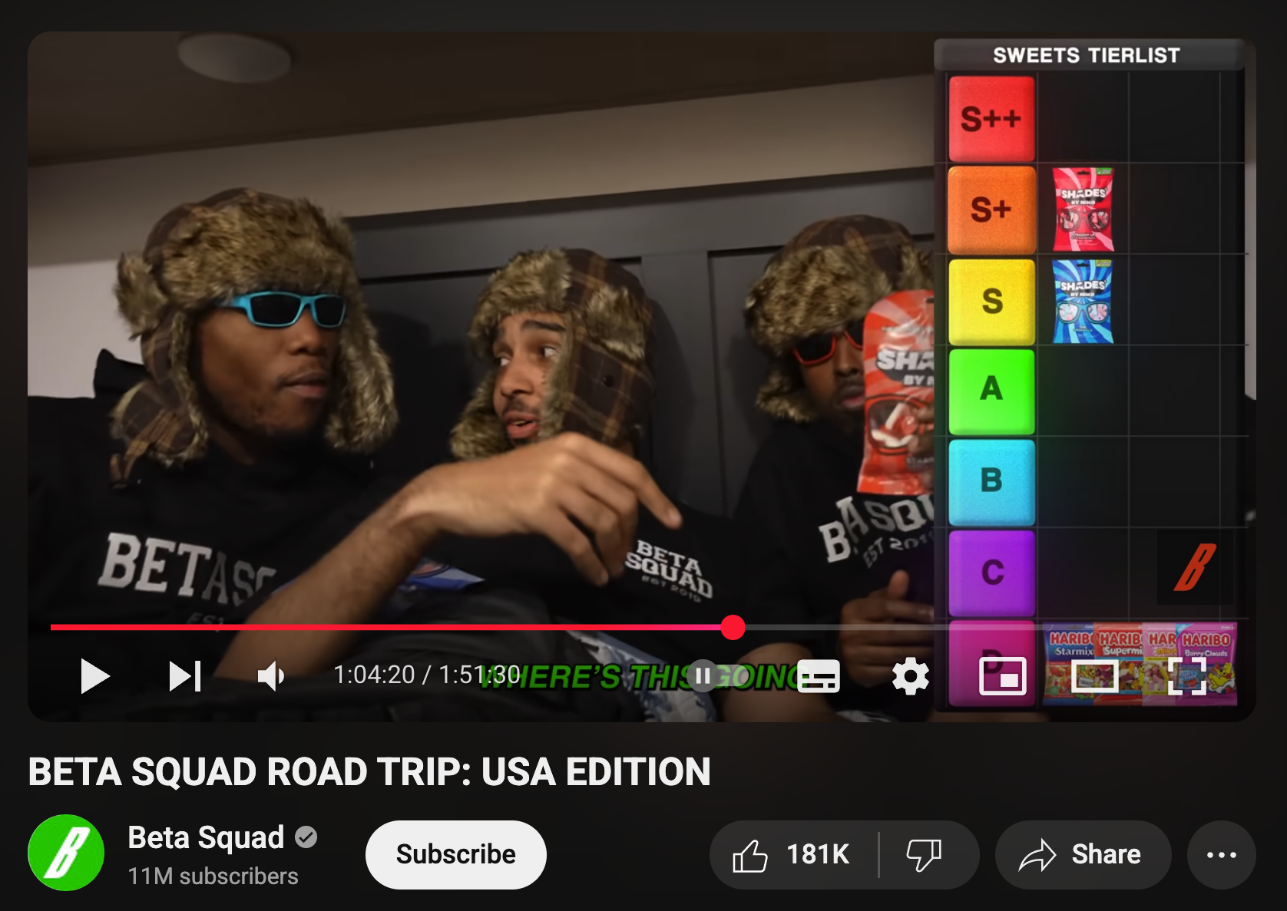
Sponsored
Content
Notes:
A noticeable change in the style or tone of the post (it feels more like an advert than usual)
Links to purchase products or services in posts or stories
Activity: Show students a few social media posts and ask them to identify which ones are likely sponsored. You can use examples from Instagram or YouTube, making sure to include posts that don’t have clear sponsorship labels to show how tricky it can be.
Discussion: Why do you think influencers might hide that something is sponsored or promoted? What might the impact of this be on their followers?

Slide 8
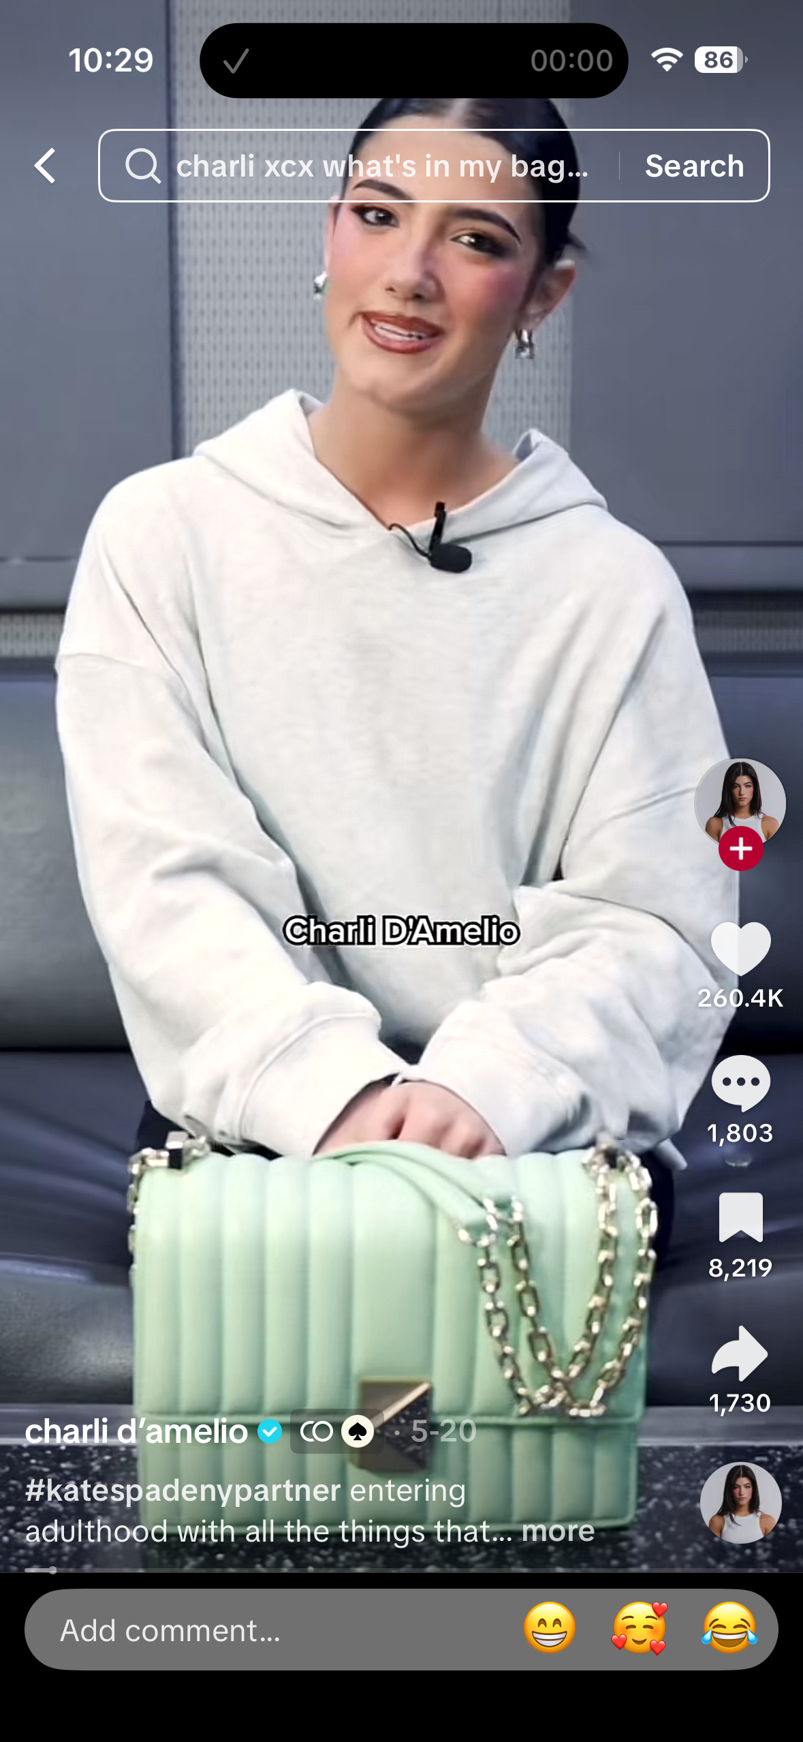
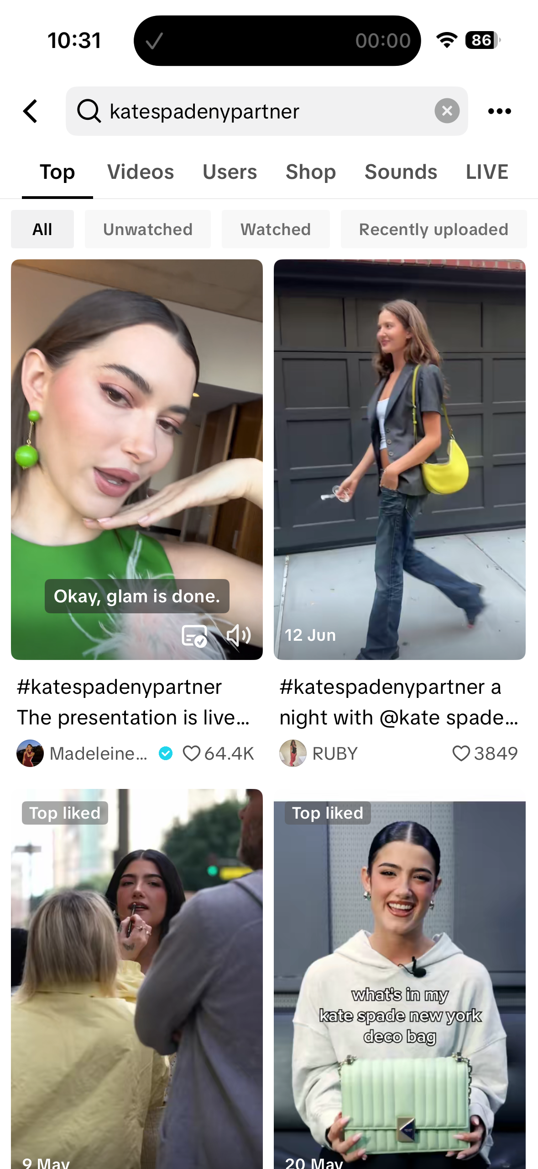
Sponsored
Content

Slide 9
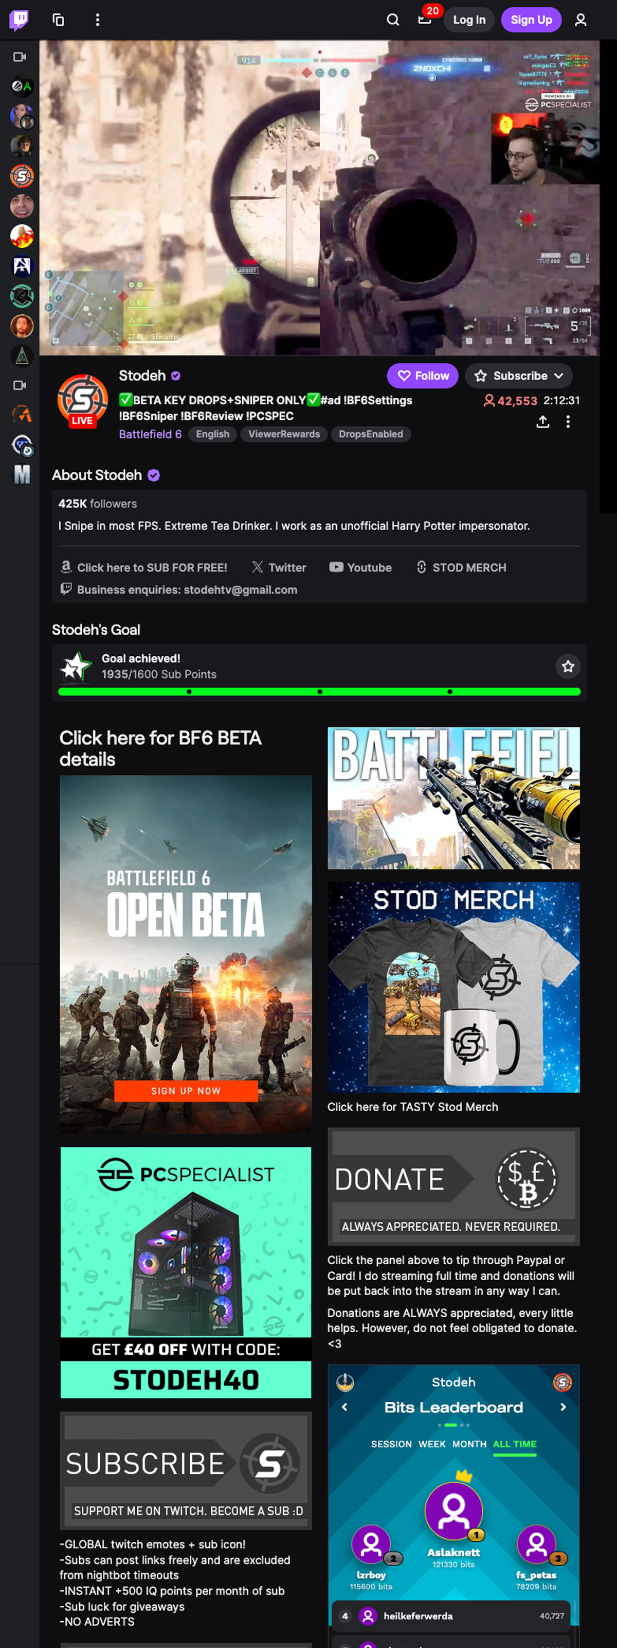
Sponsored
Content
Notes:
Activity: Show students a few social media posts and ask them to identify which ones are likely sponsored. You can use examples from Instagram or YouTube, making sure to include posts that don’t have clear sponsorship labels to show how tricky it can be.
Discussion: Why do you think influencers might hide that something is sponsored or promoted? What might the impact of this be on their followers?

Slide 10

Sponsored
Content
Notes:
Activity: Show students a few social media posts and ask them to identify which ones are likely sponsored. You can use examples from Instagram or YouTube, making sure to include posts that don’t have clear sponsorship labels to show how tricky it can be.
Discussion: Why do you think influencers might hide that something is sponsored or promoted? What might the impact of this be on their followers?

Slide 11
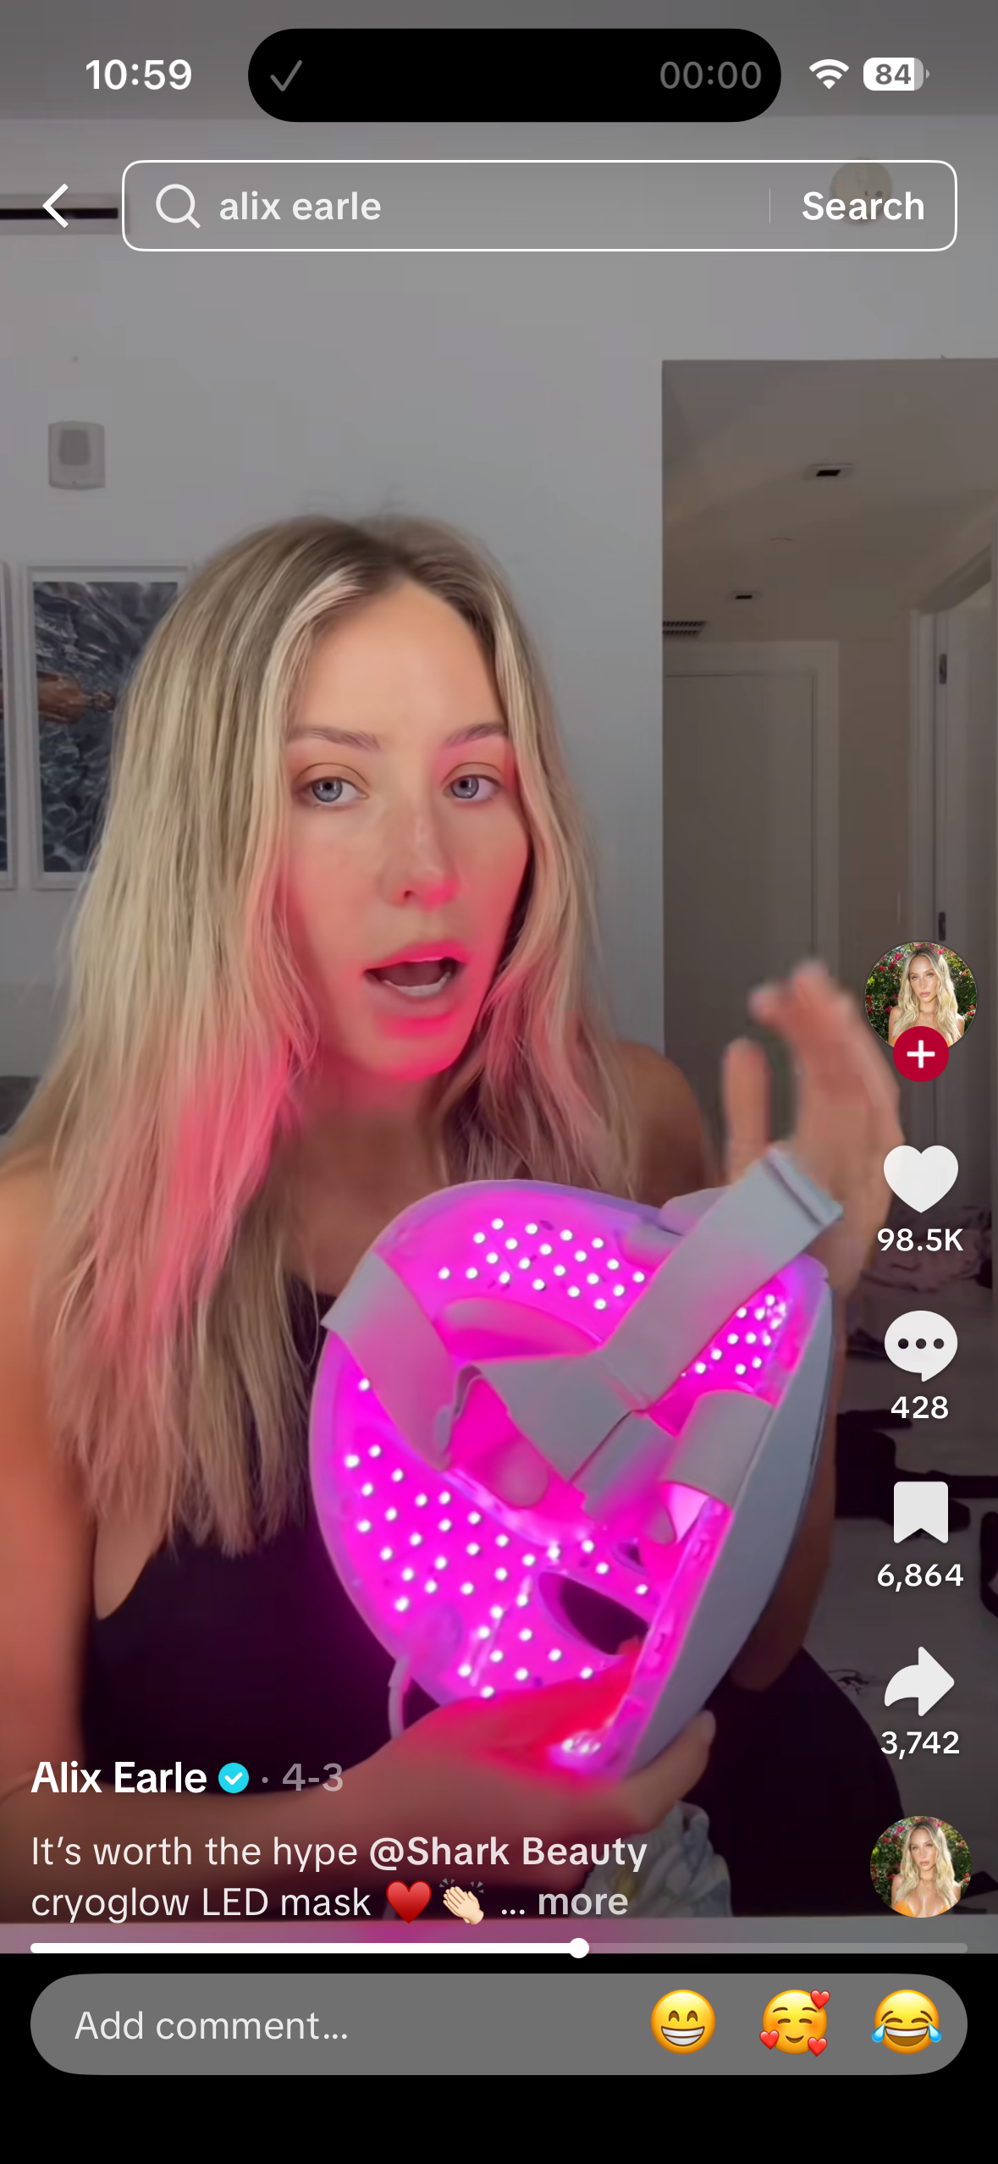
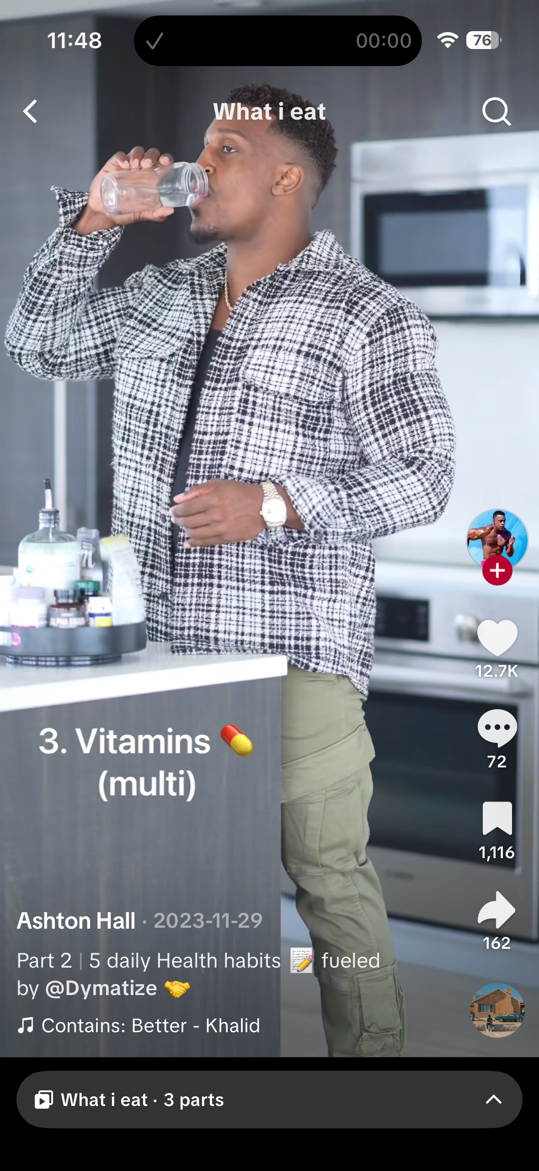
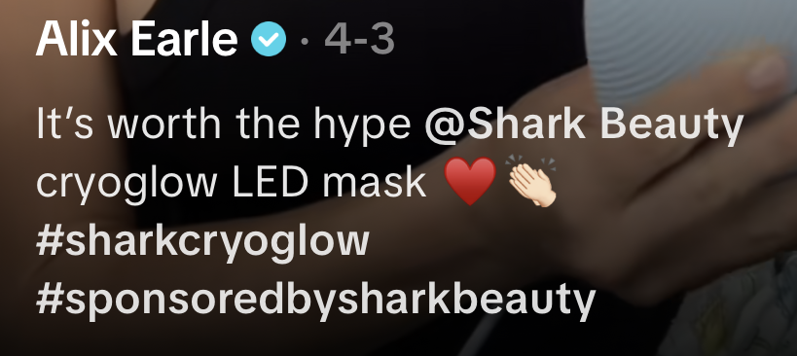
Body Image
Notes:
Body Image and Online Content: Explain that online content can be targeted to influence people's body image, particularly among young people. Many influencers promote unrealistic beauty standards by sharing photos of themselves edited or using filters to appear “perfect.”
Targeted Content and Purchasing Choices: Influencers are often paid to promote products related to body image, like weight loss supplements, beauty products, or fashion brands. Explain that these products may create pressure for followers to look a certain way.
Discuss:
Ask pupils to think about the last time they saw an influencer promoting a product or lifestyle.
Ask them to consider how this content made them feel. Did it create any pressure to look or act a certain way?
How does social media contribute to body image issues, especially for young people?
How can influencers shape what we believe is beautiful or valuable?

Slide 12

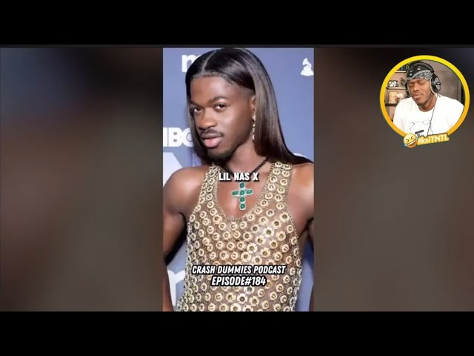

Negative
Influencing
Some products advertised can be negative influences and normalise harmful behaviour.
That’s A Lil Gay
15K views
Homophobic comments in the video title.
©Ineqe Group LTD 2025
Notes:
What influence does this image have? Pupils to discuss in pairs before sharing with class. Pupils to point out the negative video title, the clear bullying of another individual, the homophobia.
Discussion: Why do you think some influencers may promote negative or harmful content? Why is it important to be critical of what you see online, especially when influencers might make something look easy or desirable?
Discuss the potential harm examples like this video can cause to followers.

Slide 13
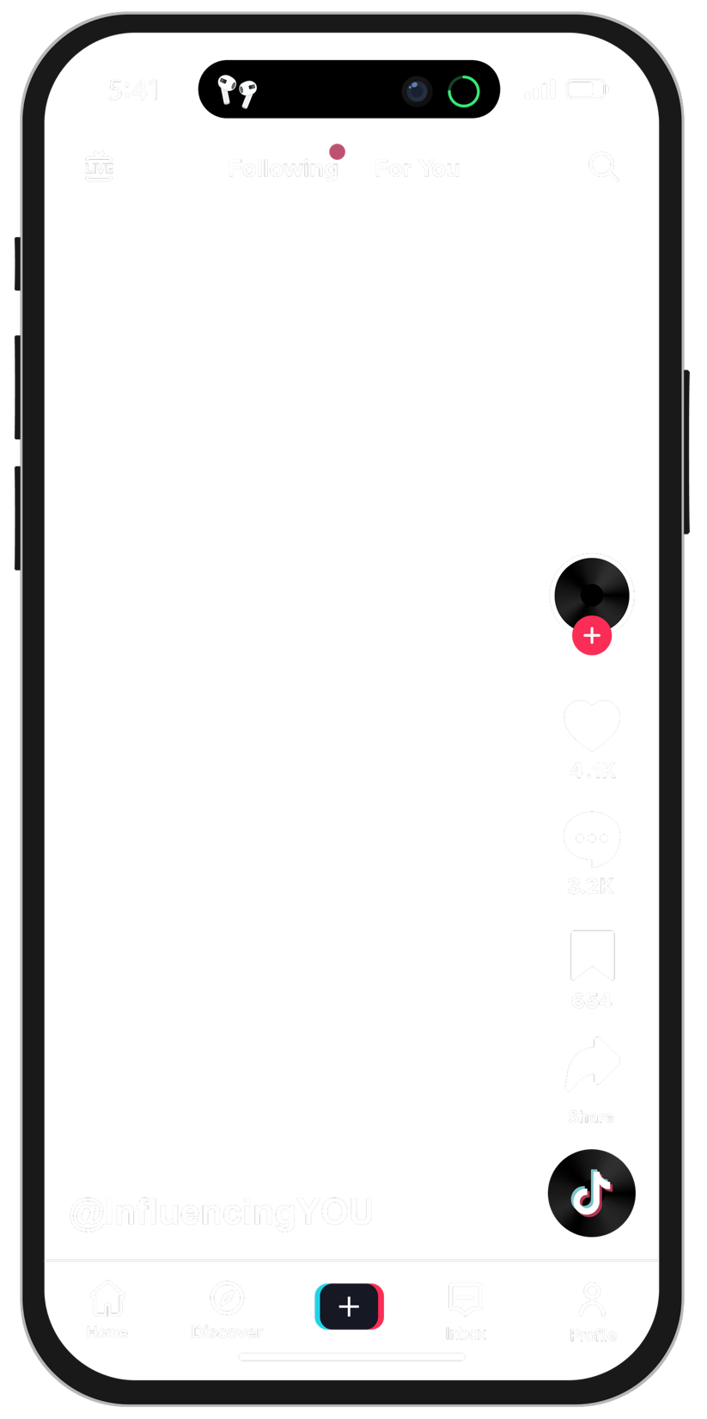
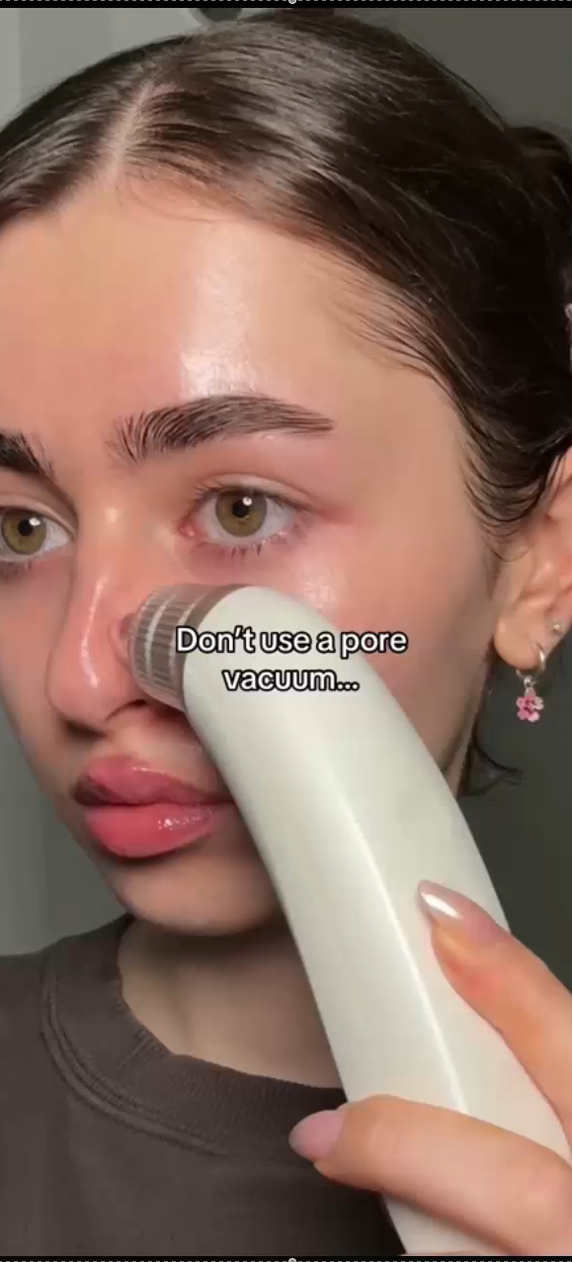
Negative
The list of products this TikTok account promotes using for skincare includes:
Influencing
Pore strips
Clay masks
Carrot juice
Salmon
LED mask
Tretinoin
Avocado
Clean makeup brushes
Eat clean
Face masks
Gua-shaing
Ice-bowling
Putting garlic on your skin
Eating aloe vera
Panoxyl cream
Pimple patches
Eating:
Steak
Cottage cheese
Zucchini
Dark chocolate
Strawberries
Red peppers
Broccoli
Sweet potato
Beef tallow
Using Korean skincare
Spearmint tea
Okra Water
Hypochlorous acid spray
Some products advertised can be negative influences and encourage you to buy products that aren’t right for you, or you don’t need.
Notes:
Tiktok profile: https://www.tiktok.com/@danicolexx

Slide 14
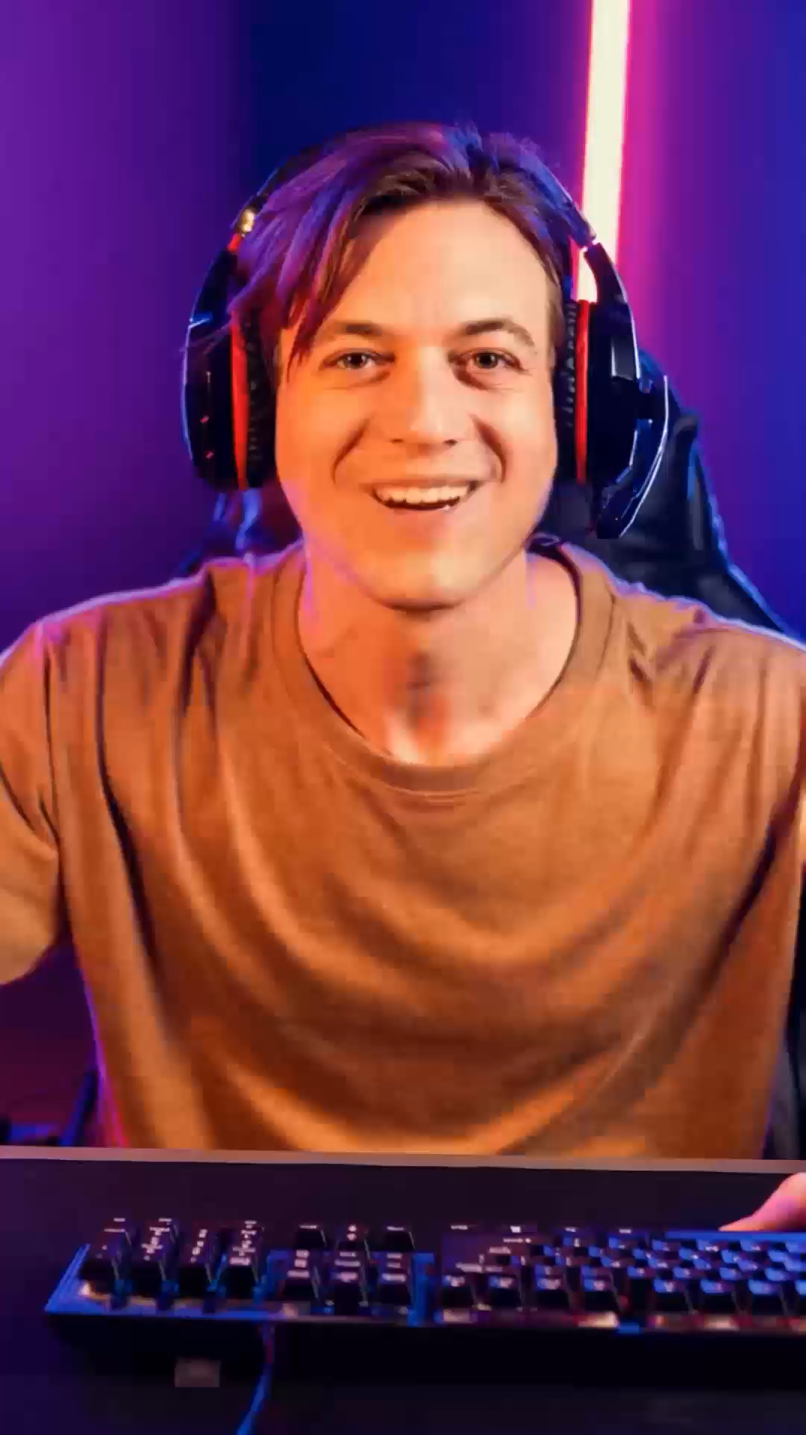
Name the
Influencer
This is an AI Generated video!
Notes:
Ai tools used: Freepik AI Suite (present AI influencer) Ask pupils if anyone know the name of this influencer? Would they be interested in watching their videos? What age do they think they are? – gather information from pupils.
Reveal the video is an AI-generated influencer. One of the latest dangers with influencer culture is that brands can create an AI-generated influencer to influence people to buy products/services or take part in harmful behaviours. There are some signs to look out for to question if a video is real or AI-generated.

Slide 15
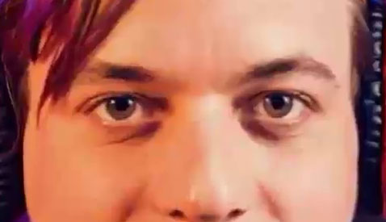
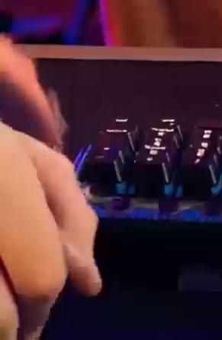
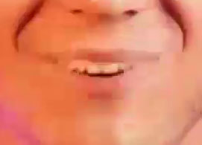
Name the
No blinking.
Influencer
No natural pauses in the audio.
Misalignments between lip movements and the audio.
Glitches
Notes:
There are some signs that you can look out for when watching videos to decide if the video is AI-generated or real. Look for signs such as no natural pauses in the audio, there are misalignments between lip movements and the audio, and the person is not blinking. There are also usually distortions in the background of the video, such as glitches or strange pattern noise.

Slide 16

Reflection

Slide 17
Self Assessment
To describe how to tell when online content has been paid for or promoted by companies or influencers.
To explain how online content is designed to influence how people feel, what they buy and how they behave.
To explain how and why some people use online platforms to influence others in negative ways, with examples.
To explain that some influencers online are not real people but computer-generated characters created to promote products or lifestyles.
©Ineqe Group LTD 2025
©Ineqe Group LTD 2025

