Slide 1
Image Sharing

Slide 2
According to Childline…
Over 20,000 counselling sessions on sexual health, relationships and sexual abuse
45% of all sessions related to mental and emotional health
Sex & sexual health is the #1 message board topic

Slide 3
Learning Objectives
Understand sexting and the law
Deepen our knowledge of what to do/who to speak to if we were worried
Learn more about the dangers of sexting and sextortion
Reflect on how easily an image can be shared

Slide 4
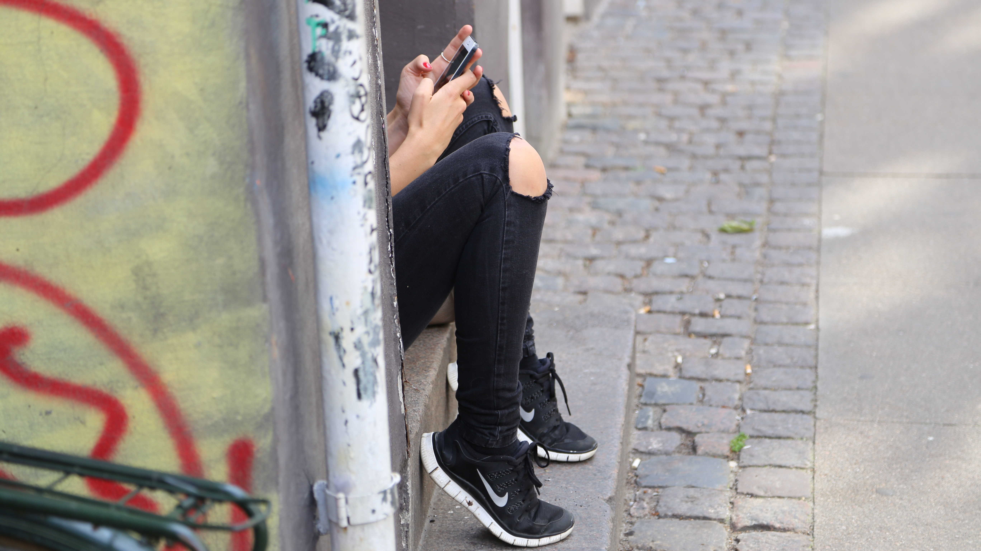
Sexting
Have you heard of this term before?
What other words might you use?

Slide 5
Sexting and the law
Indecent images of someone under 18 are illegal to create, send, have or receive.
However, the law is there to protect young people. If you have seen or shared an indecent image, report it straight away.

Slide 6
What to do if you see or share an indecent image?
The quicker an image is reported, the easier it is for internet platforms and the police to take the image offline and stop it being shared.
Speak to a trusted adult. They will know who to speak to and how to help you.
Speak to Childline, either online or on the phone (0800 1111).

Slide 7
Things to remember
Sending an image of yourself means it can be shared with others.
Always talk to a trusted adult or to Childline if you are worried.
Platforms like Twitter, Facebook and Google can remove images and prevent them spreading further.
Sexting can lead to online bullying, grooming or emotional stress.

Slide 9
Scenario 1
Tom (17) makes a friend on Instagram. He finds her really attractive and they begin flirting. They had never met in real life. The only image he has ever seen of her is her Instagram pictures. She asks him to share an image of his body. Tom sends it as he wants to impress her. Once she receives the message, she tells Tom that she is going to share the indecent image of him on social media unless he pays her to stop.
What would you do if this was your friend?
Notes:
Video/ audio

Slide 10
Scenario 2
Samantha (16) met Jack (19) online. They flirted and got on quite well. After talking for two weeks, they decided to meet in person. Samantha has been on a date with Jack. They both enjoyed the date. It is getting quite late and Samantha goes home. As she gets back to her bedroom she receives a Snapchat message from Jack.
”Great date babe” – Jack
”Yeah… Had top banter didn’t we?”
“For sure… We should probs finish off the date then?”
“What you mean?”
“I mean send me (peach emoji)”
“No. Don’t ruin it.”
“Go on. You was flirting all night. You know you wanna”
As her friend, Samantha texts you for advice.
What would you do if this was your friend?

Slide 11
Are you a Safer School?
Contact us to find out!
028 9600 5777
saferschools@ineqe.com
www.oursaferschools.co.uk

