Slide 1



Image
Sharing

Slide 2
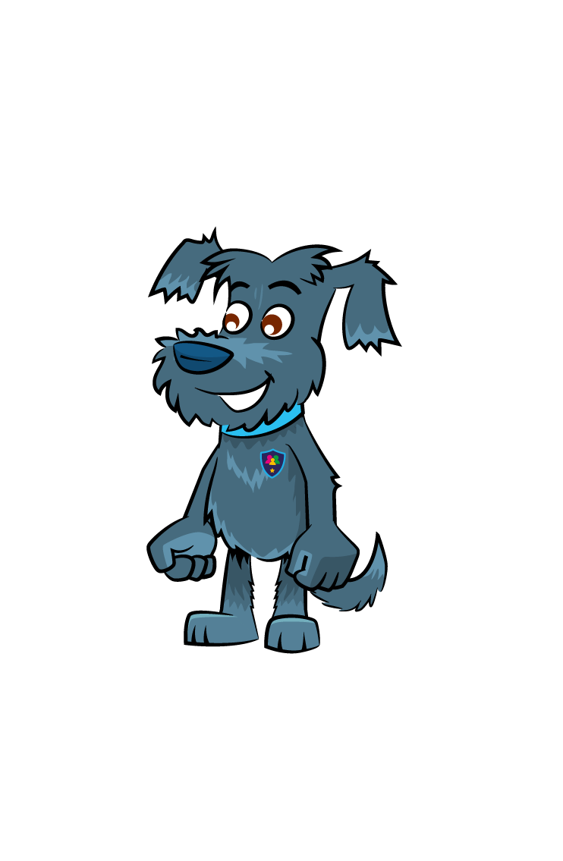

Learning Objectives
Understand consent for sharing images
Reflect on how easily an image can be shared

Slide 3



Sharing Images
What do you take pictures or videos of?
Who do you share them with?

Slide 4
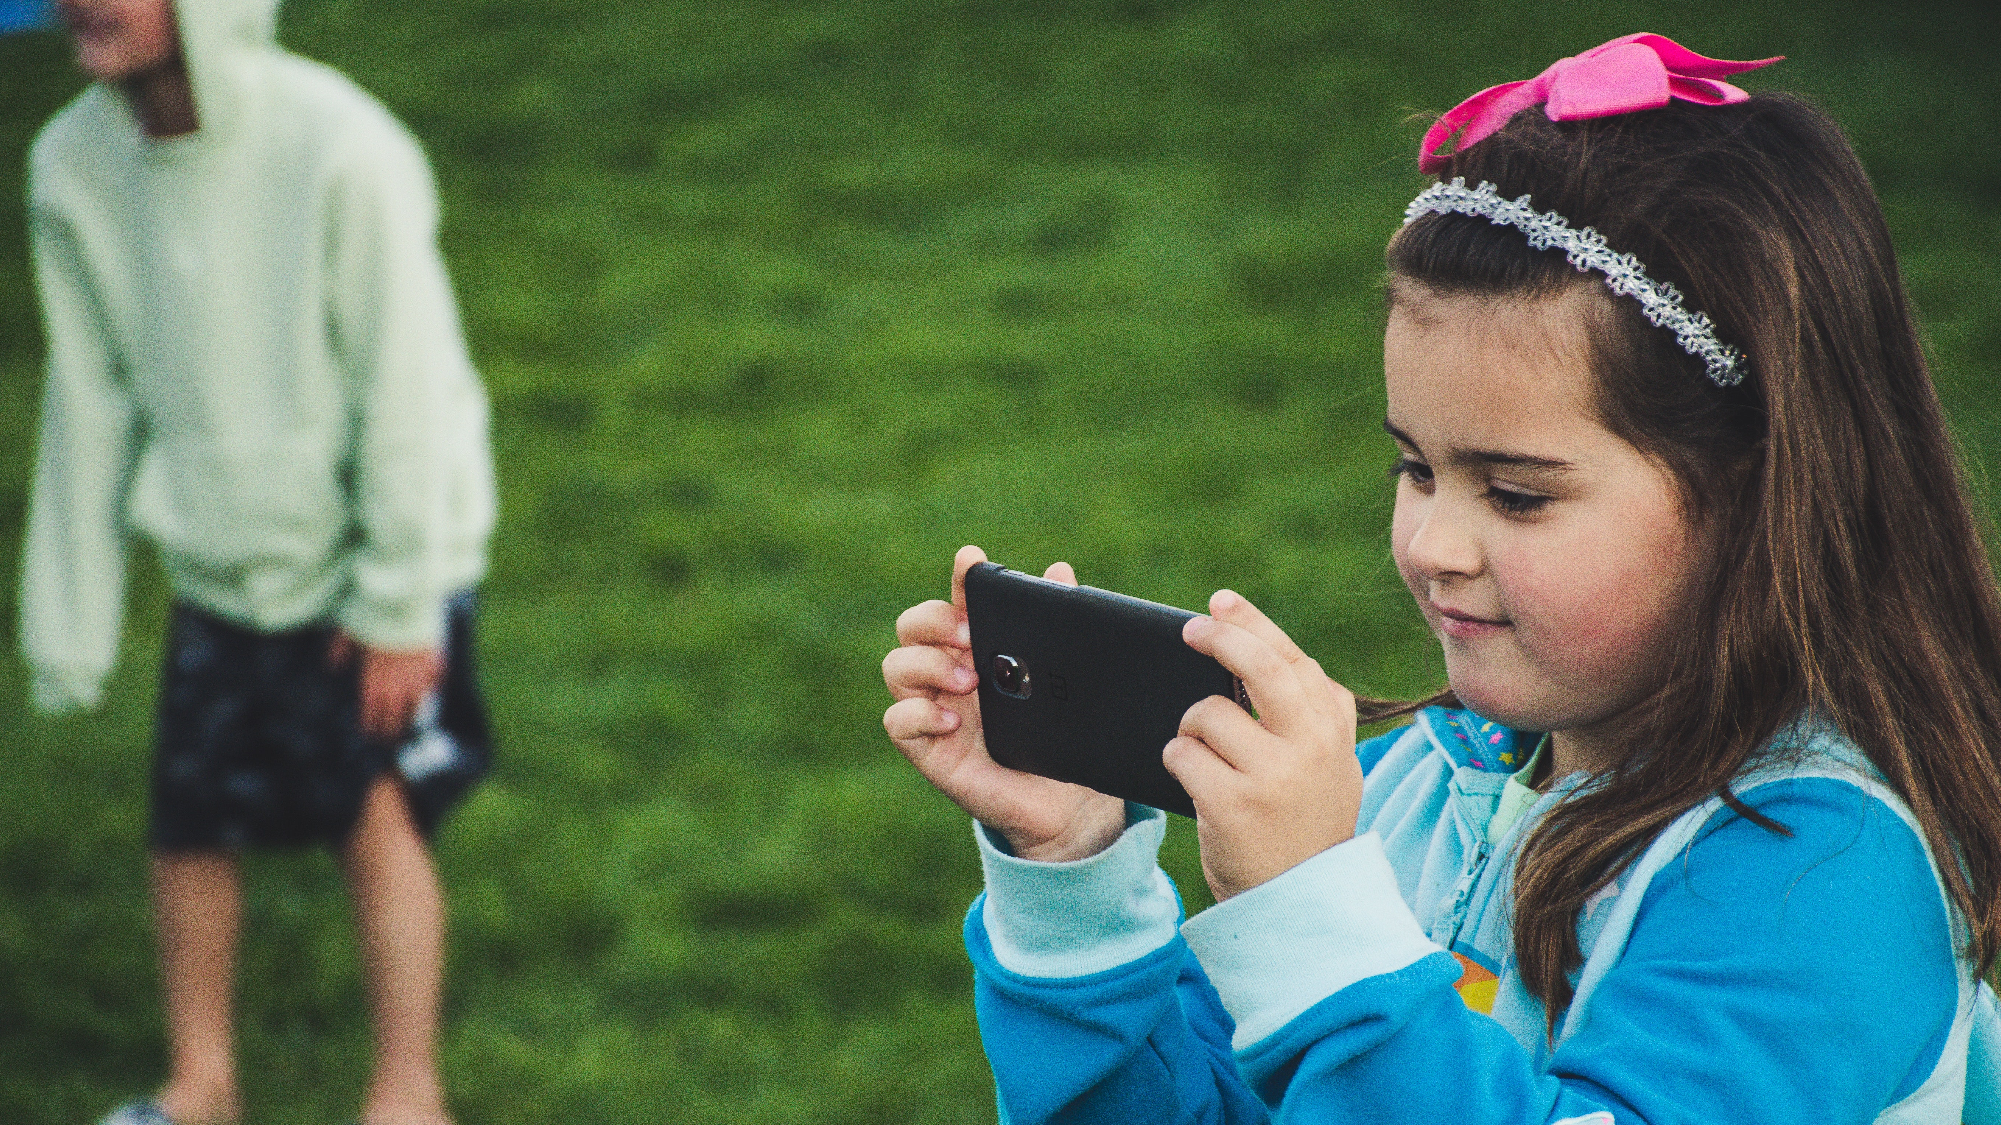
Did you know there are
rules for sharing images?
You need consent to take and share images/videos of others.
People also need your consent to take/share your image.

Slide 5
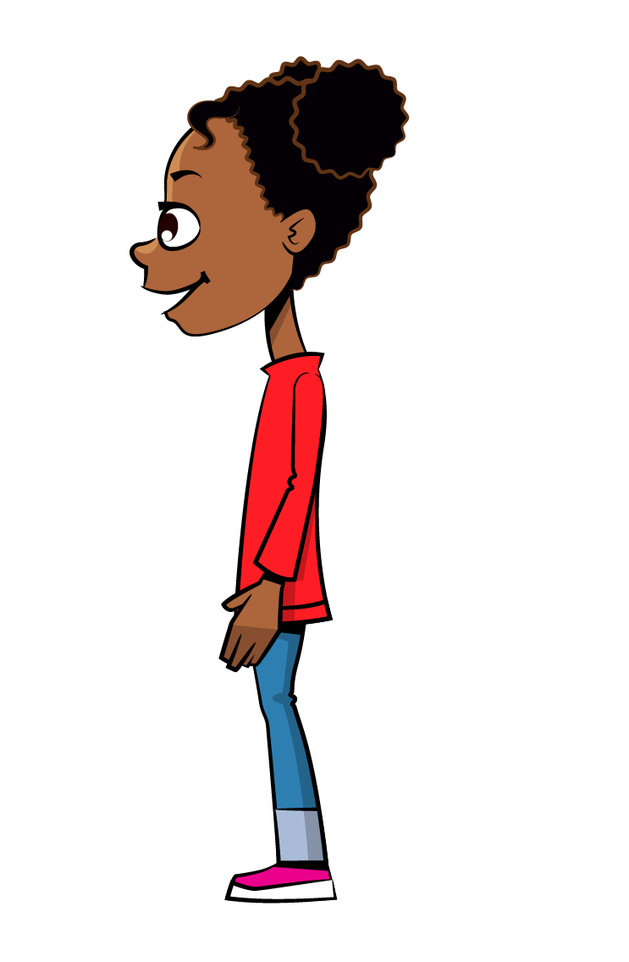

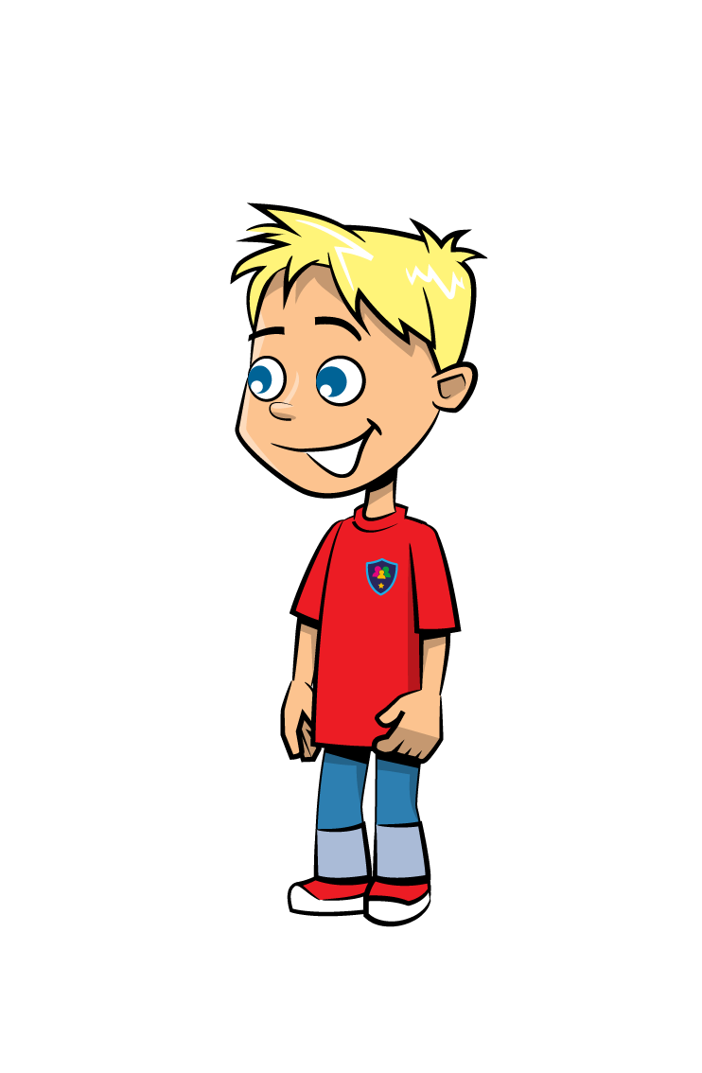

What to do if you see or share an
indecent image
The quicker an image is reported, the easier it is for internet platforms and the police to take the image offline and stop it being shared.
Speak to a trusted adult. They will know who to speak to and how to help you or…
Speak to Childline, either online or on the phone (0800 1111).

Slide 6
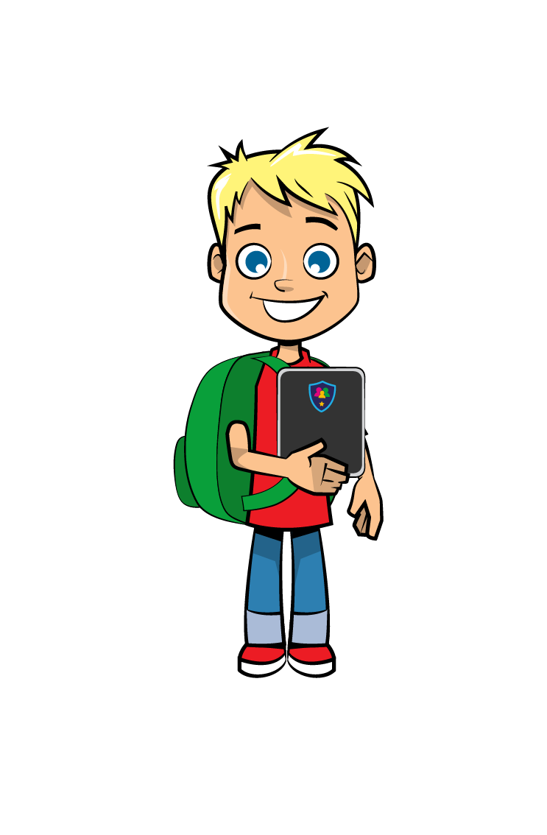


Things to remember
Sending an image of yourself means it can be shared with others.
Always talk to a trusted adult or to Childline if you are worried.
Platforms like Twitter, Facebook and Google can remove images and prevent them spreading further.

Slide 7

String task
Gather in a circle.
Hand out 4 balls of string to 4 pupils.
They must hold the end of the string and throw the ball when instructed.

Slide 8
String task
Ball 1 – The people you have shared an image with.
Ball 2 – Those people sharing your image.
Ball 3 – The people who have searched and found your image.
Ball 4 – People who have seen the image being re-shared.

Slide 9

Scenarios
We’re going to look at some scenarios together to help us reflect on what we learned earlier about consent and what to do if you see or share an inappropriate image.
For each scenario, tell me how you would help if it was your friend in that situation.

Slide 10


Slide 11
Scenario 1
Daniel (12) has met Jenny online through Fortnite. They become good friends and begin to message on WhatsApp. Judging by her profile picture, Daniel guesses that Jenny is older than him and might even be over 18. He thinks she is incredibly pretty and she is very friendly and kind. Daniel asks if he can add her on twitter, snapchat or Instagram. She tells him that she doesn’t have social media. Jenny asks Daniel to share a picture of himself.
What would you do if this was your friend?

Slide 12

Scenario 2
Kherissa (11) is on a camping trip with her school. One of the girls has managed to sneak her phone on to the trip. She starts livestreaming on periscope from the girls’ shared bedroom. Kherissa tells her to stop as she is getting changed. The girl does not stop and films Kherissa as she gets changed.
What would you do if this was your friend?

Slide 13

Self-assessment: or
Understand consent for sharing images
Reflect on how easily an image can be shared

Slide 14



Are you a Safer School?
Contact us to find out!
028 9600 5777
saferschools@ineqe.com
www.oursaferschools.co.uk

