Slide 1
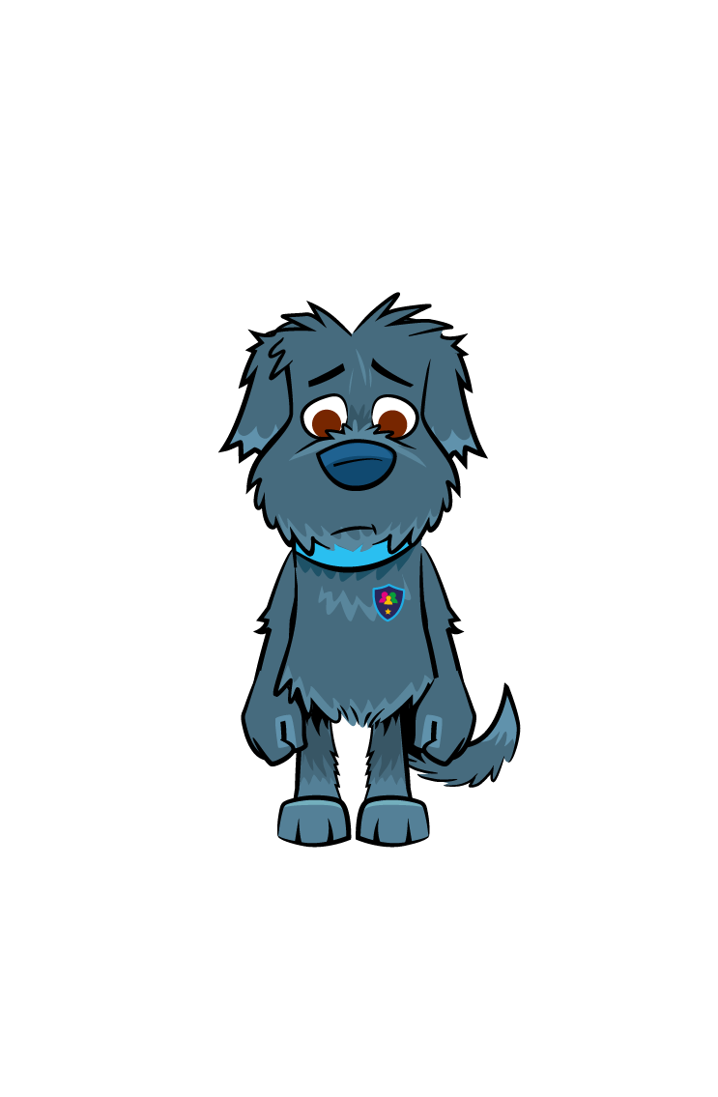

Fake
News

Slide 2

Learning Objectives
Learn to identify if news is real, fake or satire.
Understand how to spot Fake News.
Develop our knowledge on how to challenge Fake News.

Slide 3

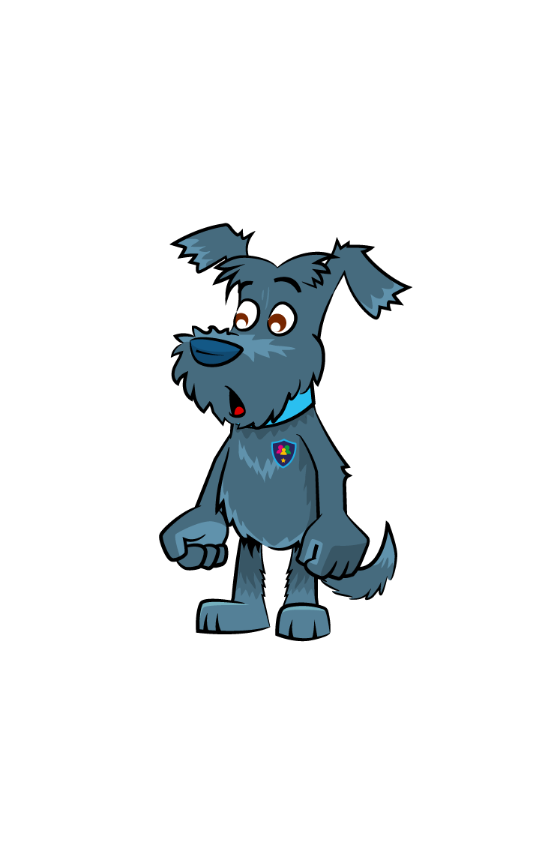

How to spot Fake News:
Research – check the publisher.
Evidence – check the sources.
Analyse – check the date.
Learn – google the quotes.

Slide 4

How to spot Fake News:
Facts – use a fact checker.
Attention – pay close attention to images.
Knowledge – look at what the experts are saying.
Examine – look at the language used – is it dramatic or hyperbolic?

Slide 5





How you can challenge Fake News:
Is the story from a credible newspaper, website or platform?
Are other platforms, news companies or websites reporting on it?
Is it for or against something?
Do the sources check out?
Does the URL or link look legit?
Is it simply telling me something or trying to shock or worry me?
Ask - who wrote this? Why did they write it?

Slide 6
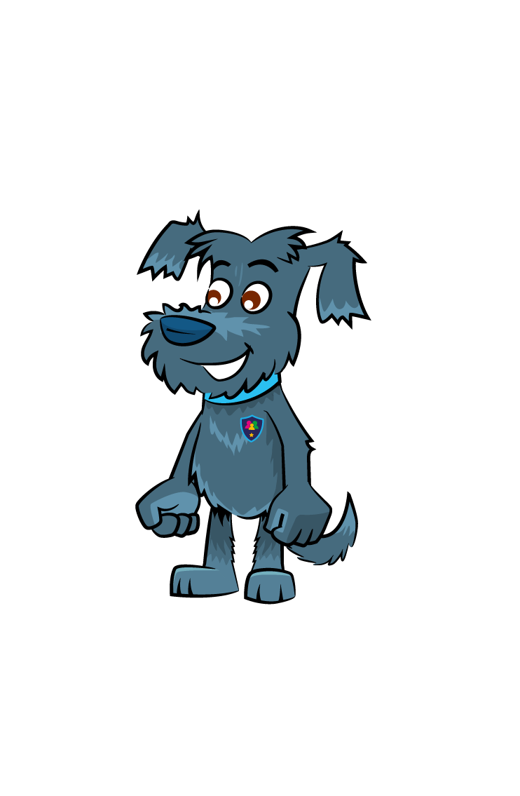

What is satire?
Satire sometimes uses words with double meanings, puns or silly quotes.
Satire often mocks, jokes or parodies current events.
Satire is different from fake news; it uses sarcastic comedy on purpose to entertain people.
If something is sarcastic, odd, funny and dramatic at the same time, it might be satire.

Slide 7





Spot the fake news
FAKE
SATIRE
FAKE
REAL
REAL
FAKE
SATIRE
Can you identify if the following news stories are real, satire or fake?
REAL
REAL
SATIRE
FAKE
FAKE

Slide 8
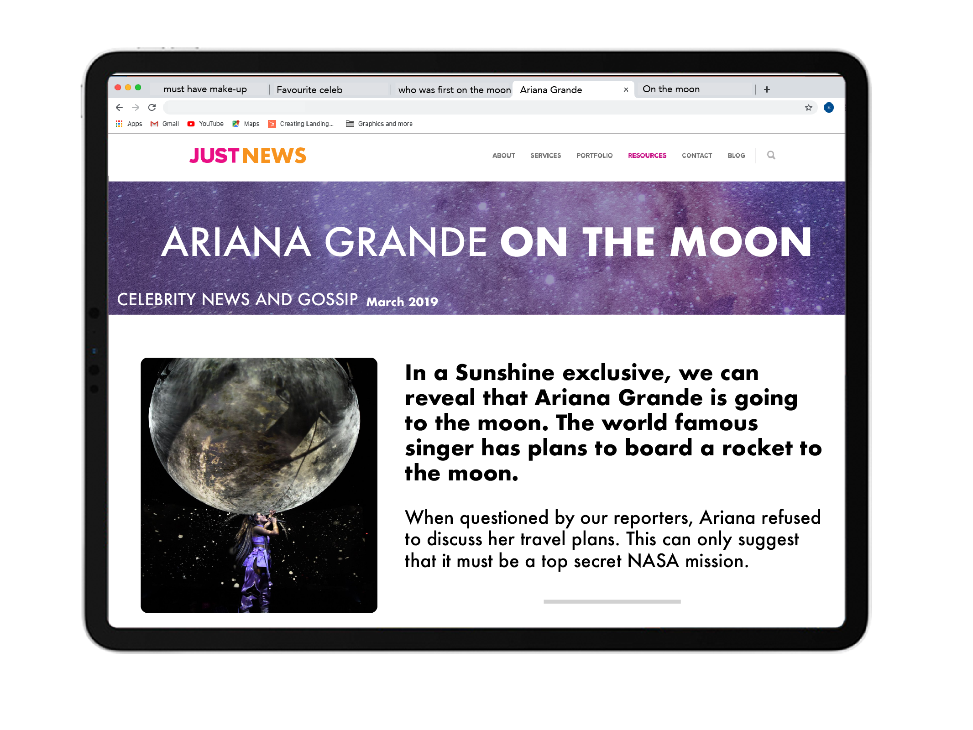





Slide 10


Slide 11


Slide 14
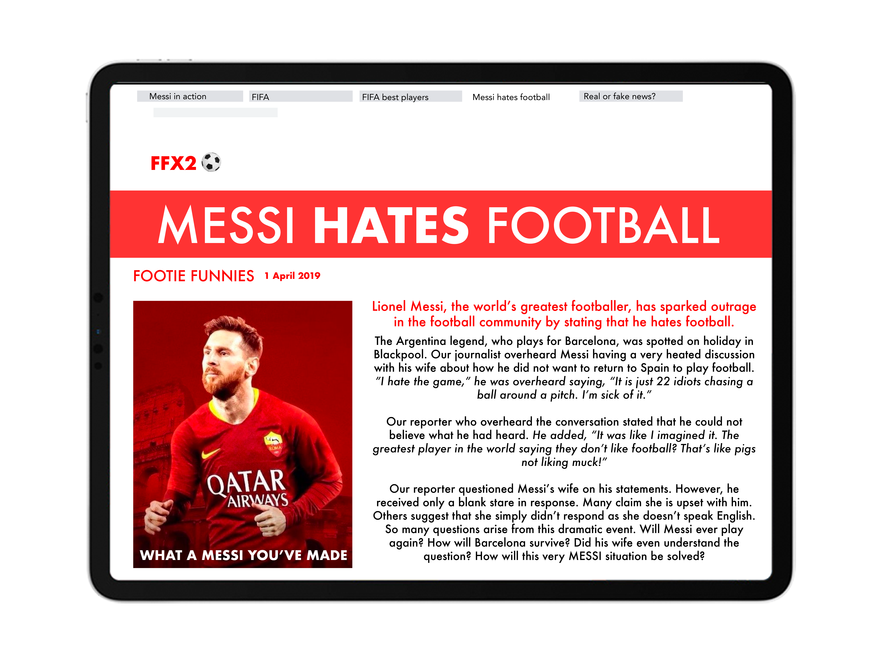

Slide 17

Task
We’re going to create a poster for the other pupils in our school on how to spot Fake News.
The poster must contain instructions for how to identify Fake News.

Slide 18



Have you downloaded the Safer Schools App? Scan below!

