Slide 1



Fake News

Slide 2

Learning Objectives
Learn to identify if news is real, fake or satire.
Understand how to spot Fake News.
Develop our knowledge on how to challenge Fake News.

Slide 3


How to spot Fake News:
Research – check the publisher.
Evidence – check the sources.
Analyse – check the date.
Learn – google the quotes.

Slide 4


How to spot Fake News:
Facts – use a fact checker.
Attention – pay close attention to images.
Knowledge – look at what the experts are saying.
Examine – look at the language used – is it dramatic or hyperbolic?

Slide 5




How you can challenge Fake News:
Is the story from a credible newspaper, website or platform?
Are other platforms, news companies or websites reporting on it?
Is it for or against something?
Do the sources check out?
Does the URL or link look legit?
Is it simply telling me something or trying to shock or worry me?
Ask - who wrote this? Why did they write it?

Slide 6


What is satire?
Satire sometimes uses words with double meanings, puns or silly quotes.
Satire often mocks, jokes or parodies current events.
Satire is different from fake news; it uses sarcastic comedy on purpose to entertain people.
If something is sarcastic, odd, funny and dramatic at the same time, it might be satire.

Slide 7
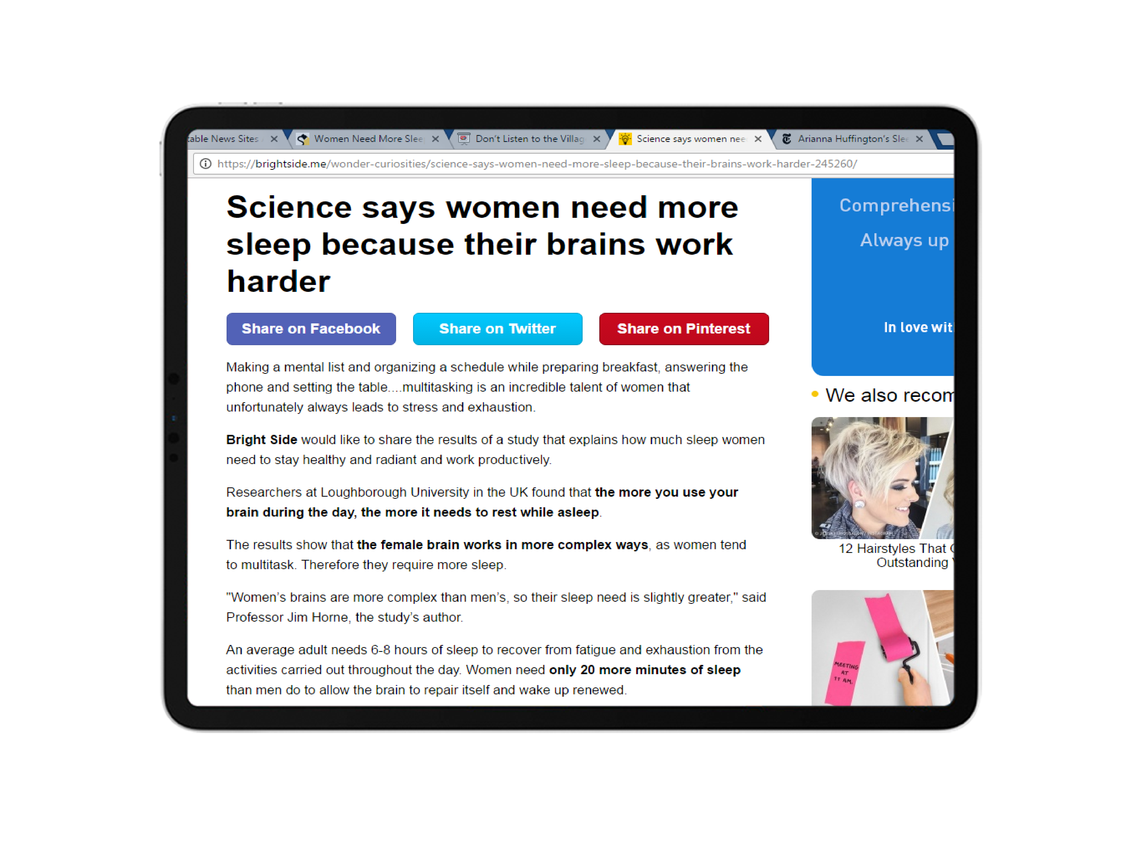
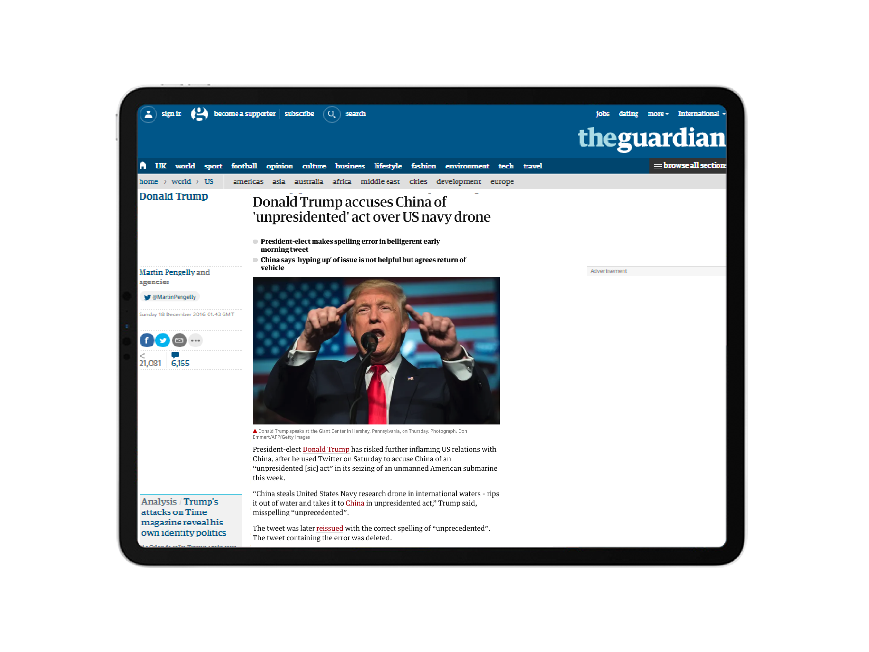
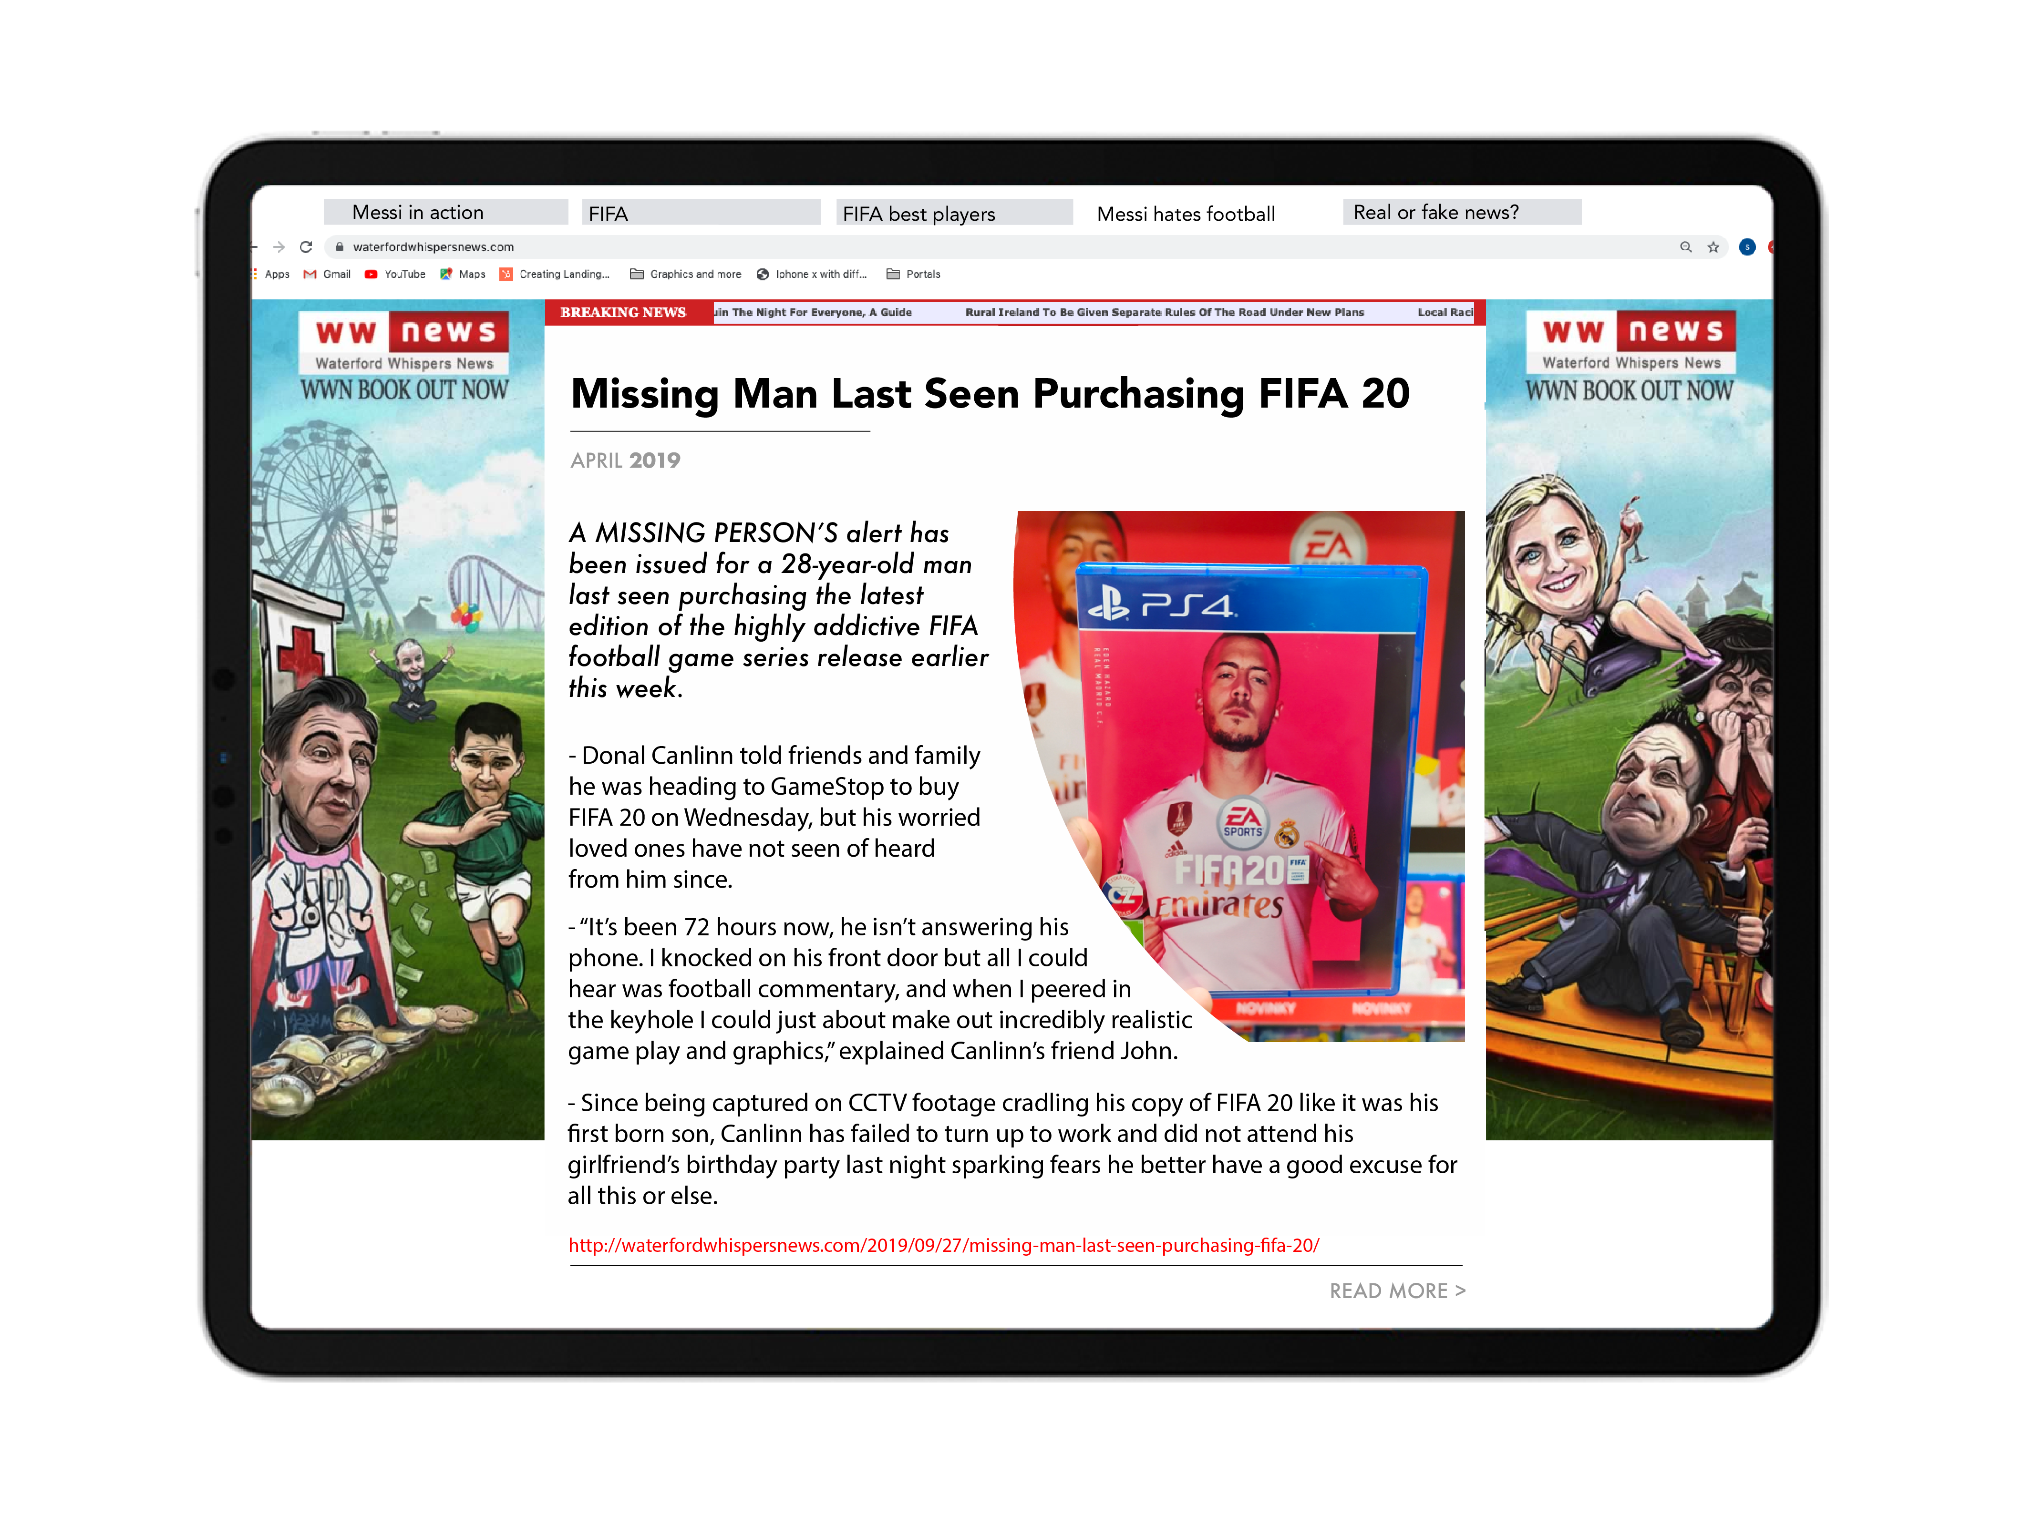
Task
News Evaluation
I am going to show you a series of News stories.
You must use your evaluation sheet to assess whether you think the article is Real, Fake or Satire.

Slide 10
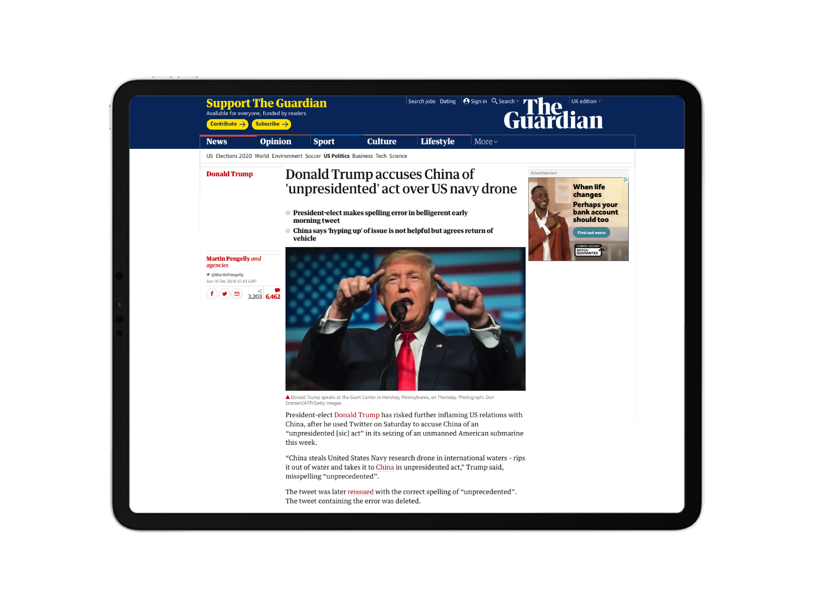

Slide 11

Feedback
Let’s review our worksheets together
and see whether we think each story is real, fake or satire.

Slide 12




Are you a Safer School?
Contact us to find out!
028 9600 5777
saferschools@ineqe.com
www.oursaferschools.co.uk

