Slide 1
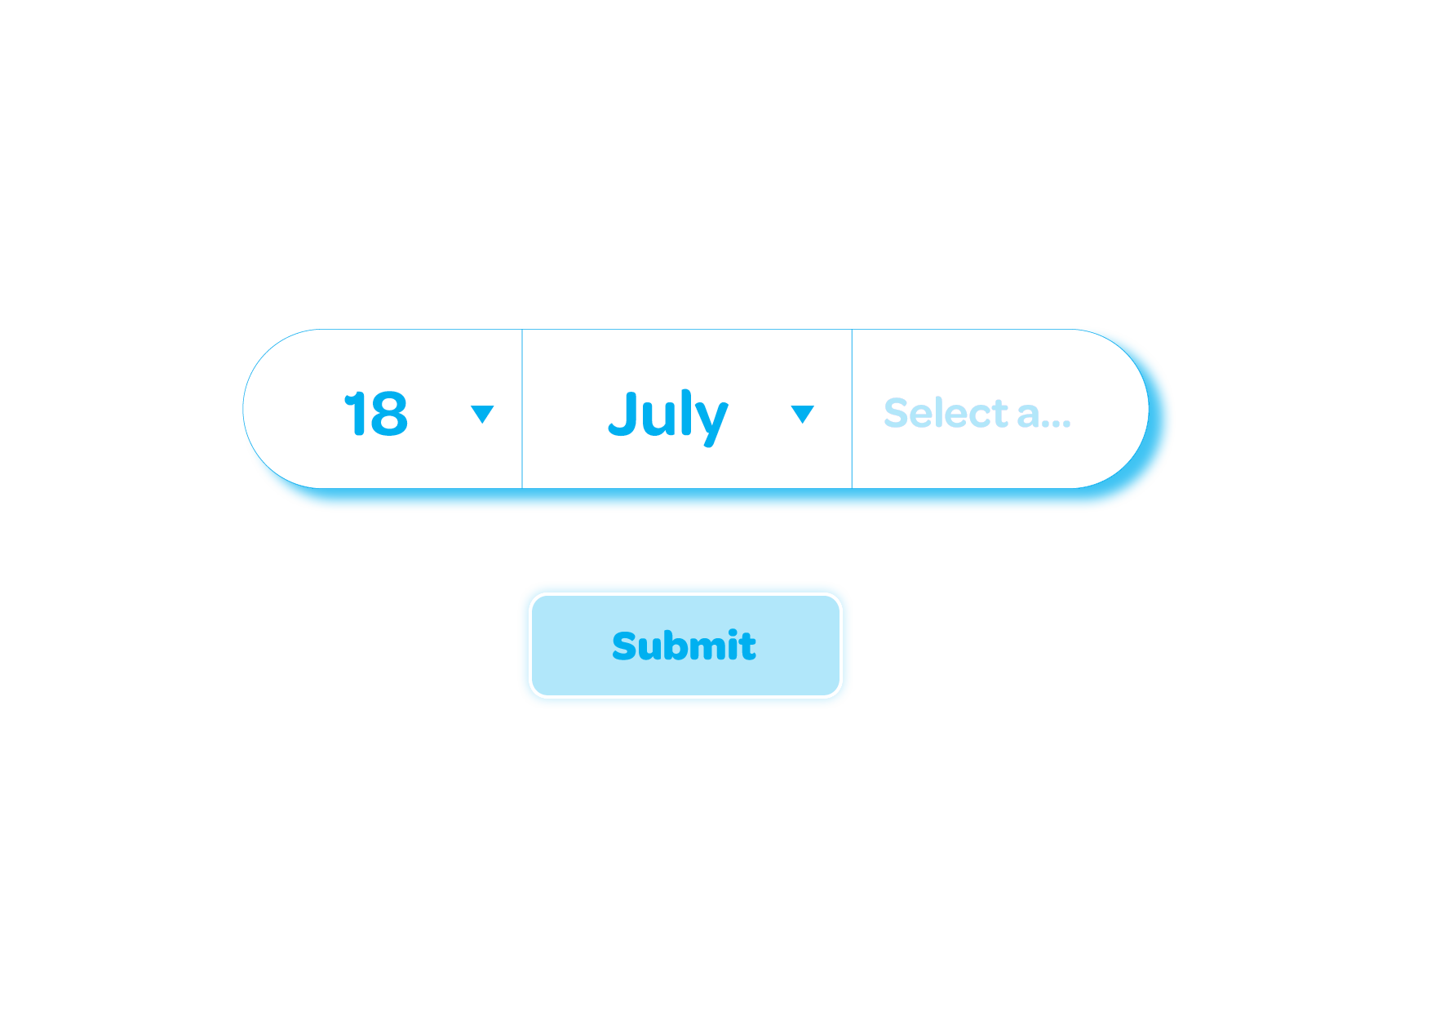


Age Verification
The Benefits of Using Your Real Age Online
© Ineqe Group Ltd 2023

Slide 2
Learning Objectives
Understand the dangers of using a fake age online.
Understand the benefits of using your real age online.
© Ineqe Group Ltd 2023

Slide 3








Hands up who uses social media?
How old do you need to be to use these apps?
© Ineqe Group Ltd 2023
Notes:
All = 13 apart from WhatsApp which is 16

Slide 4



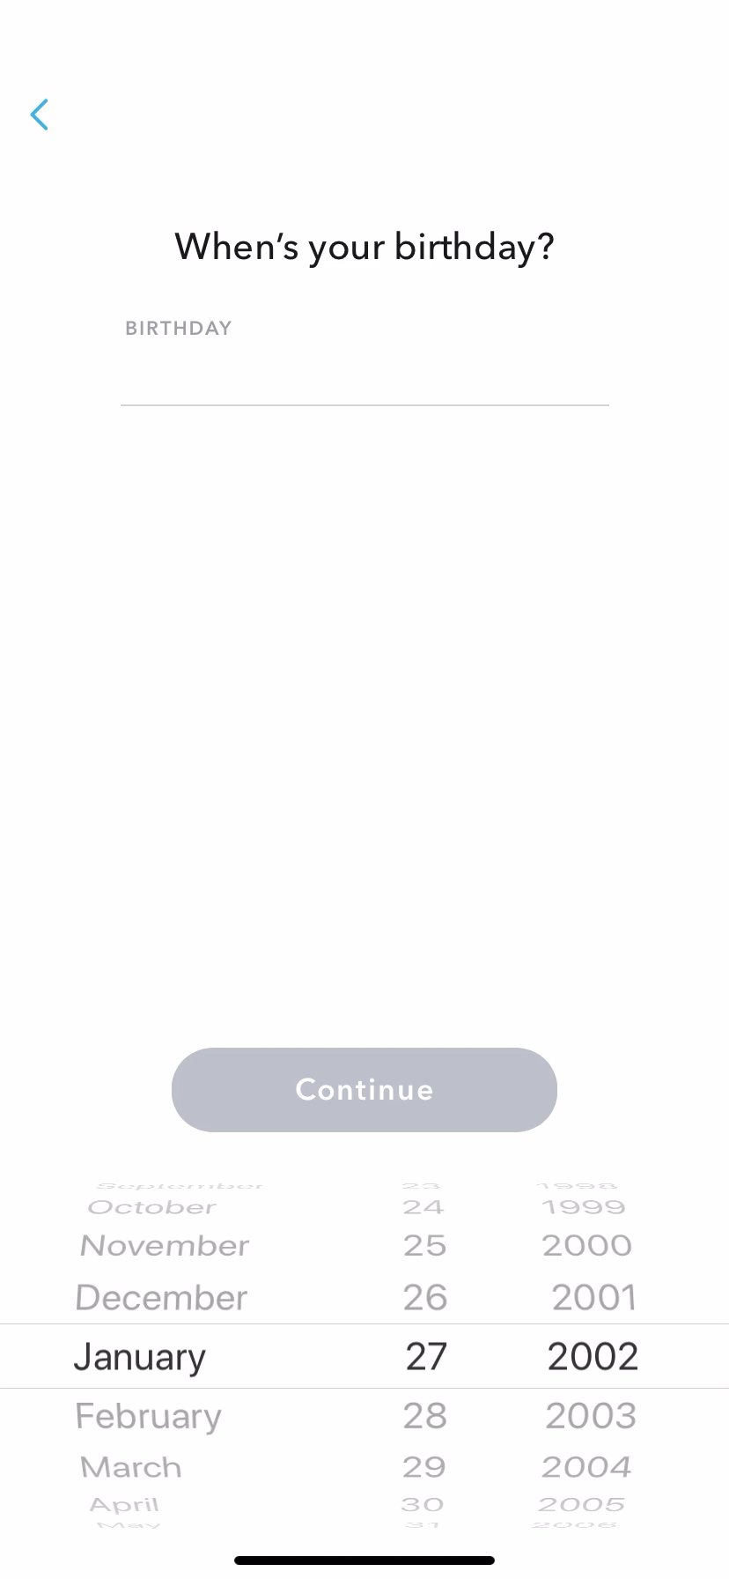
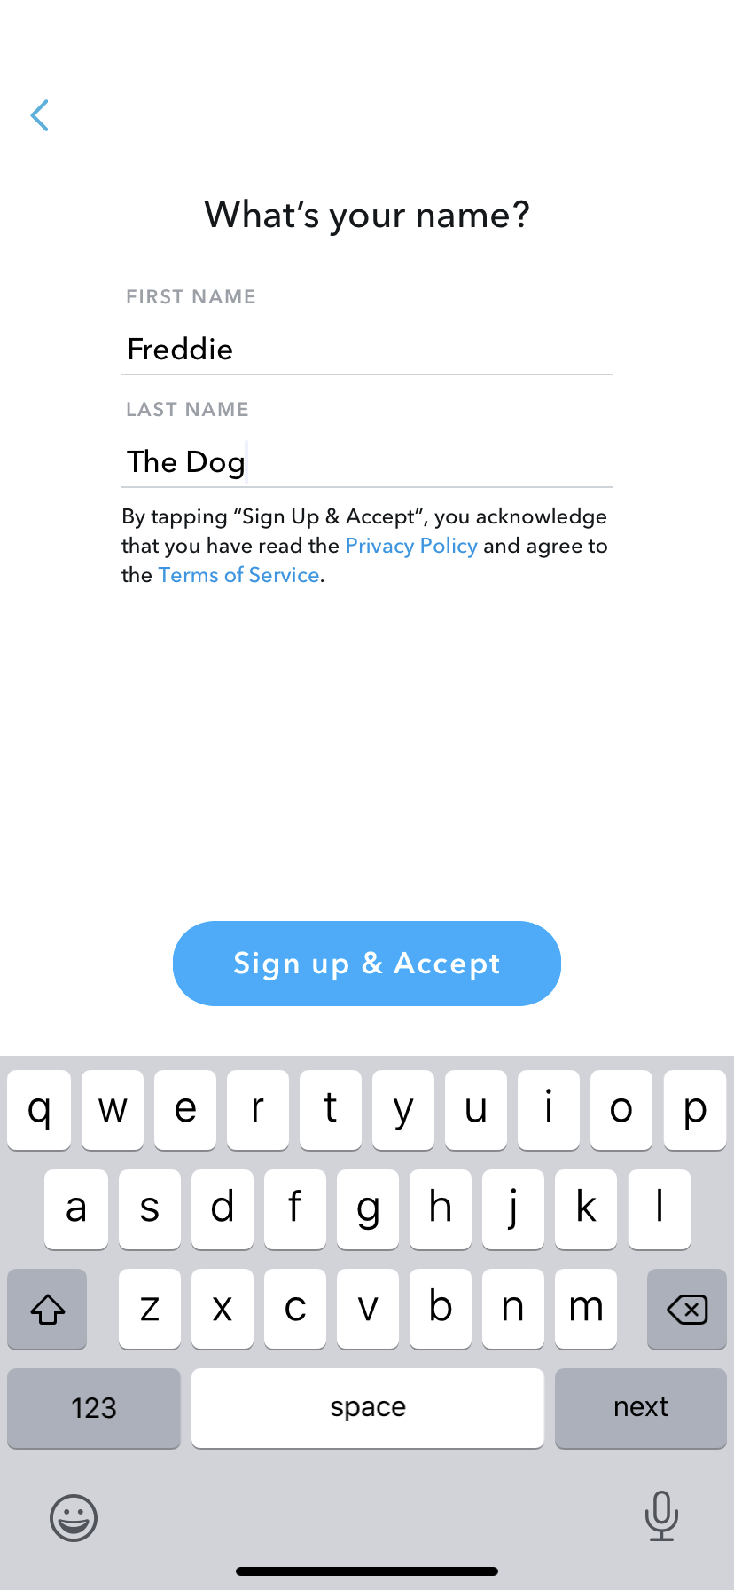
Be honest… Who has used a fake age to sign up for a social media account?
© Ineqe Group Ltd 2023
Notes:
Prompt pupils – Who used snapchat/twitter/facebook/tiktok/youtube before they were 13?

Slide 5

Now that you’re over 13, you can use many Social Media platforms
This includes Snapchat, Instagram, X, TikTok, YouTube and Facebook.
Now that you’re old enough – Why do you think it is important to use your real age?
© Ineqe Group Ltd 2023
Notes:
Pause for some suggestions – Then move on to the scenario on the next slide to discuss in further detail.

Slide 6





Benefits of using your real age
Talking to people who are the same age as you
This means you could share similar interests/hobbies and will feel safer when talking to others online.
© Ineqe Group Ltd 2023
Notes:
If you use your real age you will be able to speak to your peers about similar interests.
If you use a fake age such as 19 and you try do add a boy or girl who is your actual age – do you think they will accept your friend request??
If you use a fake age you may be speaking to adults – which isn’t safe or fun for anyone.

Slide 7


Benefits of using your real age
You’ll see content appropriate for your age
If you use an adult age, you’ll see content that is not appropriate for you.
You could miss out on fun, viral posts or videos which are aimed at your age group.
© Ineqe Group Ltd 2023
Notes:
You will receive videos and posts which are more suitable for your age.
You don’t want to miss out on the latest TikTok or YouTube viral sensation – make sure you use the correct age.

Slide 8

Benefits of using your real age
You will have access to the appropriate settings and filters
On many social media sites they have even better safety settings and filters for users under the age of 18.
This means you can be safer online and are much less likely to see any inappropriate content.
© Ineqe Group Ltd 2023
Notes:
Adults privacy settings differ from that of 13-17 year olds

Slide 9

Scenarios
We’re going to look at some scenarios together. You need to use your worksheet to write about each scenario.
Part 1
Discuss the situation with your group and write down any potential dangers you can think of.
Part 2
Think of an example of a similar experience you or your friends have had (remember this will be totally anonymous).
© Ineqe Group Ltd 2023

Slide 10
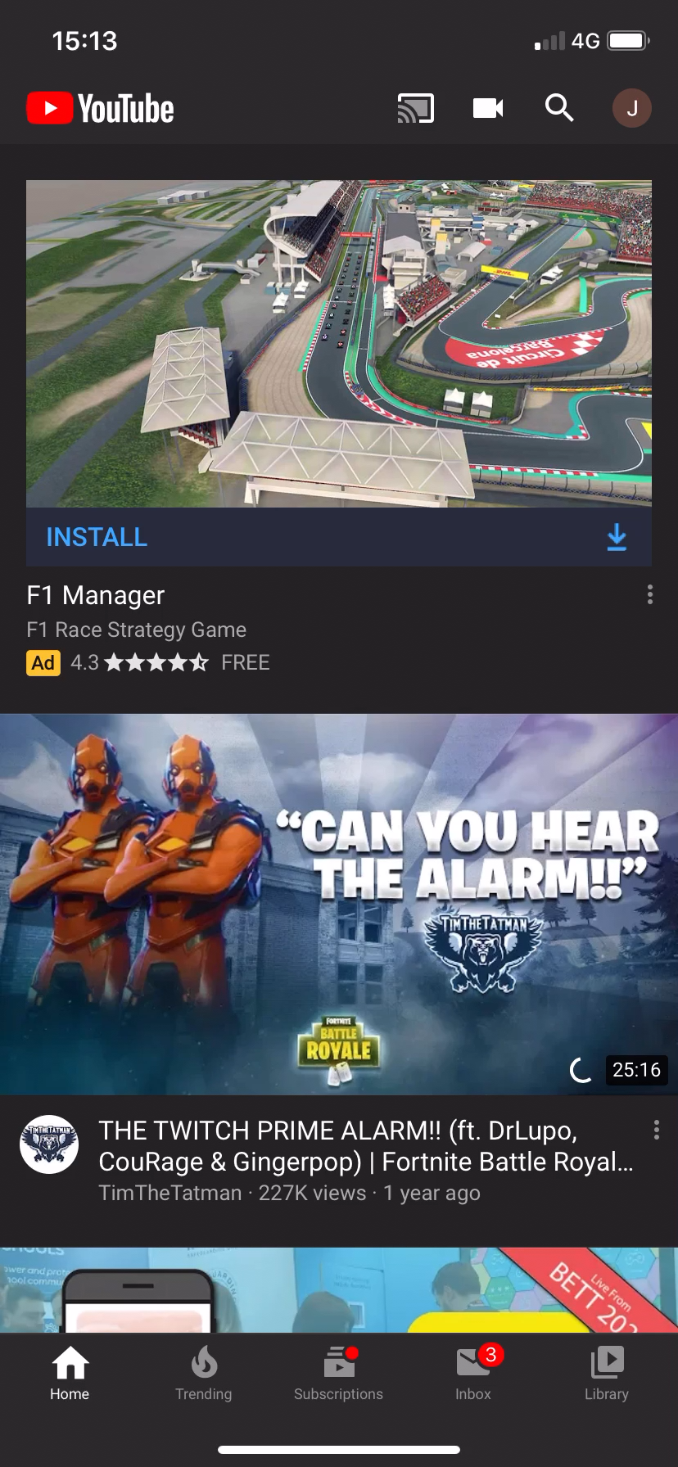
Scenario 1
This is James’ YouTube. He was 11 when he signed up for an account saying he was 18.
Potential Dangers:
Adverts targeted at adults
Content for 18+
Less options for filtering settings
© Ineqe Group Ltd 2023
Notes:
Answers on worksheets
Click on to reveal the potential dangers for the group discussion.

Slide 11
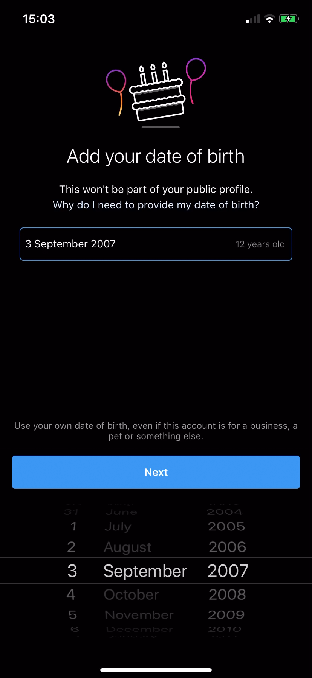
Scenario 2
Amy signed up for Instagram when she was 10 and said she was 15. Now she’s 15 and her Instagram says she’s 20.
Potential Dangers:
Friend requests from adults
Adverts targeted at adults
Less options for filtering settings
© Ineqe Group Ltd 2023
Notes:
Answers on worksheets

Slide 12
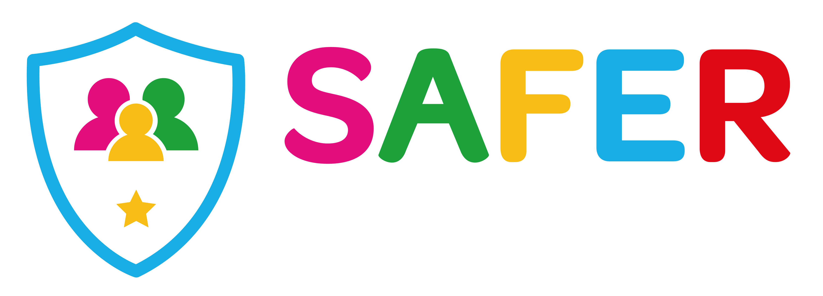



Are you a Safer School?
Contact us to find out!
028 9600 5777
saferschools@ineqe.com
www.oursaferschools.co.uk
© Ineqe Group Ltd 2023

